Slide 1
Social Justice and the
Social Determinants of Health
Jeffrey V. Johnson, Ph.D.
Professor and Director, Office of Global Health, UMSON
NRSG 780

Slide 2
WHO: “Social Injustice is Killing
People on a Grand Scale”
The poor health of the poor
The social gradient in health within countries
The health inequities between countries
Caused by unequal global & national distribution of:
  power,
  income,
  goods,
  services,
These cause an unequal distribution of “health damaging experiences” in people’s immediate lives:
  access to health care, schools, and education,
  their conditions of work and leisure,
  their homes, communities, towns, or cities
WHO Commission on Social Determinants of Health. Closing the Gap in
A Generation, 2008, page 1.

Slide 3
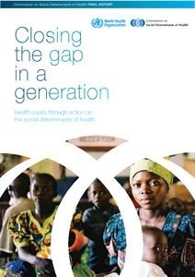
WHO Social Determinants Report

Slide 4
What are ‘Social Determinants’?
Expands on the concept of poverty (income)
Focus on basic material needs for food, clothing, shelter, and sustainable livelihoods, physical environments, and health systems
Emphasizes human development as essential to health and hence the need for education, supportive communities, and participatory political structures
Focus on inequality and injustice in access and distribution of material and social resources

