Slide 1
Dissemination of DNP Quality
Improvement Projects
Presented by:
Susan Bindon, DNP, RN-BC, CNE, CNE-cl
Assistant Professor, Institute for Educators and
Director, Post-Master's DNP Program sbindon@umaryland.edu
QI Brief
QI Brief 5.2: Released Spring 2019
Notes:
Welcome to the University of Maryland School of Nursing’s Quality Improvement Briefs.
My name is Susan Bindon and I am an Assistant Professor in the Institute for Educators and Director of the Post-Master’s DNP Program here at the University of Maryland School of Nursing.
Today's presentation is titled: Dissemination of DNP Quality Improvement Projects

Slide 2
Objectives
Describe dissemination
Discuss the benefits of disseminating your work
Identify resources to support dissemination efforts
Notes:
The objectives for this presentation are to:
Describe what dissemination is.
Discuss the benefits of dissemination and help to identify resources that can support dissemination efforts.

Slide 3
What is dissemination?
Cambridge Dictionary defines it as:
“…to spread or give out news, information, ideas, to many people”
Notes:
According to the Cambridge Dictionary the definition of dissemination is to spread or give out news, information, and/or ideas to many people. Building on this idea of sharing or spreading news and ideas, we want to connect this and make it relevant to your DNP projects.

Slide 4

Relevance to DNP project
Internal
  On site
  UMSON
External
  Local
  Regional
  National
Notes:
As you are planning your project, you should also be thinking about how you will share your results, and maybe even lessons learned in the process. Consider disseminating both internally and externally. Your practice site will be interested, of course, and you will present to the team there. You can also think about sharing to a broader audience by way of posters, presentations, and even publications. Always be thinking about who needs to know about your work, and what will be the best format in which to share it. You will be amazed how one conversation or presentation leads to another as you work gains momentum.

Slide 5
Benefits of Dissemination
NDNP 813 focuses on evaluation and dissemination
Expand the # of people familiar with your work
Provide additional networking opportunities
Receive insights and input from others
Expand your scholarly abilities
Add to your curriculum vitae (CV)
Add to and/or validate evidence on a topic
Help expand local and national efforts to improve healthcare and population health
Notes:
We recommend that you disseminate your work as broadly as you can. You worked hard on your DNP project. Others can benefit from you sharing your work with them. Sharing your work will also provide you opportunities to network more effectively with others which can lead to opportunities.
Giving a formal presentation will expand your abilities as a scholar. You’ll get insights from others when you share your work. Publications will endure and are available to the broadest audience.
And last but not least, sharing your work will help expand local and national efforts to improve healthcare.
So look for as many opportunities as possible to disseminate your work. Don’t hold back.

Slide 6

Dissemination Strategies
Staff meetings and/or councils
Grand rounds
Publications, presentations, posters
Social media, (Twitter, Facebook, Instagram, LinkedIn)
Webinars, abstracts, newsletters
Executive summaries
DNP
Notes:
There are many options students can use to disseminate their work. Let people know about your expertise!
Examples include:
Staff meetings and/or councils
Grand rounds
Publications, presentations, posters
Social media, (Twitter, Facebook, Instagram, LinkedIn). We recommend of course using a professional vs. personal account for sharing your work.
Webinars, abstracts, newsletters
Executive summaries

Slide 7
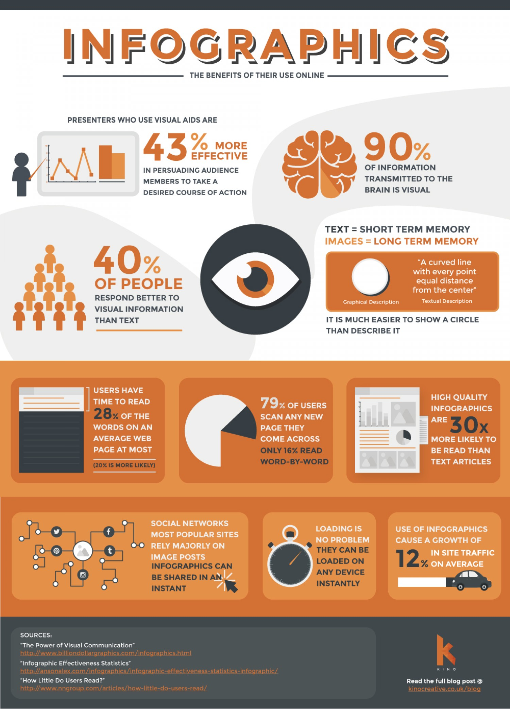
Data Display Strategies
Notes:
As we’ve mentioned, there are many options a scholar can use to disseminate their work. How you decide to display your data often depends on the type of project and the chosen venue or audience. Here are some ideas to consider.
Info-graphics are easy to create and are a great way to visually display your project. Several free software programs and templates are available online. They are easy to share, print, or imbed in other media.
The next three slides provide a few dissemination tips for using social media, developing a manuscript for publication, and posters and presentations.

Slide 8
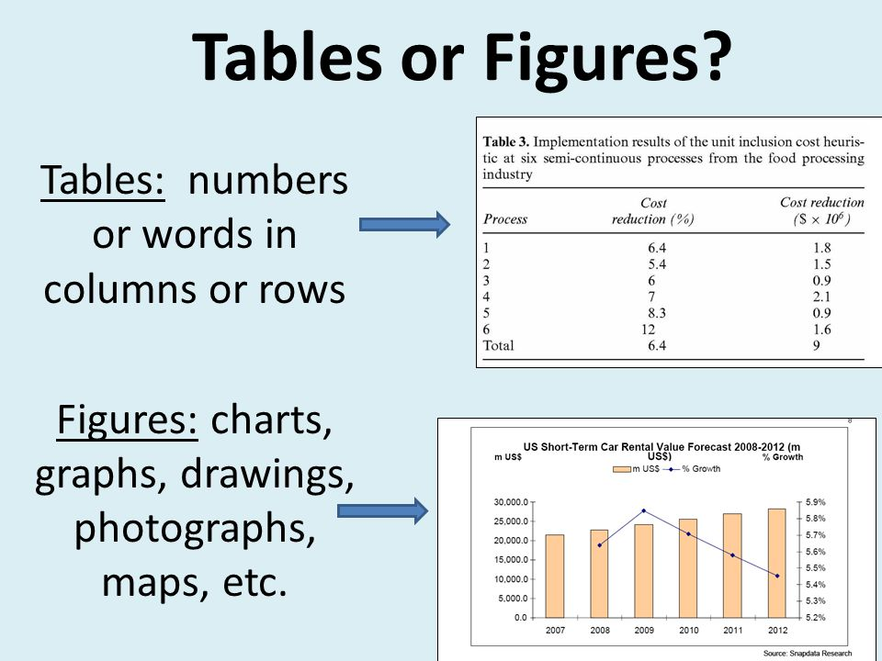
Data Display Strategies
Notes:
Formal publications and posters require clear, concise presentation of data to support and add to your written words. Tables and figures should be self-explanatory and should help the reader quickly see patterns, trends, and key outcomes. Page space comes at a premium, so be sure to carefully choose what and how you want to include. Statisticians, librarians, peers, faculty, and editors can be a big help here.

Slide 9
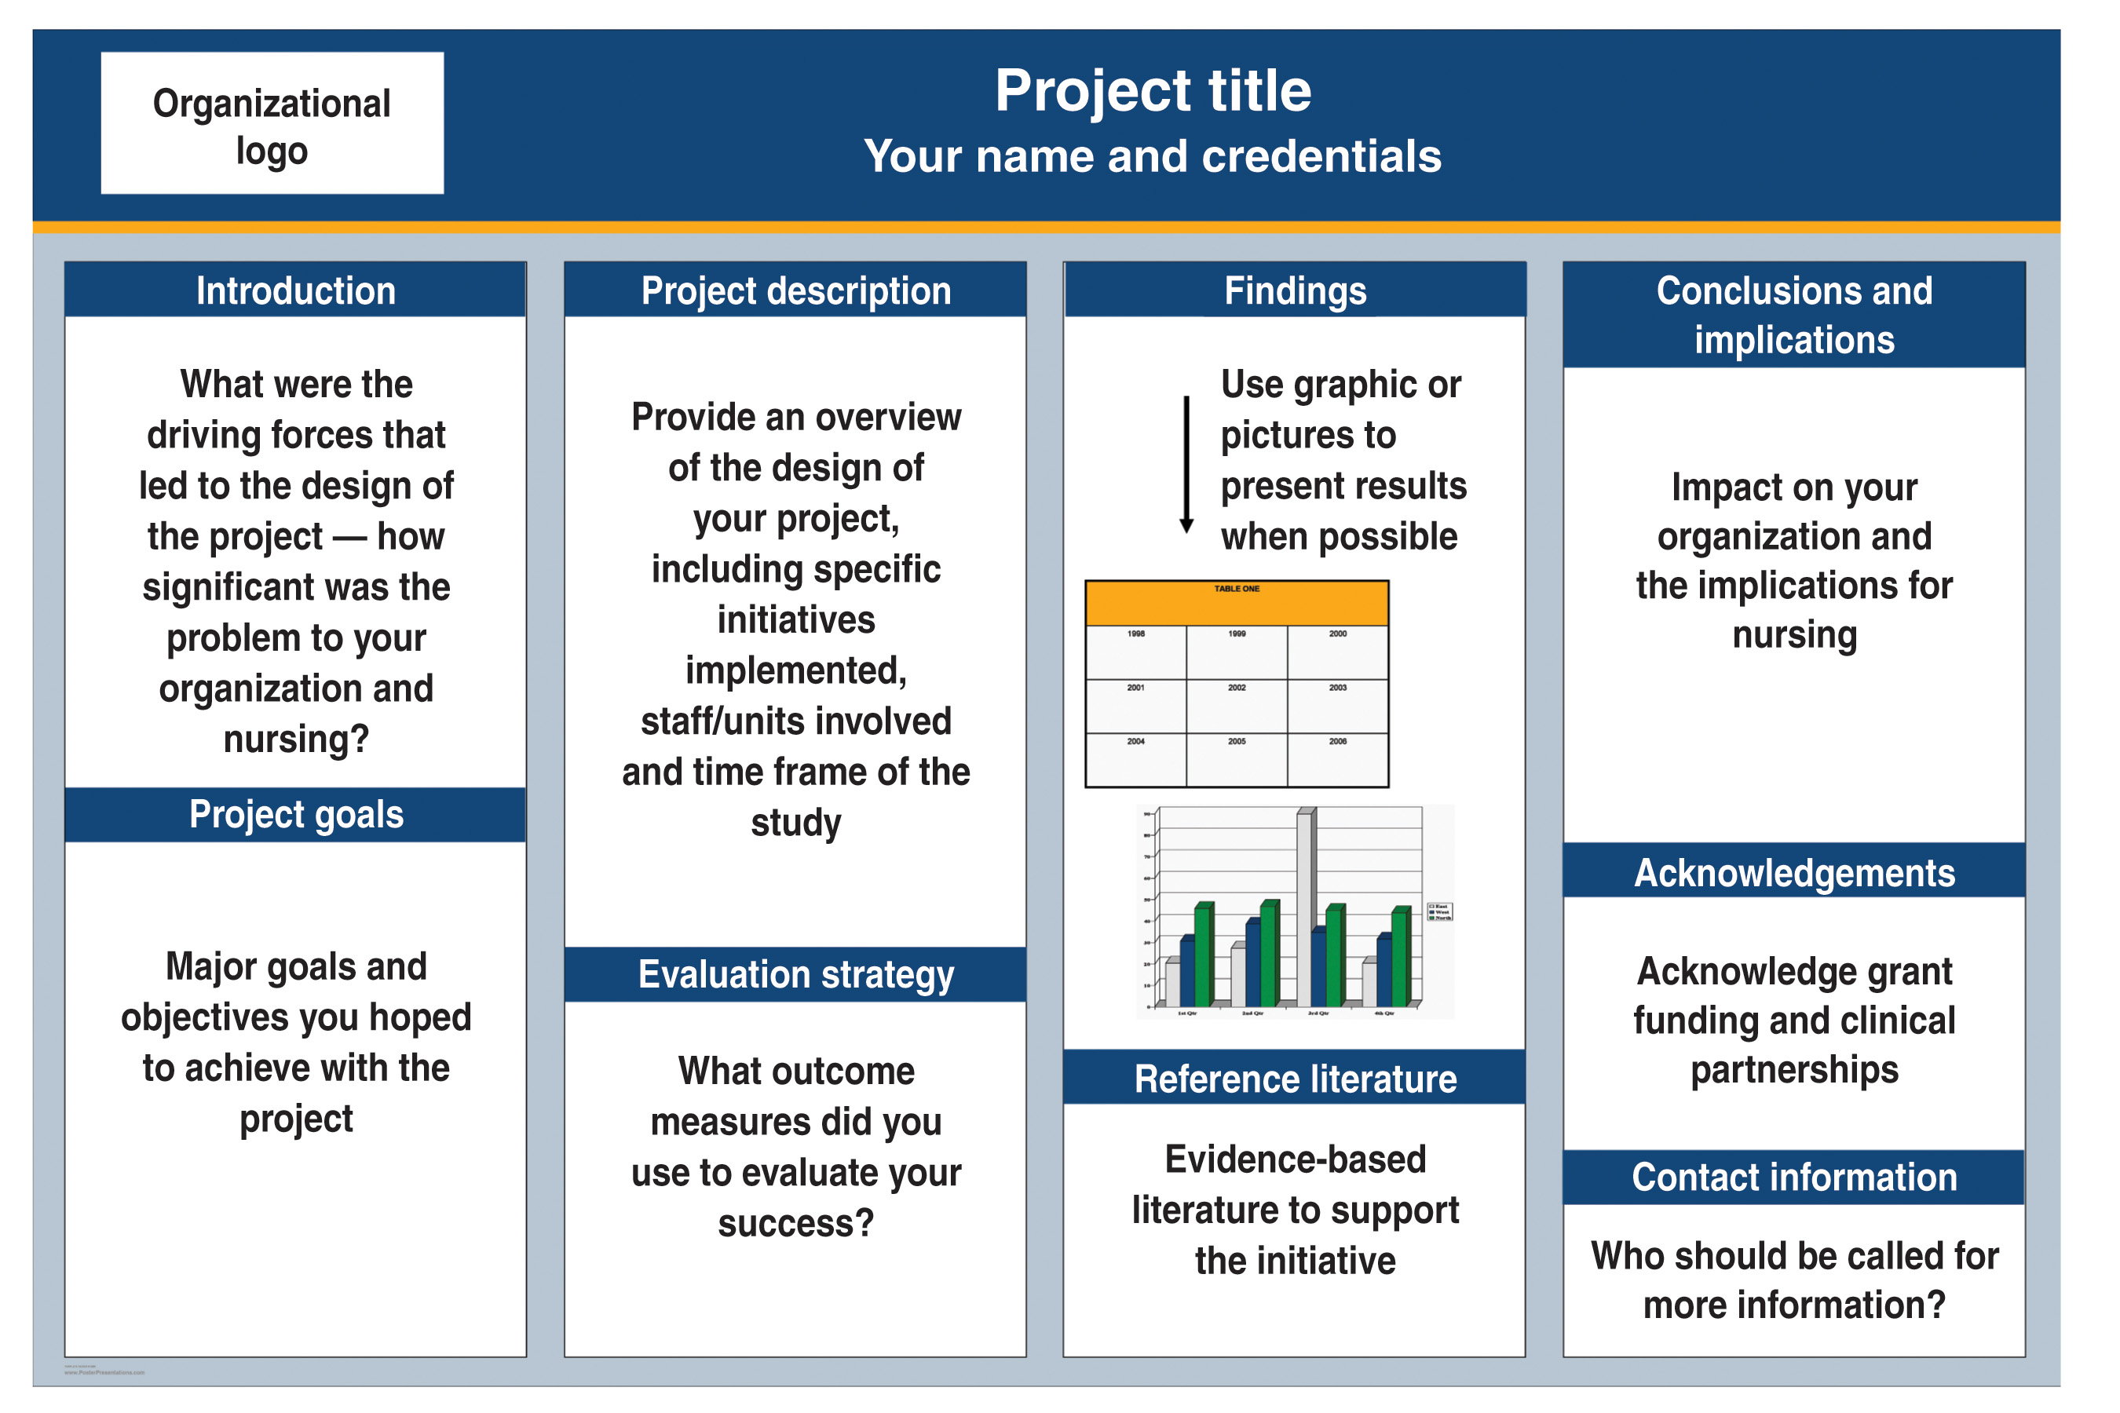
Posters
Notes:
This slide depicts a typical poster template with some key areas highlighted. Different venues may require a specific poster size or may dictate what is to be included, be sure to check before finalizing your work.

Slide 10
Poster and Manuscripts Organization
Standards in Quality Improvement Reporting Excellence (SQuIRE) guidelines
Drives audience to focus on content rather than format
Review Part 1 and Part 2 QI Briefs about SQuIRE guidelines
Notes:
One common method used for scholarly posters and manuscripts is the SQUIRE guidelines, which stands for the Standards in Quality Improvement Reporting Excellence.
The SQUIRE Guidelines use the standard format of an introduction, methods, results, and discussion sections. However, the SQUIRE Guidelines recommend 18 possible quality improvement sub-headings you can choose from.
Keep in mind that not all of the sub-headings apply to each student’s DNP QI Project. Choose the SQuIRE sub-headings that apply to the design of your QI Project.
If you have questions about the SQuIRE Guidelines there are excellent resources online, and you can also view the two QI Briefs about SQuIRE guidelines.

Slide 11
Presentation and Poster Templates
Use one of the approved UMSON presentation and poster templates when presenting your DNP project
Located at: http://www.nursing.umaryland.edu/about/administration/offices/comm/templates/
Notes:
There are several poster and PPT presentation templates you will choose from when developing your DNP project poster. Please choose one of these approved University of Maryland School of Nursing templates whenever you are presenting your DNP project.
An example of a student’s DNP poster is included in the QI Brief attachments.

Slide 12
Social Media Tips
Sign-up for a professional Twitter account
Follow, like, and share UMSON news!
All social media is public
Be cognizant of your personal and UMSON brand
Do not share patient or staff personal information
Do not share the name of the site or other identifying information about your DNP project
Read the UMSON social media Policy!
Notes:
Social media is a great way to share your work with others. Social media platforms help you amplify your work. You can also support the professional reputation of your colleagues.
Be wise when using social media, as we know that all social media is public. What you post on-line could affect your ability to secure and maintain employment. As you build your brand, think carefully about what you want people to know about you, and of course, always be professional in your posts and responses.
Do not share information about the patients or staff involved in your work, or the name of the site where you did your DNP project.

Slide 13
Confidence
Ask your peers to review your work
Be specific in your request
Welcome constructive feedback
Peer reviewers will help you avoid gaps or missteps
Notes:
Perhaps the biggest potential barrier to dissemination is how you feel about the work you did.
Many individuals who complete a doctorate degree suffer from imposter syndrome. The imposter syndrome is where an individual does not have confidence in themselves and is hesitant to own the expertise they have gained. The “doctor” title and the expectations that go with it do not yet “fit”. Some students may have a hard time accepting this new title. It’s a common feeling that the more we learn, the less prepared we feel, as we realize how much more there is to learn and do. It may help to acknowledge how much you have learned and have to share with others.
Being willing to disseminate your work is a way to open yourself up to constructive feedback and continue your development as a scholar. Disseminating your work can be intimidating as people may criticize your work. But, sharing your work is how we learn and progress. People ask questions because they are interested. You are the expert on your project and will be ready to respond.
On the other hand, some individuals are over confident and may think their work is better than it is.
One way to help find balance between the two extremes is to ask your peers to review your work. Choose peer reviewers who you trust to be honest and who will be critical of your work. Ask them specific questions so you can get specific feedback on various aspects of your work. These peer reviewers will help you avoid public mis-steps.

Slide 14

Let UMSON faculty know if you…
Present a poster at a state or national conference
Give a presentation at a state or national conference
Have a paper published about your work
Notes:
Please notify your UMSON faculty if you do a poster or podium presentation, or if you publish an article on your work. We want to celebrate and spread your good news!

Slide 15

Give credit to collaborators
Faculty who advised you on your work
Individuals at the site who made major contributions
Differentiate between “acknowledgement” and “co-author”
Notes:
Be sure to give others credit for their contributions to your project and list them as co-authors if appropriate. There are strict guidelines about what constitutes authorship, but broadly one must put pen to paper or fingers to keyboard to qualify, meaning that advisement, IRB work, or data collection, for example, do not include authorship.

Slide 16
Questions? Comments?
QI Brief
Email: NRSDoctoral@umaryland.edu
Notes:
The QI Briefs are being developed as a resource for faculty and students. Please let us know if you have any suggestions or questions.
Let us know if there are any topics that you think should be added.
Your collaboration and support is greatly appreciated. Together we will achieve our goal To expand the expertise of the University of Maryland’s Faculty and Students in the education of and use of quality improvement and safety concepts, methods, and tools.
Thank you for completing this presentation!

