Slide 1
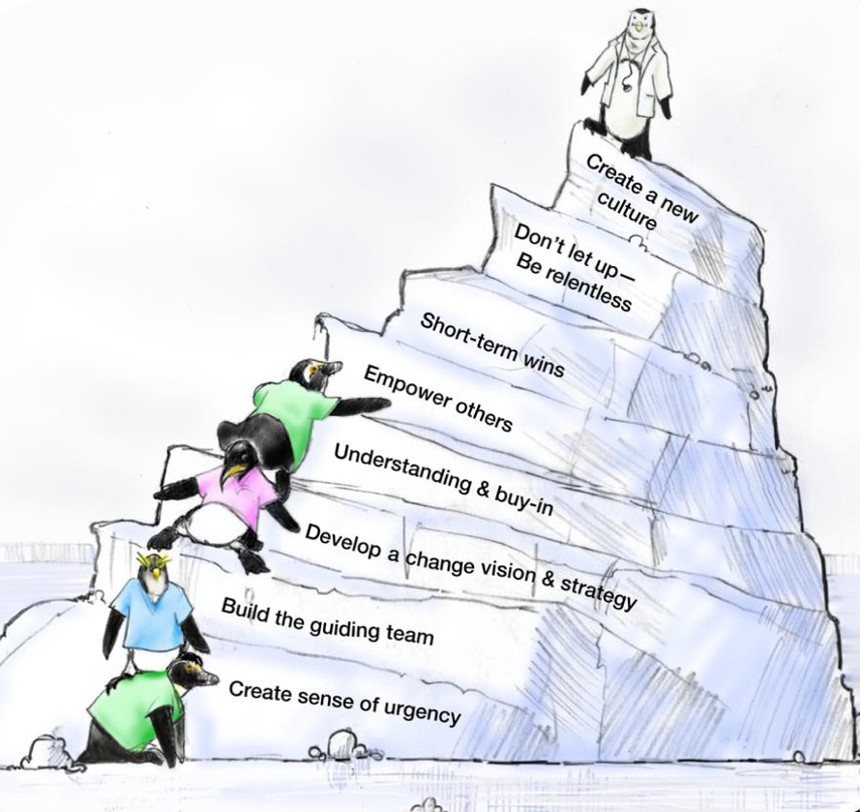
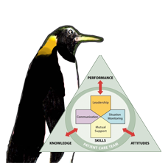
Facilitators of Sustainable Change⁵
As seen in TeamSTEPPS®

Slide 2
Sustainability and Spread⁶
Sustainability
Embedding a successful improvement into the culture and norms of a facility
Spread
Implementing a successful improvement across multiple settings and/or facilities

Slide 3
Steps to Creating a Sustainability Plan
Identify and develop program champion(s)
Build the implementation team
Empower frontline staff
Establish a sustainability measurement plan
Identify and Address Barriers to Sustainability
Engage staff with stories
Recognize and celebrate success

Slide 4
Identify and Develop Program Champion(s)
Program champion(s) will—
Communicate and reinforce resident safety and program goals as a priority
Have physician, nursing, and administrative support
Be motivational and inspiring
Have influence
Be able to communicate the vision
Serve as a coach
For more information on coaching, please see the Role of the Nurse Manager module within the AHRQ CUSP toolkit

Slide 5
Build the Implementation Team
This team will ideally include the following members:
Facility team lead
Administrator
Data coordinator
Survey coordinator
Identify a team leader to address team member concerns throughout the project
Include your program champion to persuade and motivate
Understand the program goals and components
Notes:
This team will be different for LTC

Slide 6
Establish a Sustainability Measurement Plan
Assess readiness for sustainability
Build measurement system for collecting process, outcomes, and quality improvement data
Determine what, when, and how to measure performance and who will collect the data
Establish robust followup and transparent feedback system that uses data to continuously improve performance

Slide 7
Identify and Address Barriers to Sustainability
Active involvement of administrative and clinical champions can address barriers by—
Motivating team members to support program interventions
Highlighting positive staff experiences as a result of new procedures
Dedicating time and resources to help carry out the interventions

Slide 8
Engage Staff With Stories
Stories are a powerful way to engage staff in ways that numbers cannot
Encourage your team leaders to discuss actual resident stories to drive home important lessons

Slide 9

Recognize and Celebrate Success
Recognizing success, large and small and both early on and long term, is important to sustainability.

Slide 10
Steps for Sustaining Efforts
Collect, review and share data with facility administration and frontline staff
Communicate and engage
How is staff reminded of the project on an ongoing basis? Posters with CAUTI rates? Announcements such as “100 days since the last CAUTI”?
Align with other QAPI efforts
Celebrate successes
Incorporate into orientation and training
Address barriers to sustainability with workable solutions

Slide 11

Potential Barriers to Sustainability
Lack of organizational infrastructure and resources
Staff turnover
Organizational skepticism
Individual resistance to change

Slide 12
Workable Solutions to Sustainability Barriers
Lack of organizational infrastructure and resources
Develop strategies and flexibility to account for resource fluctuation
Plan financial resources for maintaining improvements beyond the project end
Staff turnover
Embed newly developed processes into new staff orientation and organizational policies
Train staff continuously, including train-the-trainer education
Develop volunteer network to assist in case of staffing fluctuations and/or shortage (funding, staff turnover)

Slide 13
Workable Solutions to Sustainability Barriers¹
Managing skepticism
Present ongoing evidence that the new process is a better one
Show staff and stakeholders real data
Reserve staff time away from normal duties to work on proposed improvements
Encourage active senior leader engagement
Consider measuring how frequently senior leaders/administrators review sustainability data/outcomes as indicator of engagement at this level

Slide 14
Assessing your Sustainability Plan
What is your sustainability measurement plan?
What data will be acceptable?
How often will it be reviewed?
How will you make this as part of daily operations?
Included in orientation of new staff?
Included in competency of existing staff?
How will you make sure excitement will be the same in a year or two as it is today?

