Slide 1
Advancing Nursing Terminology
NURS 737: Nursing Informatics Concepts and Practice in System Adoption
Module 3, Topic 1
This document is intended solely for the use of N737. Not for distribution

Slide 2
Content
National Interoperability Standards
NLM Nursing Resources for Standards and Interoperability
Standardizing Nursing Data Using Terminologies
Interoperability Use Case
Advancing Nursing Terminology

Slide 3
National Interoperability Standards

Slide 4
Interoperability Standards Advisory (ISA)
The ISA process represents the model by which the ONC will coordinate the identification, assessment, and determination of "recognized" interoperability standards and implementation specifications for industry use to fulfill specific clinical health IT interoperability needs
https://www.healthit.gov/isa/

Slide 5
ISA Timeline and Comment Process
Comments on the ISA are accepted year-round, and changes are made to the web version of the ISA frequently throughout the year, based on comments and other changes to the health IT standards environment as ONC becomes aware of them.
An annual Review and Comment period also occurs each summer-fall, when a majority of comments are received.
Annual ISA Process Timeline:
January: Current Year Reference Edition is published, web version of ISA is available for ongoing review and comments.
Winter/Spring/Summer: Changes may be made to the web-version of the ISA throughout the year, while the ISA Reference Edition remains static.
Late Summer/Early Fall: Annual Review and Comment Period opens for sixty days - site changes are on hold so all reviewers are seeing the same content.
Fall: Fall: ONC and HHS staff review comments received, make site updates and prepare the following year's Reference Edition for publication by early January.
https://www.healthit.gov/isa/isa-timeline-and-comment-process

Slide 6
United States Core Data for Interoperability (USCDI)
The USCDI is a standardized set of health data classes and constituent data elements for nationwide, interoperable health information exchange.
V3 – current version
A USCDI “Data Class” is an aggregation of various Data Elements by a common theme or use case.
A USCDI “Data Element” is the most granular level at which a piece of data is exchanged.
For example, date of birth is a data element rather than its component day, month, or year, because date of birth is the unit of exchange
https://www.healthit.gov/isa/united-states-core-data-interoperability-uscdi

Slide 7
USCDI (Cont.)
With the publication of USCDI v3, ONC is accepting submissions for new data elements through the ONDEC system and comments on existing data elements until September 30, 2022.
ONC plans on releasing Draft USCDI v4 in January 2023.
ONC launches a public website to solicit recommendations from the public for changes and additions to the USCDI.

Slide 8
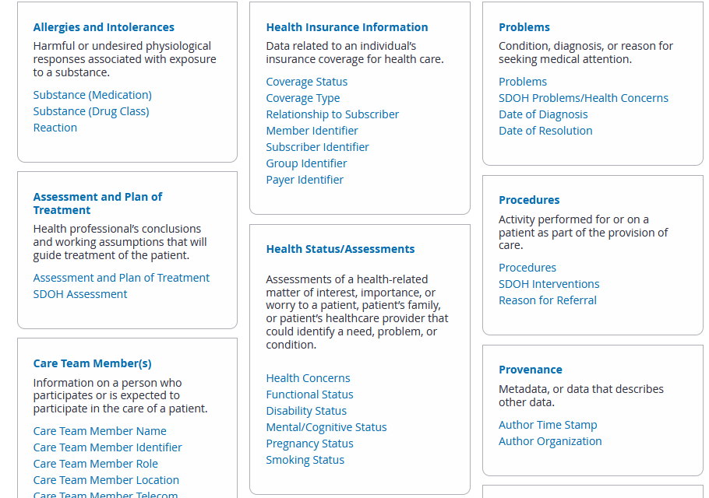
USCDI V3
USCDI v3 contains data classes and elements from USCDI v2 and new data classes and elements submitted through the ONDEC system. https://www.healthit.gov/isa/united-states-core-data-interoperability-uscdi#uscdi-v3

Slide 9
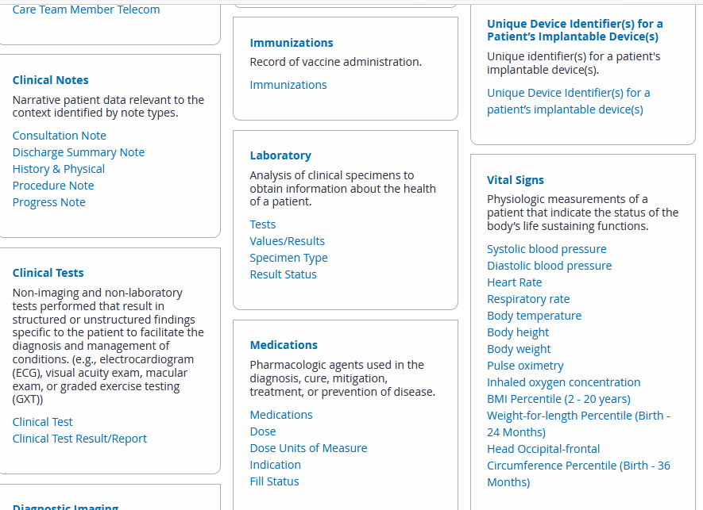
USCDI V3 (cont.)

Slide 10
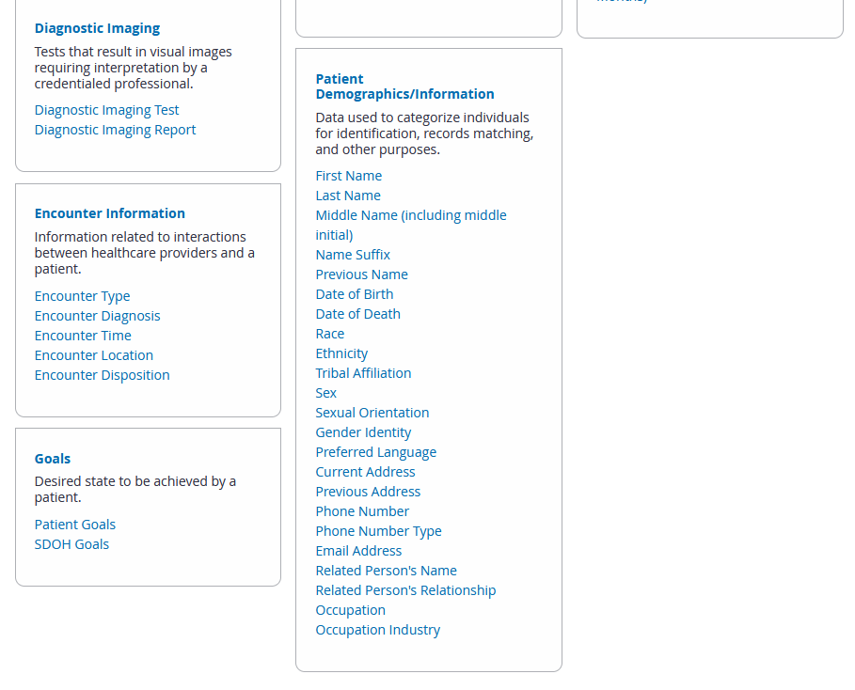
USCDI V3 (cont.)

Slide 11
NLM Nursing Resources for Standards and Interoperability
NLM a web page developed to:
» Describe use of SNOMED CT and LOINC in implementing Meaningful Use relevant to the nursing community,
» Information about nursing terminologies,
» National and international collaboration efforts to harmonize nursing terminologies and facilitate interoperability
» Demonstration of the UMLS to extract synonymy between SNOMED CT, LOINC, and nursing terminologies
» Links to additional resources relevant for nursing clinical documentation purposes.

Slide 12
NLM Nursing Resources for Standards and Interoperability
Unified Medical Language System (UMLS)
» The UMLS integrates and distributes key terminology, classification and coding standards, and associated resources to promote creation of more effective and interoperable biomedical information systems and services, including electronic health records.
» UMLS can be used to:
Link terms and codes between your doctor, your pharmacy, and your insurance company
Coordinate patient care among several departments within a hospital
Process texts to extract concepts, relationships, or knowledge
Facilitate mapping between terminologies
Develop an information retrieval system
Extract specific terminologies from the Metathesaurus
Create and maintain a local terminology
Develop a terminology service
Research terminologies or ontologies

Slide 13
NLM Nursing Resources for Standards and Interoperability
Unified Medical Language System (cont.)
» The three knowledge sources
Metathesaurus: Terms and codes from many vocabularies, including CPT, ICD-10-CM, LOINC, MeSH, RxNorm, and SNOMED CT. Hierarchies, definitions, and other relationships and attributes.
Semantic Network: Broad categories (semantic types) and their relationships (semantic relations).
SPECIALIST Lexicon and Lexical Tools: A large syntactic lexicon of biomedical and general English and tools for normalizing strings, generating lexical variants, and creating indexes.

Slide 14
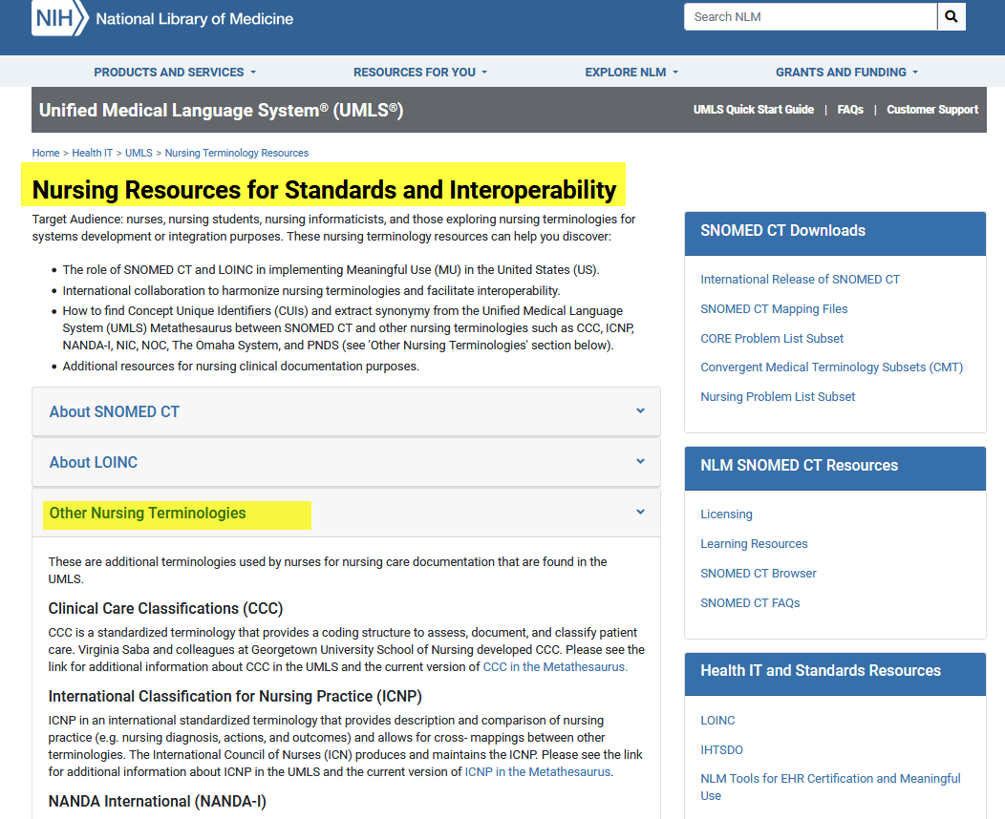
NLM Nursing Resources for Standards and Interoperability
https://www.nlm.nih.gov/research/umls/Snomed/nursing_terminology_resources.html

Slide 15
Purpose:
Inclusion of Recognized Terminologies Supporting Nursing Practice within Electronic Health Records and Other Health Information Technology Solutions
Support for the use of recognized terminologies
supporting nursing practice
Promote integration of terminologies into information technology solutions
Facilitate interoperability between different concepts, nomenclatures, and information systems
(https://www.nursingworld.org/practice-policy/nursing-excellence/official-position-statements/id/Inclusion-of-Recognized-Terminologies-Supporting-Nursing-Practice-within-Electronic-Health-Records/)

Slide 16
4.
Inclusion of Recognized Terminologies Supporting Nursing Practice within Electronic Health Records and Other Health Information Technology Solutions
All health care settings should create a plan for implementing an ANA recognized terminology supporting nursing practice within their EHR.
Each setting type should achieve consensus on a standard terminology that best suits their needs and select that terminology for their EHR, either individually or collectively as a group (e.g., EHR user group).
Education should be available and guidance developed for selecting the recognized terminology that best suits the needs for a specific setting. (cont.)

Slide 17
4.
When exchanging data with another setting for problems and care plans, Systematized Nomenclature of Medicine - Clinical Terms (SNOMED CT®) and Logical Observation Identifiers Names and Codes (LOINC®) should be used for exchange. LOINC should be used for coding nursing assessments and outcomes and SNOMED CT for problems, interventions, and observation findings. (ONC, 2018)
Health information exchange between providers using the same terminology does not require conversion of the data to SNOMED CT or LOINC codes.
Development of a clinical data repository that includes multiple recognized terminologies should be based on the national recognized terminologies of ICD-10, CPT, RxNorm, SNOMED CT, and LOINC.

Slide 18
ANA-Recognized Standard Nursing Terminologies
ANA Nursing Informatics Scope and Standard of Practice, 3rd edition

Slide 19
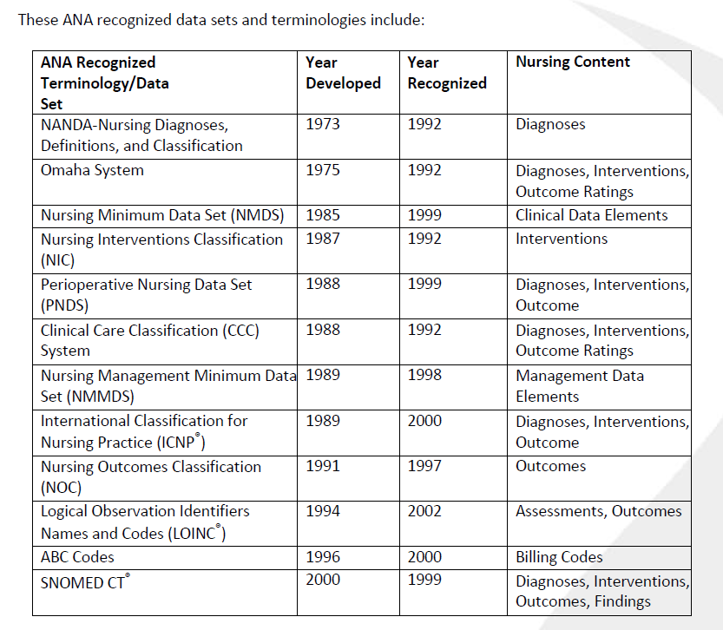
ANA-Recognized Standard Nursing Terminologies

Slide 20
Standardizing Nursing Data Utilizing Terminologies
Translating Proprietary Codes to Standardized Terminology Codes
Nikki Vande Garde BSN, RN-BC – Director, Platform Development
Cerner Corporation

Slide 21
Currently supported nursing terminologies/structures
Electronic Health Record
» LOINC & SNOMED
Questions & Answers
» SNOMED, IMO, and more
Nursing Problems
» FHIR
Population Health & Big Data
» UMLS Vocabularies + More
» Utilize standard terminologies to standardize & normalize data from multiple sources including multiple EHRs, claims, pharmacies and more
Data standardization - The process of mapping proprietary or unrecognized code values to codes from an industry-standard nomenclature.
Data normalization - The process by which standardized attributes are categorized or rolled up into meaningful groupings, such as for display purposes, rules processing, or analytics reporting.

Slide 22
How are we increasing use of standard terminologies
Electronic Health Record
» Ongoing content development
» Participating in industry discussions/workgroups to determine necessary
development
» FHIR use cases driving increased mappings
Population Health & Big Data
» Use cases growing daily driving increased amount of mappings that exist between data sources and standard terminologies
Cross Platform
» Longitudinal patient-centered plan of care
» Terminologists submitting many requests to SNOMED for patient specific
interventions & outcomes
– Instead of: “Teach patient how to…”, shift to: “Learn how to…”

Slide 23
Vision for greater integration
“Apples” = “Apples” is not good enough
» When an exact match is not available between a standard
terminology and a proprietary code (such as an EHR “question”), is it always OK to use a less specific code?
For the most part… it can’t be “nursing vocabularies”
» Vocabularies and structures supporting interoperability and big data
initiatives must be interdisciplinary
» Should nursing define the nutrition risk assessment questions, or should we collaborate with the nutrition experts to determine the questions
Nursing must have input across many disciplines, and many disciplines need to have input for nursing

Slide 24
Challenges
Lack of all necessary standard terminology codes
Risk of losing context, and health data has layers of context
Lack of terminology expertise
Lack of understanding related to importance of terminologies
Legacy data
“Duplicates” exist within LOINC (and they need to exist)
» Pre versus Post coordination
» Slightly different wording of questions
Copyright challenges
» Available within LOINC and additional copyrights
» Not available within LOINC because of additional copyrights
Standard Terminologies are an “afterthought” when developing assessment tools/scales
24

Slide 25
Vital Signs – FHIR Profile

Slide 26
Challenges
Pre and Post Coordination
» Translate “Oral Temperature” to “Body Temperature” + “Body Site”?
© Cerner Corporation. All rights reserved.
26

Slide 27
Vital Signs – FHIR Profile

Slide 28
Challenges
Have we really agreed on what vital signs are?
» Do we really agree on the basics, like what is a “heart rate” that should be mapped to LOINC 8867-4 that is part of the FHIR profile for Vital Signs LOINC 85353-1?
If a heart rate is a measurement of how many beats per minute the heart contracts, and stored as a numeric value with a units of measure = beats per minute, then is it always a heart rate that should be coded to LOINC 8867-4?
© Cerner Corporation. All rights reserved.
28

Slide 29
LOINC – Heart Rate
29

Slide 30
All Heart Rates
Which heart rates do nurses “allow” to land as a vital signs’ “heart rate” in the EHR? What about all the other heart rates?
Not Specified Heart Rates
“At Rest” Blood Pressures
Not “at rest” Heart
Rates
Orthostatic Heart Rates

Slide 31
EHR “Questions” mapped to LOINC 8867-4 = Heart Rate
Heart Rate Pre Transfusion & Heart Rate Post Transfusion Reaction
Heart Rate Pre Procedure & Heart Rate Post Procedure Pulse Rate
Pulse
Pulse Rate Pretreatment RT & Pulse Rate Posttreatment RT
Croup Pulse Rate (beats/minute) Heart Rate – Anesthesia
Heart Rate - Surgery Heart Rate Monitored
Heart Rate Monitored, Cuff Heart Rate-Remote Monitoring Heart Rate, Apnea
Heart Rate – Pulse Ox Heart Rate
ED Heart/Pulse Rate
Heart Rate ABD (Apnea/Bradycardia/Desat Episodes)
Rate (BPM) RVAD Heart Rate LVAD Heart Rate Heart Rate-VAD
Dialysis Pulse Rate
RC Pretrial Heart Rate & RC Posttrial Heart Rate
Pre Capping Heart Rate & Post Capping Heart Rate
When an exact code doesn’t exist, the acceptable practice is to map to the less specific.
LOINC 8867-4 is the most generic “heart rate”.
Are these appropriate to
represent as the “Vital Signs” heart rate?
Or, is it better to stop picking and choosing heart rates that are considered “Vital Signs”?
Do we even agree that clinicians are picking and choosing which
heart rates make it to “Vital Signs”
in EHRs today?

Slide 32
Example “heart rates” NICU patient
Vital Signs - Heart Rate, O2 Sat, O2 L/Min
160
140
120
100
80
60
40
20
0
15:00
14:00
13:00
12:00
11:00
10:00
9:00
Heart Rate
O2 Sat
O2 L/Min
32

Slide 33
Example “heart rates” NICU patient
Apnea, Bradycardia Events
100
90
80
70
60
50
40
30
20
10
0
13:05
12:10
8:45
Heart Rate
O2 Sat
33

Slide 34
Example “heart rates” NICU patient
Combined Vital Signs + Apnea/Bradycardia Events
160
140
120
100
80
60
40
20
0
13:05 13:00
Heart Rate
15:00
14:00
12:10
12:00
11:00
9:00
8:45
O2 Sat
O2 L/Min
34

Slide 35
Interoperability Use Case
Susan Matney, PhD, RNC-OB, FAAN, FACMI

Slide 36
Current Situation
Each setting uses a unique terminology to represent pressure injuries
» Some standardization of codes is now occurring, but…
» Data is not consistent setting to setting, or even vendor to vendor
This means that:
» Tracking and trending Peter’s data across settings is impossible
» Clinicians do not have the comprehensive view of the single patient’s history
» We cannot automate evidence based practice and personalize care
» Sharing executable software across settings is impossible
» There are unmet needs for health care applications and decision support
» It is “organization-centric care” not patient-centered care
8

Slide 37
Use Case: Peter Pepper
40 year old male military veteran
» 5 years post lumbar spinal cord injury (obtained from a blast In Afghanistan)
» Stage IV Pressure Injury
Peter Pepper is wheelchair bound and has no feeling from the waist down. He is admitted today for treatment of a stage four pressure injury with tunneling. The wound is 3 cm X 4 cm and 3 cm deep. There is a 3 cm tunnel in the two o’clock direction. The edge of the wound is boggy.
47
Free photo obtained from: https://www.flickr.com/photos/bcgovphotos/21039219486

Slide 38
Advancing Nursing Terminology
ONC Annual Meeting 2017
(Selected slides with permission; URLs and Screen shots updates)

Slide 39
Goal = Interoperable Wound Data
48

Slide 40
Skin Assessment LOINC Panel (partial)

Slide 41
Wound Assessment LOINC Panel (partial)
50

Slide 42
Encoding The Patient Story
Type | Text | Terminology | Code | FSN
Finding | Wound Present | SNOMED CT | 416462003 | Wound (disorder)
Observation | Wound Type | LOINC | 72300-7 | Skin Alteration:Type:PT:Skin:Nom:::
Value | Stage IV Pressure Injury | SNOMED CT | 420597008 | Pressure ulcer stage 4 (disorder)
Observation | Body Location | LOINC | 39112-8 | Body location qualifier:Find:PT:^Patient:Nom::
Value | Coccyx | SNOMED CT | 287274001 | Entire skin of coccygeal region (body structure)
51

Slide 43
Encoding The Patient Story
Type | Text | Terminology | Code | FSN
Finding | Wound Present | SNOMED CT | 416462003 | Wound (disorder)
Observation | Wound Type | LOINC | 72300-7 | Skin Alteration:Type:PT:Skin:Nom:::
Value | Stage IV Pressure Injury | SNOMED CT | 420597008 | Pressure ulcer stage 4 (disorder)
Observation | Body Location | LOINC | 39112-8 | Body location qualifier:Find:PT:^Patient:Nom::
Value | Coccyx | SNOMED CT | 287274001 | Entire skin of coccygeal region (body structure)
Panel/Grouping | Wound Size | LOINC | 72287-6 | Wound Size Panel::PT:Wound::
Question 1 | Wound Width | LOINC | 39125-0 | Width:Len:PT:Wound:Qn::
Value | 3 centimeters | SNOMED CT | 258672001 | centimeter (qualifier value))
Question 2 | Wound Length | LOINC | 39126-8 | Length:Len:PT:Wound:Qn::
Question 3 | Wound Depth | LOINC | 39127-6 | Depth:Len:PT:Wound:Qn::
52

Slide 44
Encoding The Patient Story
Type | Text | Terminology | Code | FSN
Finding | Wound Present | SNOMED CT | 416462003 | Wound (disorder)
Observation | Wound Type | LOINC | 72300-7 | Skin Alteration:Type:PT:Skin:Nom:::
Value | Stage IV Pressure Injury | SNOMED CT | 420597008 | Pressure ulcer stage 4 (disorder)
Observation | Body Location | LOINC | 39112-8 | Body location qualifier:Find:PT:^Patient:Nom::
Value | Coccyx | SNOMED CT | 287274001 | Entire skin of coccygeal region (body structure)
Panel/Grouping | Wound Size | LOINC | 72287-6 | Wound Size Panel::PT:Wound::
Question 1 | Wound Width | LOINC | 39125-0 | Width:Len:PT:Wound:Qn::
Value | 3 centimeters | SNOMED CT | 258672001 | centimeter (qualifier value))
Question 2 | Wound Length | LOINC | 39126-8 | Length:Len:PT:Wound:Qn::
Question 3 | Wound Depth | LOINC | 39127-6 | Depth:Len:PT:Wound:Qn::
Question | Periwound Condition | LOINC | 72301-5 | Description of Periwound
Value | Boggy | SNOMED CT | 449737008 | Boggy periwound skin (finding)
53

