Slide 1
NURS 737: Nursing Informatics Concepts and Practice in System Adoption
Module 6, Topic 1
Implementation of Nursing/Health Care Informatics Solutions (Part I)
This document is intended solely for the use of N737. Not for distribution.

Slide 2
What is an Implementation?
An implementation includes more than the installation of a new system.
It also includes the changes in workflow processes and organizational structures necessary to support the new technology and correct the business processes for which new technology is designed.
(For change management, see Module 7)

Slide 3
Implementation Strategies

Slide 4
The Systems Life Cycle(SLC): Review
Eight Phases
  Planning
  System Analysis
  System Design/Selection
  Development
  Testing
  Training
  Implementation
  Evaluation

Slide 5
How To Implement EHRs?
Assess Your Practice Readiness
Plan Your Approach
Select or Upgrade to a Certified EHR
Conduct Training & Implement an EHR System
Achieve Meaningful Use
Continue Quality Improvement
(https://www.healthit.gov/playbook/electronic-health-records/#Adopt-Implement-summary)

Slide 6
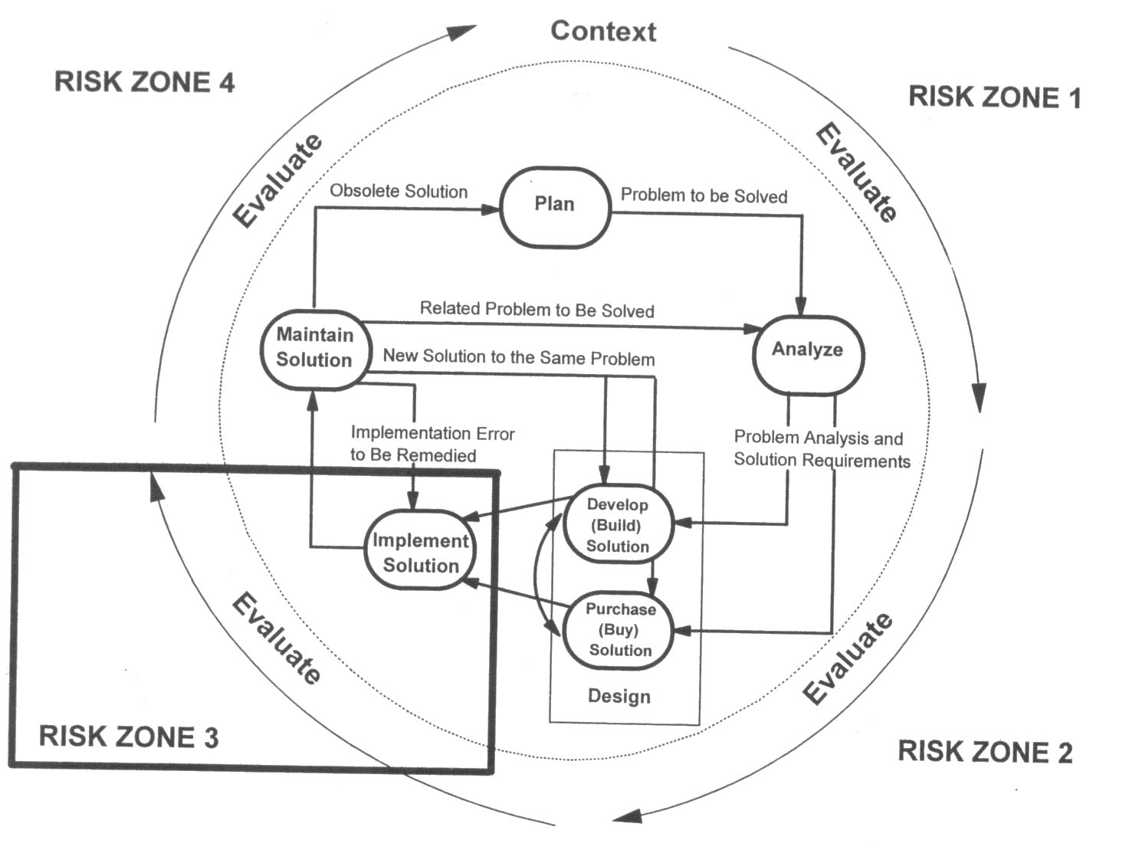
Extended Systems Life Cycle Model
(Snyder-Halpern & Hoyman, 2000 – old but depicts the concept well)

Slide 7
Selected Considerations in EHR Implementation
Meaningful use : Make sure that the system meets the requirements.
Electronic health information exchange (HIE)
  Allows clinicians and patients to appropriately access and share information securely
  (http://www.healthit.gov/providers-professionals/health-information-exchange/what-hie)
Consumer engagement MU Stage 2
  Requires eligible providers to give patients access to view EMR and use eMessaging
Cost savings
  EHRs save money, paper and time. Assess if you need an EHR that will print Rxs, receive lab reports, link to insurance company formularies and/or public databases.
  (https://www.healthit.gov/topic/health-it-and-health-information-exchange-basics/medical-practice-efficiencies-cost-savings)

Slide 8
Project Teams for Implementation
Combines users, IT, and vendor
  Users provide functional specifications and support implementation
    Often PMs are from user community (if skilled)
  IT handles technical implementation, wiring, protocols, hardware
  Vendors
    Joint project – Collaborators

Slide 9
Project Teams for Implementation
Executive Steering Team
    Initiates the vision
    CEO, CFO, CIO, Medical Director
Project Steering Team
    Develops RFP, evaluates responses, submits finalists
    Project Manager, physician champions, nurse champions, IS members, interface coder, consultant
Project Work Team
    Brings the technology to the users
    Vendor, implementation team, trainers, Super users

Slide 10
Steps in Implementation Process
Planning
Hardware/software installation
Implementation task force training & education
Customization/Modification
System testing

Slide 11
Steps in Implementation Process
Documentation development
User education and training
Parallel testing
“Go Live”
Post-implementation review

Slide 12
Planning
1. Communication plan
  Stakeholders, including users, need frequent communication to facilitate buy-in
  Presentations, posters, newsletters, e-mails, etc.
  Other creative approaches
2. Policy and Procedure development
3. Training plan
4. Resource management plan
5. Plans for implementation outcome assessment

Slide 13
Hardware/Software Installation
Location and types of existing hardware
  Outlets, lighting, ambient noise, privacy
Walk-through with installers
  Re-evaluate safety and proper location
Ask for a system demo

Slide 14
Training and Education of the Implementation Team
Training and Education
Team educated about mission of system, how it fits with strategy, system limitations, individual duties, disaster recovery, etc.
Initial training is usually done by the vendor
  Depending on contract
  Selected implementation team members and Super users must understand and be comfortable with overall functionalities so that they can teach/support other users.

Slide 15
Customization/Modification
Beginning phases require formative evaluations
May spawn the need for customization or modification
Team is responsible for reviewing the requested changes
  Are they sensible? Utility? 80% rule?
  Are there any opportunities for changes in workflow for better outcomes?
  Remember, too much customization may require a higher maintenance fee (or potential issues) in the future when the system needs updates.

Slide 16
Customization/Modification
Change management – use formalized request forms for customization requests and document follow ups (see change management slides in Section II of this module)
Often vendors require some time period before changes can be done
Change management procedures must be included in the contract

Slide 17
System Testing
Who tests the systems?
  A team comprised of users, technical experts, quality assurance personnel, etc.
Several types of testing, including:
  Usability test (before and/or after go-live)
  Performance test (before go-live)
    Response time requirement
    Throughput requirement
  Acceptance test (final product acceptance after go-live)
Notes:
Done by professional team
**Singular use for “usability test”, “performance test”, etc. works fine.

Slide 18
System Testing (cont.)
The final full system-level test before go-live
  A dry run in the test system prior to go-live
  Tests the entire hardware and software
Deployment testing
  Tests full functionality in the live system
  Can be accomplished carefully by preloading the first small set of data
Notes:
Done by professional team

Slide 19
System Testing (cont.)
Acceptance testing
  Verification of operating procedures using checklists
  Done by users with developers / vendors
  Simulates real world loading
  Data entry
  Data Retrieval
  Accessing connected modules
  Trying to get it to break
  Major milestone - if passed, system now “belongs” to organization

Slide 20
System Documentation Development
Actually ongoing - but delivered during this phase
  System
  Program
  Educational materials
  Operator guides (technical)
    Flow charts, table & record layouts, operational procedures, dictionary of terms, backup and recovery procedures, etc.
  User guides

Slide 21
User Education and Training
Training begins BEFORE Go-Live (timing may vary, but 2-3 weeks prior to go-live)
Assessment of training needs
Needs assessments (e.g., gap analysis; setting priorities; identification of training methods and barriers)
Training methods (e.g., CBT, e-training, paper-versions)
Development of materials

Slide 22
User Education and Training
Scheduling / Budgets
Application of adult learning theories
Evaluation plans for training

Slide 23
User Education and Training
Not just the hands-on training, but influencing and preparing for change
General guidance
  Quiet area
  Good lighting and comfortable
  Multiple sessions of short (1-2 hours) segments
  Food helps to improve attendance

Slide 24
Training and Education: Approaches/Methods
Approaches:
Train-the-trainer approaches
Just-in-Time training
Methods:
CBT (Computer-Based Training)
E-training
Print-Based Training
Audio- and/or Video-based training
Notes:
CBT – computer-based training

Slide 25
Go-Live (Activation) Plans
Now it’s time to turn-on the switch.
Expect the unexpected
  Need plans to prevent issues and manage situations.
The implementation team must have specific plans to manage go-live activities.
Plans may vary depending on systems.
You may not want to think about this – What if the system fails?
  Have a back-up plan (Remember, “it’s not the end of the world……”)

Slide 26
Go-Live (Activation) Plans
Develop Go-Live plans for:
  Decision making (if something happens how will the team make decisions?)
  Communication
  Risk management
  List of tasks that need to occur before, on the day, and after the go-live date
  Contingencies
  End use support

Slide 27
Go-Live (Activation) Plans
Examples of Go-Live plans:
  Communication: Ch 6. Table 6.1 (Sengstack & Boicey, 2015)
  Operational Readiness Review Document: Table 6.4
  Go-live checklist: Table 6.5

