Slide 1
NURS 737: Nursing Informatics Concepts and Practice in System Adoption
Module 1, Topic 2
Scope of Nursing Informatics Practice
This document is intended solely for the use of N737. Not for distribution

Slide 2
Before get to the content, consider the following questions:
All nurses handle data, information, and knowledge. Then, are all nurses informatics nurses?
What makes us different from other nurses?
INSs use computers, technology, and other NI tools and methods to “support” nursing work
INSs focus on information structure, design, and presentation and on what that information can do to promote decision-making.

Slide 3
Scope of Nursing Informatics Practice
Specialty Attributes: What makes NI a specialty?
Functional areas: Roles of Informatics Nurse Specialists
Informatics Competencies
Standards of Nursing Informatics Practice
Professional Performance

Slide 4
Scope of Nursing Informatics Practice
Nursing Informatics Specialists (INSs): “The INS is a registered nurse with formal graduate education in informatics.”
Informatics Nurses (INs): “An IN is a registered nurses with an interest or experience in an informatics field, most often nursing informatics.” (ANA, 2022)

Slide 5
Value Statement
Using their continually evolving knowledge and skills, INs and INSs provide value in the following ways:
Unique combination of nursing and informatics practice expertise
Unique combination of nursing and informatics practice expertise
Data information, and knowledge management for
individuals and populations
Informatics leadership and organizational strategy
Health care policy influence
Scientific research and discovery
Integration of sociotechnical framework
Education across the spectrum of healthcare systems

Slide 6
Nursing Informatics Practice Areas
Management, Administration, and Leadership
Clinical Informatics
Data Management and Analytics
Patient Safety and Quality
Research and Evaluation
Compliance and Integrity Management
Coordination, Consultation, Facilitation, and Integration

Slide 7
Specialty Attributes
Organizational representation
At least one organization must represent a specialty – NI has several
AMIA – NI-WG
(https://www.amia.org/programs/working-groups/nursing-informatics)
American Nursing Informatics Association (ANIA) (https://www.ania.org)
Alliance for Nursing Informatics (ANI)
(https://www.allianceni.org/)

Slide 8
Specialty Attributes
Educational programs
Graduate
UMSON was the first (Degree: MSN in Nursing Informatics)
University of Utah
Many nurses are choosing health informatics and other areas to acquire needed skills
Certificate programs
Many are available

Slide 9
Specialty Attributes
Credentialing mechanism
ANCC credentials: INSs as generalists in NI (https://www.nursingworld.org/our-certifications/informatics-nurse/)
Credential awarded: RN-BC
Eligibility criterion for our students:
Refer to a criterion for an individual who completed a graduate program in nursing informatics

Slide 10
Functional Areas for Nursing Informatics
ANA Scope and Standards of Practice (2015)
Administration, leadership, and management
Systems analysis and design
Compliance and integrity
Consultation
Coordination, facilitation and integration
Development of systems, products and resources
Educational and professional development
Genetics and genomics
Information management/operational architecture
Policy development and advocacy
Quality and performance improvement
Research and evaluation
Safety, security, and environment
Integrated Functional Areas: Telehealth and Informatics
10

Slide 11
NI New Position Trend: Examples
Chief Nursing Informatics Officer Clinical Transformation Analyst Data Analyst Clinical Safety Analyst EHR Regulatory Compliance Specialist Health Informaticist/Analyst | Quality Measures Developer Senior System Administrator System Architect Telemedicine/ Telehealth Nurse Coordinator Vice President, Chief Information Officer Vice President, IT Operations

Slide 12
Functional Areas for the INS
Varying nursing Roles in Informatics by HIMSS:
2020 HIMSS NI Workforce Survey (N=1,359) includes findings on
Workplace
Title, Education, Training
Salary and Satisfaction
Education and Experience
Job Details
Organizational Structure
(https://www.himss.org/sites/hde/files/media/file/2020/05/15/himss_nursinginformaticssurvey2020_v4.pdf)
Notes:
https://amia.org/communities/working-groups

Slide 13
Evolution of Informatics Competencies
Informatics competencies are a requisite for all registered nurses.
The AACN, QSEN, TIGER, and ANA recommend essentials and competencies for informatics
Quality and Safety Education for Nurses (QSEN)
American Association of Colleges of Nursing (AACN)
Technology Informatics Guiding Educational Reform (TIGER) Initiative
American Nurses Association

Slide 14
Evolution of Informatics Competencies
Quality and Safety Education for Nurses (QSEN)
The goal of the 3 phases of the QSEN project is to address the competencies necessary to continuously improve the quality and safety of the healthcare systems in which nurses work. The group also proposed clarified competencies in the areas of knowledge, skills, and attitudes (KSAs).
Phase I: Competencies needed for pre-licensure nursing education
Phase II: Competencies needed for graduate and advance practice nurses.

Slide 15
Evolution of Informatics Competencies
The American Association of Colleges of Essentials for Nursing Education (2021):
https://www.aacnnursing.org/AACN-Essentials
Domain 8 (Level II)
Competencies and subcompetencies
(see next page)

Slide 16
Essential Domain 8: Informatics and Healthcare Technologies
8.1 Describe the various information and communication technology tools used in the care of patients, communities, and populations.
8.2 Use information and communication technology to gather data, create information, and generate knowledge.
8.3 Use information and communication technologies and informatics processes to deliver safe nursing care to diverse populations in a variety of settings.
8.4 Use information and communication technology to support documentation of care and communication among providers, patients, and all system levels.
8.5 Use information and communication technologies in accordance with ethical, legal, professional, and regulatory standards, and workplace policies in the delivery of care.

Slide 17
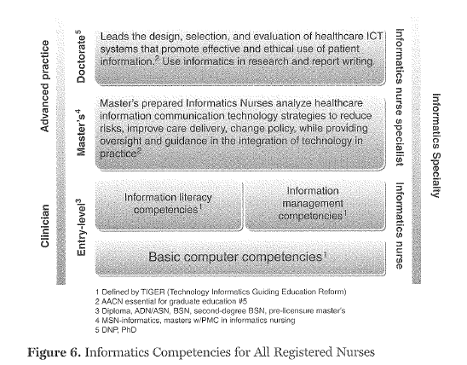
ANA Scope and Standards of Practice (2022)
Synthesis of Evolution of NI Competencies
(ANA, 2022, p. 53)

Slide 18
Other Professional Organizations Contributing to NI Education and Competencies
Informatics Competencies for IN and INS
American Nurses Association (ANA)
American Medical Informatics Association (AMIA)
American Nursing Informatics Association (ANIA)
Health Information and Management Systems society (HIMSS) Nursing Informatics Working Group

