Slide 1

NURS736: Technology Solutions for Knowledge Generation in Healthcare
Managing Organizational Information

Slide 2
Table of Content
Administrative Applications Supporting Healthcare Delivery
Major Financial Information Systems
Practice Management Systems
Material Management
Human Resources Information Systems
Business Intelligence
Downtime and Disaster Recovery for Health Information Systems
Downtime Risk Assessment
Downtime and Response Planning
Downtime Determinator Model
Redundant Systems
Downtime Policies and Procedures
Disaster Planning
Business Continuity Management
Communication During Downtime

Slide 3
Administrative Applications Supporting Healthcare Delivery

Slide 4
Major Financial Information Systems (FIS)
General ledger
Payroll system
Patient accounting system
Claims processing and management system
Contract management system
Fixed asset management system

Slide 5
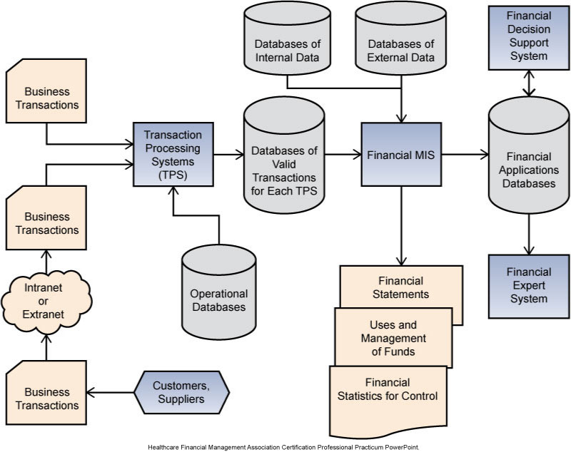

Slide 6
Financial Information System
Common Reports Used by Healthcare Organizations
Income statement
Balance sheet
Cash flow statement
FIS
Revenue cycle management
Efficiency Tools
Productivity tools
Reporting tools

Slide 7
Practice Management Systems
Patient Record
Master person index
Electronic health record (EHR)
Patient Outreach System
Electronic registry
Online Billing and Payment Tool
Billing at point of service
Follow-up billing
Hospital-Physician Connection
Provider expectations of information systems

Slide 8
Material Management—Healthcare Supply Chain
Material management in healthcare: storage, inventory control, quality control, and operational management of supplies, pharmaceuticals, equipment, and other items used in the delivery of patient care or the management of the patient care system
Material management within the context of supply chain management
Key files in the supply chain information management system
Supply item master file
Charge description master file
Vendor master file
Transaction history file

Slide 9
Material Management—Clinical Considerations of Supply Chain Operations
Nursing unit needs and physician needs are addressed
Physical layout variations may require modification to an accepted standard
Business process must be efficient before a technological solution can be integrated into the process
“One size” solution will not fit all

Slide 10
Human Resources Information Systems (HRIS)
HRIS can be operational, tactical, or strategic
Personnel Administration
Strategic and Operational Management
Staffing and Scheduling
Training and Development
Compensation, Benefits, and Pension
Performance Evaluation

Slide 11
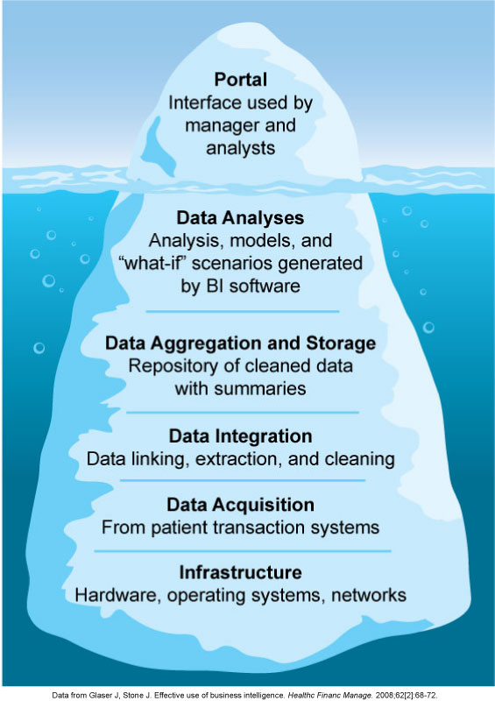
Business Intelligence (BI)
BI: Acquisition, correlation, and transformation of data into insightful and actionable information through analytics, enabling an organization and its business partners to make better, timelier decisions
Notes:
Figure 7-6 from text

Slide 12
Conclusion and Future Directions
Information technology (IT) productivity paradox—lesson learned
Promises, promises—impact of information technology on:
Quality
Analysis of data

Slide 13
Downtime and Disaster Recovery for Health Information Systems

Slide 14
Introduction
The primary objective for downtime and disaster planning is to protect the organization and the patients who are served by that organization by minimizing the disruption to the operations

Slide 15
Downtime Risk Assessment (DRA)
DRA should occur from project inception through system maturity
Downtimes can be classified by the root cause and the degree of impact
Priority of what to do first during downtime will be unique for each organization
What is their current status
What are their risks
What they want to protect first
What resources they have
Information technology (IT) team should work closely with the organization’s emergency preparedness and disaster planning groups

Slide 16
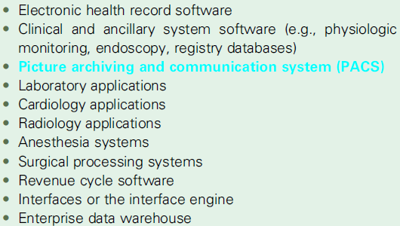
Sample Elements of Information Technology Infrastructure for Compiling Inventory of Existing Applications and Systems
Notes:
Box 18-1 from text

Slide 17
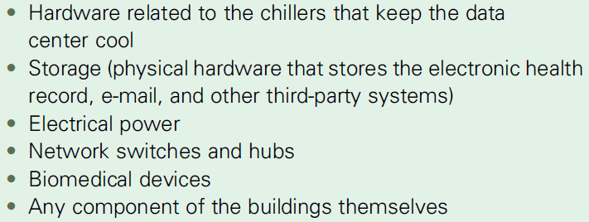
Examples of Information Technology Physical Structure for Compiling Inventory
Notes:
Box 18-2 from text.

Slide 18
Downtime and Response Planning
Consider both planned and unplanned downtimes
Develop the response and recovery plans
Quick assessment of the significance of a downtime event will help determine a response

Slide 19
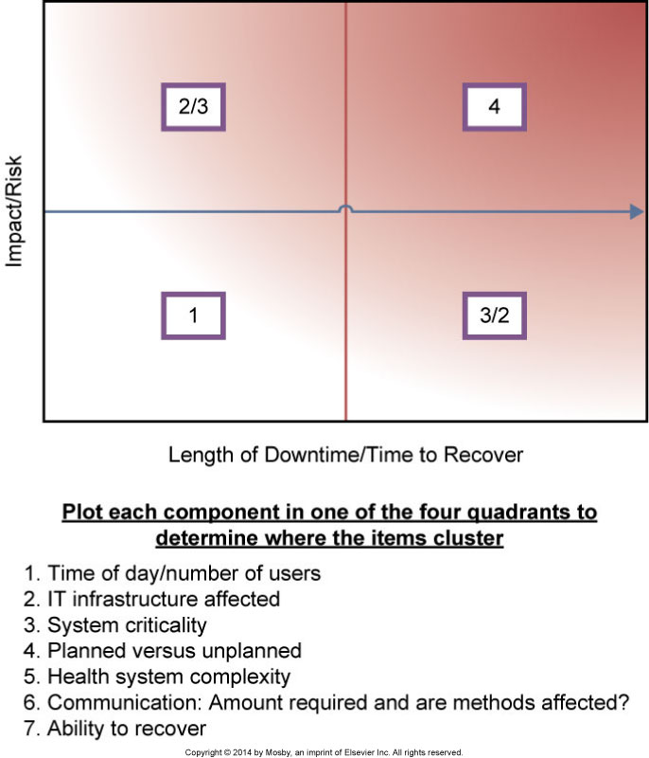
Downtime Determinator Model

Slide 20
Redundant Systems (back-up systems)
Part of the continuity of care plan for downtime
Allows patient care with computers and existing patient data
Data is downloaded periodically and automatically from the EHR and other software systems to back-up systems
Provide clinicians with the ability to access critical (usually not all) patient data during an EHR downtime
Shadow or mirror (EHR) systems often have “read” capability and sometimes have write capability
Web-based systems are used for planned downtimes

Slide 21
Downtime Policies and Procedures
Guide the clinical team to prescribe roles and responsibilities and define workarounds or manual processes to allow continuity of critical functions
Should include specific instructions about required data entry back into permanent EHRs at the conclusion of the downtime

Slide 22
Disaster Planning
Must be compliant with the Health Insurance Portability and Accountability Act (HIPAA) security rule of 1996, the Department of Health and Human Services, and The Joint Commission (TJC)
Organization needs to be prepared to rapidly test the clinical system to ensure that all aspects of the system are functioning as planned

Slide 23
Business Continuity Management (BCM)
Complementary process to disaster recovery
BCM includes
Recovering IT systems
Determining which administrative and healthcare services must be available
Timeline
Formal process for business continuity plan includes:
Business impact analysis
Recovery strategies
Formal plan
Testing of the plan

Slide 24
Communication During Downtime
Communication plan
Who needs to know?
What details do they need?
What modes of communication will be used?
Who will communicate the details to those who need to know?
What systems and workflows are affected?

Slide 25
Conclusion and Future Directions
Downtime and disaster recovery is necessary to:
Ensure the safety of personnel
Protect patients and other customers
Ensure organizational stability
Protect the critical assets of the organization
Reduce the variability in decision making during a disaster
Minimize legal liability
Minimize the economic loss

