Slide 1
NURS736: Technology Solutions for Knowledge Generation in Healthcare
Theories, Evidence Based Practice, and Program Evaluation in Health Informatics

Slide 2
Table of Content
Healthcare Professional Competencies
Theoretical Foundations of Health Informatics
Advanced Scientific Theories Applied to Nursing Informatics and Health Informatics
Nursing Informatics and Health Informatics Models
Evidence-Based Practice, Practice-Based Evidence, and Informatics
Quality of Care (AHRQ, IOM)
Star Model for Knowledge Transformation
Program Evaluation
Research for Program Evaluation
Theories and Models for Program Evaluation
Final Remarks

Slide 3
Healthcare Professional Competencies
Five core competences that should be achieved by all healthcare professionals:
Delivering patient-centered care
Working as part of interdisciplinary teams
Practicing evidence-based medicine
Focusing on quality improvement
Using information technology

Slide 4
Theoretical Foundations of Health Informatics

Slide 5
Advanced Scientific Theories Applied to Nursing Informatics and Health Informatics

Slide 6
Systems Theory
Purpose
Structure
Function

Slide 7
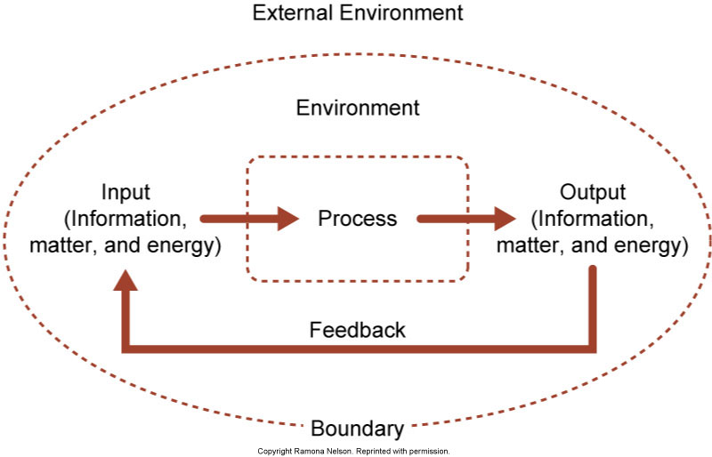
Open System Interacting with the Environment

Slide 8
Chaos Theory
Mathematical Model
Qualitative study of unstable aperiodic behavior
Deterministic - brings some order into chaos
Nonlinear dynamic systems
Highly sensitive to initial conditions
Butterfly effect
Can be used to predict the future

Slide 9
Complexity Theory
Complex organizations adapt to their environment
Complex systems are made up of self-organizing units
The adaptive response of a complex system to an environmental change includes an element of unpredictability
The change process within complex systems is nonlinear
The adaptive process within a complex organization demonstrates complex unique patterns

Slide 10
Information Theory
Shannon and Weaver Information-Communication Theory
Data-to-Wisdom Continuum

Slide 11
Schematic Diagram of a General Communication System

Slide 12
Principles of Learning
Meaningfulness assists learning
Only so much input can be processed at one time
Timing of learning is critical
Participation and practice support retention
Conceptual learning is enhanced with concrete examples
Taking in new material through more than one modality can facilitate learning
Learning is enhanced if teaching includes the cognitive, affective, and psychomotor domains
Learning takes place intentionally and unintentionally
Learning is contagious

Slide 13
Change Theories
The study of change in organizations and individuals
Planned change – Kurt Lewin
Diffusion of innovation – Everett Rogers

Slide 14
Diffusion of Innovation
Innovators
Early adapters
Early majority
Late majority
Laggards

Slide 15
Nursing Informatics and Health Informatics Models

Slide 16
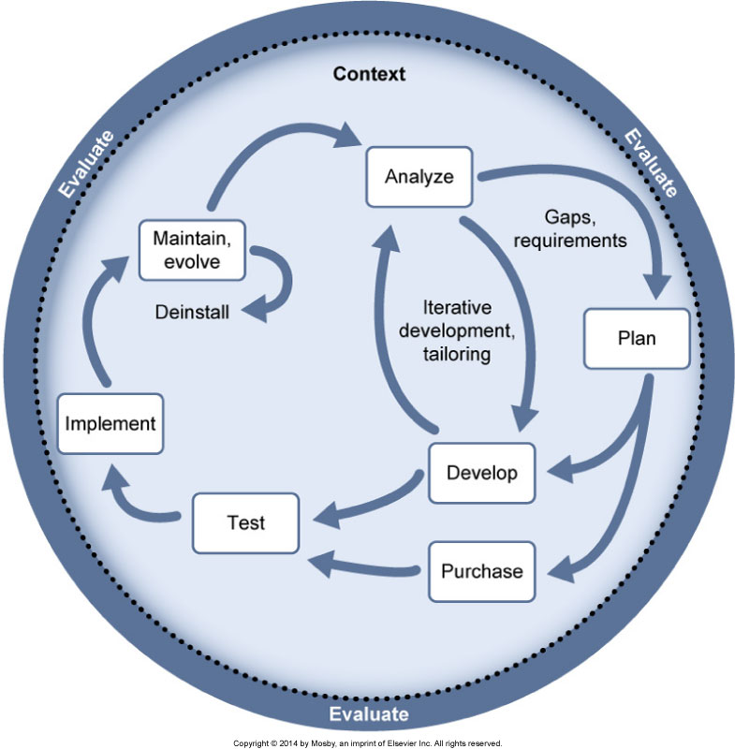
Staggers and Nelson Systems Life Cycle Model

Slide 17
Selected Models of Nursing Informatics
Nursing Informatics (NI) Pyramid Model by Patricia M. Schwirian, PhD, RN
Turley’s Nursing Informatics Model by James Turley, PhD, RN
Goosen’s Framework for Nursing Informatics Research by William T. Goossen, RN, PhD
Informatics Research Organizing (IRO) Model by Judith Effken, PhD, RN, FACMI, FAAN

Slide 18
Evidence-Based Practice, Practice-Based Evidence, and Informatics

Slide 19
Evidence-Based Clinical Decision Making
Choices are based on the idea that research-based care improves outcomes
What intervention will most likely diminish the health problem?

Slide 20
Quality of Care
Is the “degree to which health services to individuals and populations increase the likelihood of desired health outcomes and are consistent with current professional knowledge.”
(Institute of Medicine [IOM], 1990)
Quality of care lags behind knowledge
Evidence-based practice (EBP) is considered as a solution

Slide 21
Agency for Healthcare Research and Quality (AHRQ) Annual Report
Data are gathered from 36 databases
Healthcare quality in America is suboptimal
Gap between the best possible and routine care is substantial
Small gains are being made

Slide 22
Institute of Medicine (IOM) 2001 Report
STEEEP redesign:
Safe
Timely
Effective (EBP)
Efficient
Equitable
Patient-centered

Slide 23
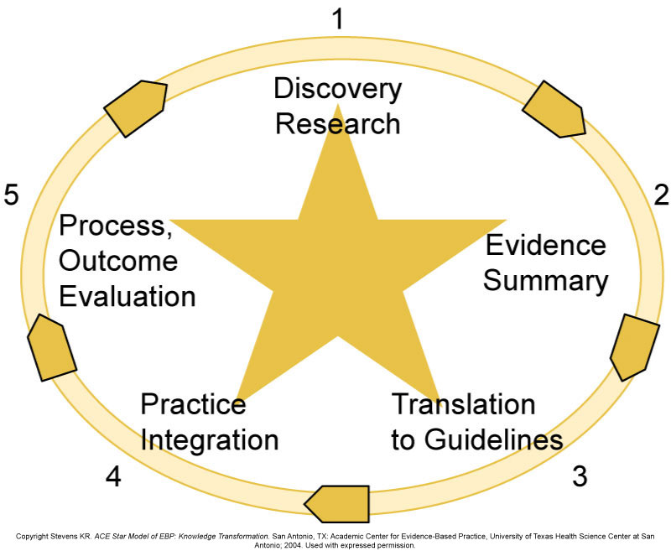
ACE Star Model of Knowledge Transformation

Slide 24
Premises of the Star Model
Knowledge transformation is necessary before research results are usable in clinical decision making
Knowledge is derived from a variety of sources. In healthcare, the sources of knowledge include research evidence, experience, authority, trial and error, and theoretical principles
The most stable and generalizable knowledge is discovered through systematic processes that control bias, namely, the research process

Slide 25
Premises of the Star Model (Cont.)
Evidence can be classified into a hierarchy of strength of evidence. The relative strength of evidence is largely dependent on the rigor of the scientific design that produced the evidence. The value of rigor is that it strengthens cause-and-effect relationships
Knowledge exists in a variety of forms. As research evidence is converted through systematic steps, knowledge from other sources (eg, expertise, patient preference) is added, creating yet another form of knowledge

Slide 26
Premises of the Star Model (Cont.)
The form (ie, package) in which knowledge exists can be referenced to its use; in the case of EBP, the ultimate use is its application in healthcare
The form of knowledge determines its usability in clinical decision making. For example, research results from a primary investigation are less useful to decision making than a clinical EBP guideline

Slide 27
Premises of the Star Model (Cont.)
Knowledge is transformed through the following processes:
Summarization into a single statement about the state of the science
Translation of the state of the science into clinical recommendations, with the addition of clinical expertise, the application of theoretical principles, and client preferences
Integration of recommendations through organizational and individual actions
Evaluation of the impact of actions on targeted outcomes

Slide 28
Point 1: Discovery Research
Knowledge produced through primary discovery
Knowledge is in the form of results from a single research study

Slide 29
Point 2: Evidence Summary
Includes:
Evidence synthesis
Systematic reviews
Integrative reviews
Reviews of literature

Slide 30
Point 3: Translation to Guidelines
Experts are called on to consider the evidence summary, fill in gaps with consensus expert opinion, and merge research knowledge with expertise to produce clinical practice guidelines
For example, research becomes clinical recommendations

Slide 31
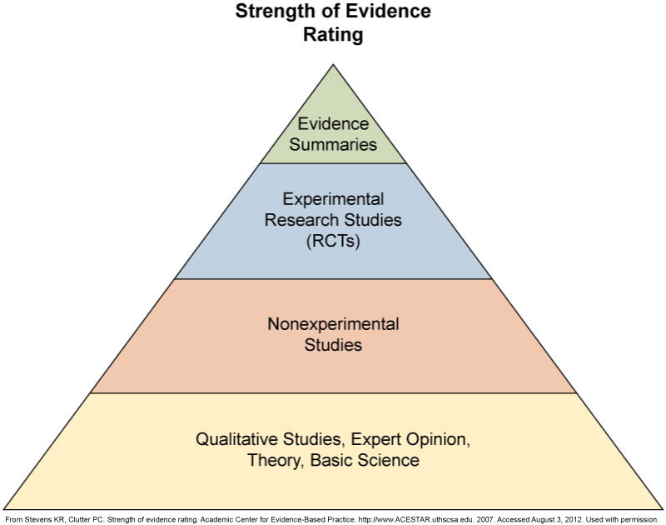
Strength-of-Evidence Rating Hierarchy

Slide 32
Point 4: Practice Integration
Integrate clinical findings into practice
Can involve change at varying levels
Individual
Organization
Policy

Slide 33
Point 5: Evaluation
Evaluate the impact of the change:
Redesign of care
Effectiveness of the care in producing desired patient outcomes
Patient outcomes
Population outcomes
Efficiency and cost factors in the care (short- and long-term)
Satisfaction of both providers and patients

Slide 34
Program Evaluation

Slide 35
Research for Program Evaluation

Slide 36
Purposes of Program or Project Evaluation
Program and organizational improvement
Quality improvement studies
Work process re-engineering
Assessment of merit and compliance
Compliance with guidelines
Response to request from The Joint Commission (TJC)
Achievement of goals and objectives
Cost and impact
Knowledge development
Hypothesis testing
Oversight and compliance

Slide 37
Key Evaluation Questions
Will the results of the evaluation be used to improve the program or to focus on determining whether the goals of the program have been met?
Formative: Goal is continuous improvement
Start early in implementation
Hold regular meetings with stakeholders for feedback
Summative: Assesses preidentified outcomes
Is conducted at the end or near the end of the program
Outcomes, such as cost, effort, and impact, are assessed

Slide 38
Key Evaluation Questions (Cont.)
Will the results of the evaluation be used to inform stakeholders of whether a particular program is “working” and in compliance with regulations and mandates?
Is it a question of research versus evaluation?
Research is more likely than evaluation to:
Measure contextual factors to increase generalizability
Be based on established scientific theory
Use validated and reliable measures

Slide 39
Key Evaluation Questions (Cont.)
Will the results of the evaluation be used to make a decision about continuing the program as is or to decide on expanding it to a larger setting?
Outcomes of interest are:
Feasibility
Cost and resources
Training
Scalability
Experience of participants
Unintended consequences

Slide 40
Theories and Models for Program Evaluation

Slide 41
Theories: Three Levels
Scientific theories
Extensive validation
Identified mechanisms and measures
Frameworks and conceptual models
Descriptive of area of interest
Not particularly validated
Relationship among variables not specified
Program theory models
Based on actual study
Implicit model of stakeholders

Slide 42
Social Cognitive Theories
Intention is the best predictor of behavior
Intentions are predicted by beliefs about:
What others expect us to do (NORMS)
Our own ability to engage in the behavior (SELF-EFFICACY)
Value of the outcome or behavior (VALUE)
Likelihood that behavior will result in an outcome
Overall attitude toward behavior (ATTITUDE)

Slide 43
Diffusion of Innovations
Stages of change:
Knowledge
Persuasion
Decision
Implementation
Confirmation
Characteristics of the intervention:
Relative advantage
Trialability
Complexity
Observability

Slide 44
Situational Awareness
Arose out of cognitive engineering
Proposes that human performance is based on three key integrated cognitive functions:
Perception: Can we see the situation clearly?
Comprehension: Do we understand the task and the overall context? Have we categorized the situation appropriately?
Projection: How well can we think ahead about the implications of the current situation and compare the pros and cons of our options?

Slide 45
Information Theory
Information flow is divided into: sender, channel, receiver, and destination.
Three levels of analysis:
Technical or statistical level: Information is defined as a measure of entropy
Semantic level: Information is defined as a reduction of uncertainty at the level of human meaning
Effectiveness level: Information is defined as a change in the goal state of the system

Slide 46
Information Foraging Theory
Is useful for evaluating information found on the internet
Assumes that humans are goal directive and adaptive, continuously weighing the effort required versus the information gained

Slide 47
Information Foraging Theory: Concepts
Information value: What is the information worth?
Information patches or the temporal and spatial location of information clusters: Where is the information located and for how long?
Information scent: What are the cues that indicate the presence of information?
Information diet: What sources should I consistently examine?

Slide 48
Information System Success
Systems quality: How well does the system work? How many errors does it create?
Information quality: How accurate is the information it produces? How fast is it available?
Impact (use, user satisfaction, outcomes): How does it impact job satisfaction? Are there adverse drug effects?
Service quality: How supportive is it?

Slide 49
Unified Theory of Acceptance and Use of Technology (UTAUT)
Predicts adoption and use
Is based on the theory of planned behavior, diffusion of innovation, and social cognition
Intentions to use are predicted by:
Performance expectancy or self-efficacy beliefs
Effort expectancies
Social influence
Facilitating conditions

Slide 50
Precede and Proceed Model
Predisposing factors: Lay the foundation for success (eg, electronic health records or strong leadership)
Reinforcing factors: Follow and strengthen behavior through incentives and feedback
Enabling factors: Support the change process; includes creating working relationships with the team

Slide 51
Promoting Action on Research Implementation in Health Services (PARiHS)
Evidence: Establishes the efficiency and effectiveness of the intervention
Context: Enhances leadership support and the integration with the culture through focus groups and interviews
Facilitation: Facilitates the implementation process through education, feedback, and support

Slide 52
RE-AIM
Reach: How many targeted users actually had the opportunity to use it? How many even knew about the system?
Effectiveness: To what extent does the intervention actually work and perform the function it was designed to do?
Adoption: What is the breadth and depth of its adoption and use? How many users? Where are they located?
Implementation: Was the intervention the same across settings and time?
Maintenance: How sustainable is it? Did usage drop off or continue to increase?

Slide 53
Theories and Models Summary
Are specific to the individual project
Consist of the “mental models” of the stakeholders
Serve the purpose of getting everyone “on the same page”
Evolve and change over the duration of the project
Can be a set of pictures, a logic model, a concept model, or a flowchart

Slide 54
Final Remarks

Slide 55
Quantitative versus Qualitative
Quantitative
Counts events, proportions, and rates
Assesses the validity of the measures
Correlates outcomes
Answers questions regarding what is “more” and what is “better”
Qualitative
Describes and characterizes
Uses stories and narrative
Uses personal experiences
Uses vivid language and unique events
Answers questions such as “What is it?” or “What was it like?”

Slide 56
Instruments for Program Evaluation
User satisfaction surveys
Provide a proxy for how well the system improves the ability to do work
Social network analysis
Explores and analyzes the adoption and use, internet searches
Cost-effective analysis
Provides a simple form of a cost-benefit analysis

Slide 57
Future Implications
Nurses will be increasingly involved in program evaluation using informatics in clinical settings
Informatics programs will be increasingly integrated with most clinical change programs with informatics being only one component
The issue of clarifying whether the project is more research versus evaluation will become increasingly important and has to be decided up front
Theory will become increasingly important to improve generalizability

