Slide 1
Ethics & Advocacy for the Mental Health Population
Anita J. Tarzian, PhD, RN
atarzian@law.umaryland.edu
(410) 706-1126

Slide 2
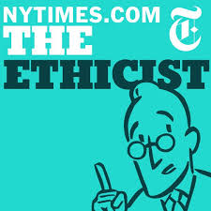
What do we mean by “ethics”?
The discipline that considers what is right or what should be done in the face of uncertainty or conflict about values.
  Involves making reflective judgments about the optimal decision or action among ethically justifiable options.
  www.ethics.va.gov/ETHICS

Slide 3
Ethics vs. law
‘You can’t legislate morality.’
Areas of overlap
LAW &
REGULATIONS
ETHICS
PERSONAL
MORALITY

Slide 4
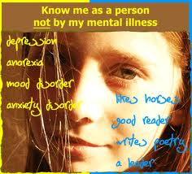

Slide 5
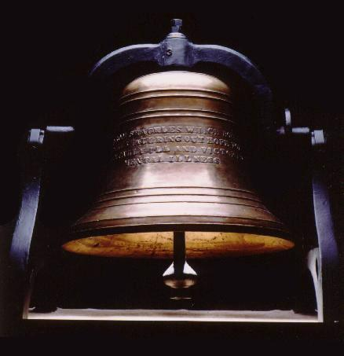

Slide 6
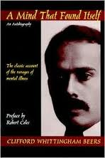
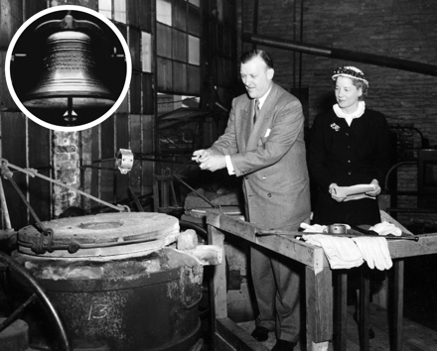
McShane Bell Foundry
Baltimore, MD
April 13, 1956

Slide 7

John Nash & schizophrenia
https://www.youtube.com/watch?v=Yqj1DhUKJco

Slide 8
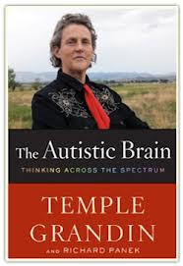
DISABILITY OR DIFFERENCE?
https://www.youtube.com/watch?v=EuzE6lMQQmo

Slide 9

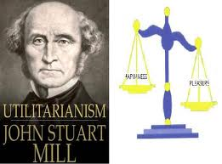
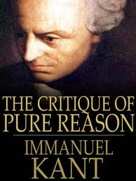

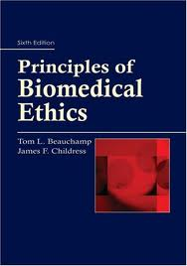
Ethical reasoning
Rights-based
  Natural
  Legal
Consequentialism
  Utilitarianism
Duty-based
  Prima facie principles
  Deontology

Slide 10
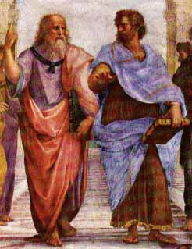
Virtue ethics
Aristotle 394-322 B.C.E.
The goal of human life is to seek happiness, an ‘excellent activity of the soul’, & to cultivate “practical wisdom”

Slide 11
Rest’s 4 Dimensions of Moral Life
Sensitivity: Can you recognize issues?
Reasoning: Can you work through issues and make reasoned judgments?
Motivation: Do you identify with professional commitments and responsibilities?
Action: Can you enact your judgments and commitments?
Rest JR. Moral Development: Advances in Research and Theory. New York: Praeger Press, 1986.

Slide 12

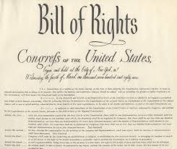

RIGHTS
Infer obligations
Natural v. legal rights
Negative v. positive rights

Slide 13
Universal Declaration of Human Rights
http://www.un.org/en/documents/udhr/
Article 1
  All human beings are born free and equal in dignity and rights. They are endowed with reason and conscience and should act towards one another in a spirit of brotherhood.
Article 3
  Everyone has the right to life, liberty and security of person.
Article 4
  No one shall be held in slavery or servitude; slavery and the slave trade shall be prohibited in all their forms.
…
→ Article 30

Slide 14
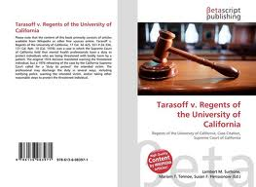
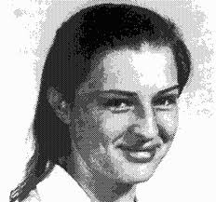
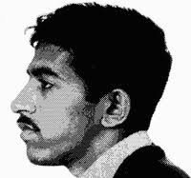
Tarasoff v. Regents of the University of California
Tarasoff v. Regents of the University of California,
17 Cal. 3d 425, 551 P.2d 334, 131 Cal. Rptr. 14 (Cal. 1976),

Slide 15
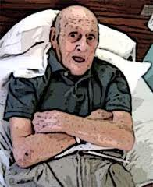
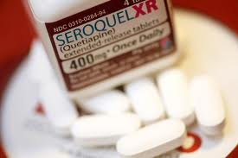
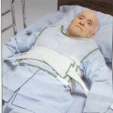
Laws, Regulations & Guidelines on Involuntary Treatment
Right to refuse treatment
  Presumption of Competency; Declaration of Incompetency; Informed Consent; Standard: Serious Risk of Physical Harm to Themselves or Others in the Near Future; Least Restrictive Alternative (Mental Health America: http://www.mentalhealthamerica.net/go/position-statements/22
AHA’s Patients Bill of Rights
COMAR (Code of Maryland Regulations) for Nursing Homes

Slide 16
Medications may be administered to a patient against his/her expressed will only under one of the following conditions:
1. An emergency exists wherein an individual presents a danger to the life or safety of the individual or others.
2. With the approval of a guardian or personal representative who has the legal authority to make health care decisions for the patient.
3. Through substituted consent for non-psychiatric treatments.
4. Under the authority of a duly authorized and executed Clinical Review Panel (psychiatric medications only).
5. Under the authority of a court of law.
Emergency Medication Administration to the Objecting Patient. Revised and Approved by Statewide Pharmacy and Therapeutics and Statewide Clinical Director s 5-18-07

Slide 17
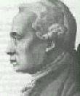
Duty-based
Kant’s Categorical Imperative
  “Act only on that maxim which you can at the same time will to be a universal law.”
  Emphasis on self-determination
1724 - 1804

Slide 18
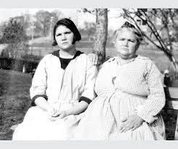
PARADIGM LEGAL CASES
Buck v. Bell. (1927) – forced sterilization

Slide 19
–Justice Holmes, 1927
“We have seen more than once that the public welfare may call upon the best citizens for their lives. It would be strange if it could not call upon those who already sap the strength of the State for these lesser sacrifices, often not felt to be such by those concerned, in order to prevent our being swamped with incompetence. It is better for all the world if, instead of waiting to execute degenerate offspring for crime or to let them starve for their imbecility, society can prevent those who are manifestly unfit from continuing their kind. The principle that sustains compulsory vaccination is broad enough to cover cutting the Fallopian tubes. Jacobson v. Massachusetts, 197 U.S. 11. Three generations of imbeciles are enough.”

Slide 20
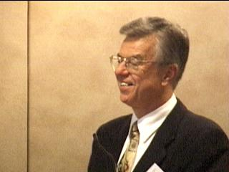

Ethical Principles as duties
W.D. Ross
  Fidelity
  Reparation
  Gratitude
  Justice
  Beneficence
  Self-Improvement
  Non-maleficence
Kant
  Respect for Persons
Beauchamp & Childress

Slide 21
Respect for Persons
To promote individual self-determination
  Individual autonomy – the right to make one’s own health care choices
To protect persons who are not rational agents by promoting their well-being and preventing them from being harmed.
  Treat others, particularly vulnerable persons unable to reason on their own, “as an end withal and never as a means merely.” (Kant)

Slide 22
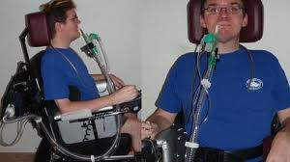
Simple vs. Complex Autonomy
Simple autonomy – decisions based solely on the patient’s choice irrespective of other factors
Complex autonomy – the individual and his/her choices cannot be separated from a greater social context
  Includes the “thick, interpersonal detail that defines the lives we lead and influences the decisions that we as individuals may make”
    Kaufert & Koch (2003), Theoretical Medicine, 24, 259-469
    Geertz (1973), The Interpretation of Cultures, NY: Basic Books

Slide 23

Individual, Family, Community

Slide 24
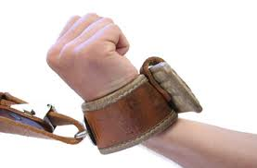
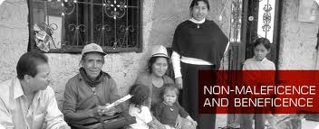
Beneficence & Nonmaleficence
Obligation to do good, not harm, to other people.
  Promote well-being:
    Patient/Family support during crisis
    Advocating to allow elderly patient to stay in home
    Protecting vulnerable child from abusive parent
  Do no harm:
    Not breaching privacy/confidentiality
    Not coercing client to comply with treatment he’s refused
    Not allowing prejudice to bias treatment

Slide 25
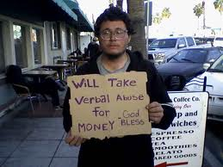
Justice
Fair and equitable determination of what is owed to a person including distribution of resources and fair treatment for individuals and society
Distributive justice
  equal share
  merit
  need
  outcomes

Slide 26
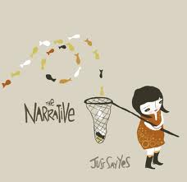
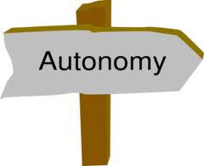
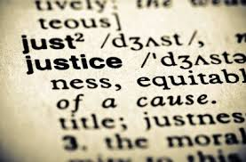
Problems with principles
Over-emphasis on autonomy
Under-emphasis on justice
Weighing of principles depends on context
  Combine principles with narrative or casuistic (case-based) approach

Slide 27
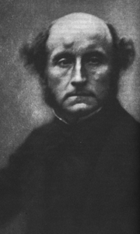
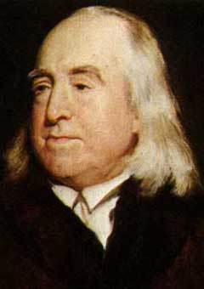
Consequentialism
Jeremy Bentham (1748-1832)
Actions are to be judged strictly on the basis of how their outcomes affect general utility (happiness).
John Stuart Mill (1806 – 1873)
We ought to aim at maximizing the welfare of all sentient creatures, and that welfare consists of their happiness.

Slide 28
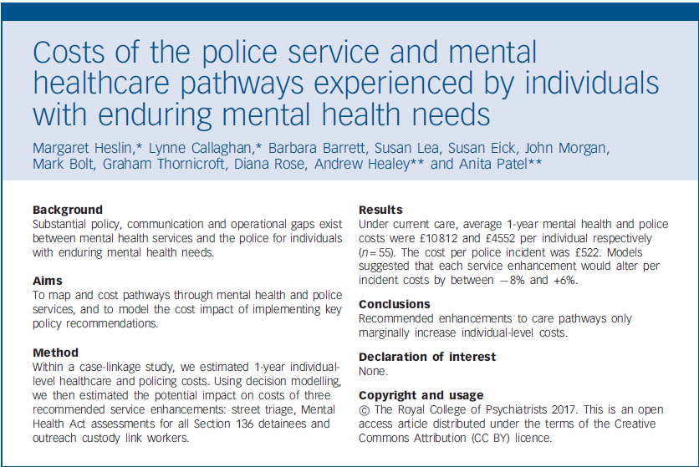
British J of Psych (2017), 210, 157-164.

Slide 29

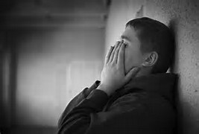
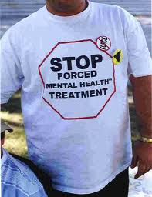
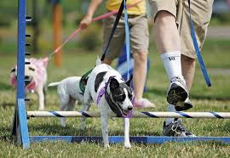
Obligatory dangerousness criteria
“RIGHT”
“WRONG”
Protects rights of individuals with mental illness
Voluntary measures are more effective than forced commitment
Fails to protect individuals with mental illness who need help
Harms to society if mentally unstable individuals not treated

Slide 30
Methods of ethical justification
Deontology
  Rule based
  Duty to protect liberty rights
  High bar for involuntary treatment
Consequentialism
  Outcomes based
  Maximize benefits, minimize harms
  May consider lower bar for involuntary treatment if supported by outcomes

Slide 31
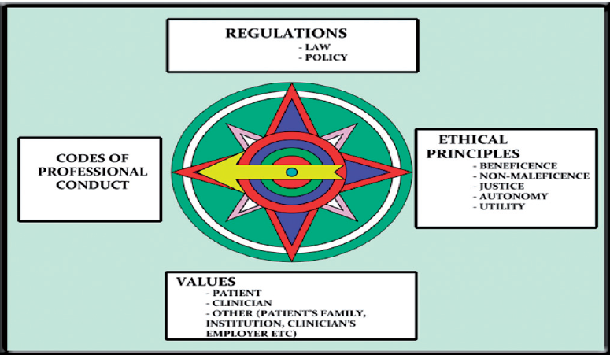
Manson, H.M. (2012). The development of the CoRE-Values framework as an aid to ethical decision-making. Medical Teacher, 34: e258–e268, at e262.

Slide 32
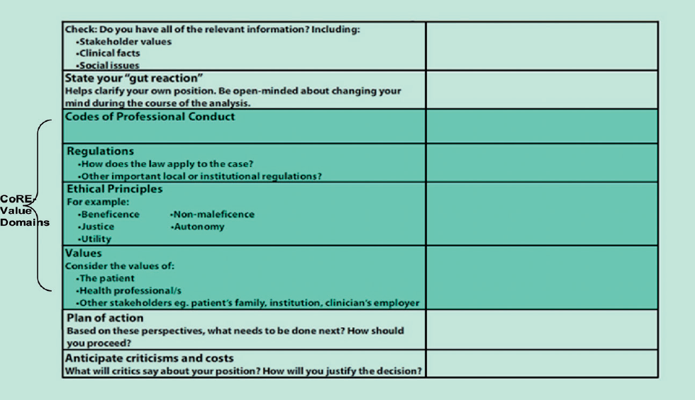
Manson, H.M. (2012). The development of the CoRE-Values framework as an aid to ethical decision-making. Medical Teacher, 34: e258–e268, at e263.

Slide 33
CASE STUDY
A 17 year old female is admitted to the medical ward of a community hospital for malnutrition and weight loss due to anorexia nervosa. The nurse is told by the patient's physician and nursing supervisor to interact minimally with the patient to avoid being "manipulated" by her, and to use restraints as necessary to ensure that the patient receives the ordered tube feedings via nasogastric tube. The nurse believes that it is her duty to try to establish a therapeutic bond with the patient, and that actively force feeding the patient—including with the use of hand restraints—will do more harm than good.

Slide 34
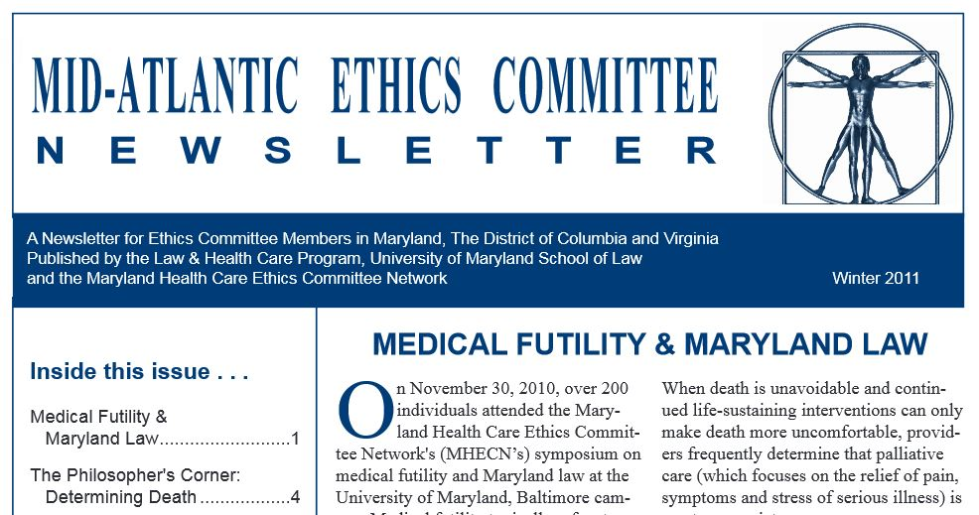
Case commentary
Mid-Atlantic Ethics Committee Newsletter
  http://digitalcommons.law.umaryland.edu/maecnewsletter/38/

Slide 35
Moral Distress
“Knowing the ethically right thing to do, but being unable to act upon it.”
“Acting in a manner contrary to your personal & professional values, which undermines your integrity and authenticity.”
Jameton, A. (1993). Dilemmas of moral distress: moral responsibility and nursing practice. AWHONN’S Clin Issues Perinat Womens Health Nurs, 4(4), 542-551, as cited in assigned reading for class.

Slide 36
Values-based practice
Woodbridge-Dodd K. (2012). Values-based practice in mental health and psychiatry.
Curr Opin Psychiatry. 25(6), 508-12.
Be aware of values
Be clear where values are in reasoning process
Improve knowledge of values
Use communication to resolve value conflicts
Start with the client’s values
Don’t resolve values conflicts by a pre-prescribed rule but by balancing different values perspectives
Make decisions with clients in partnership
VBP works in partnership with EBP

Slide 37
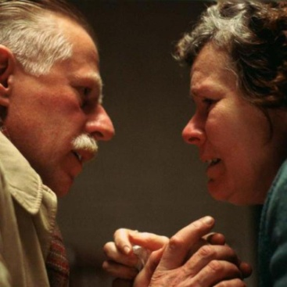
Mrs. W
Mrs. W is a 72 year old woman with Alzheimer’s dementia who resides in a chronic care facility. She is physically functional, but has become increasingly agitated and paranoid. She insists on leaving the facility. Despite staff attempts to calm and distract her, she becomes increasingly agitated. She refuses all medications. A physician orders that she be given a psychotropic medication. The nurse questions whether it is appropriate to hold her down to give her the medication by injection, since she is refusing.

Slide 38
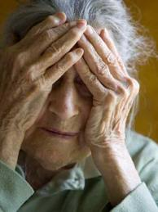
Ethical question/concern
Is it ethically justifiable to make Mrs. W. take medication by force or deception against her will?

Slide 39
Relevant information
“Gut reaction”
Codes of Professional Conduct
Laws/Regulations
Ethical Principles
Values
Plan of action
How will you justify the decision?
Manson, H.M. (2012). The development of the CoRE-Values framework as an aid to ethical decision-making. Medical Teacher, 34: e258–e268, at e263.

Slide 40
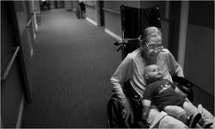
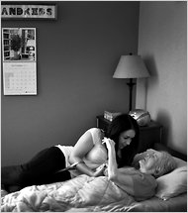

Giving Alzheimer’s Patients Their Way, Even Chocolate
(NYT, 12-31-2010)
http://www.nytimes.com/2011/01/01/health/01care.html

Slide 41

Beatitudes Nursing Home
A Journey to Becoming Restraint-Free & Staying There http://www.youtube.com/watch?v=BmVpuO3rcqY (7 min)

Slide 42
Using improv in persons with dementia
https://www.youtube.com/watch?v=3ETna2mX49M

Slide 43
RESOURCES
American Nurses Association
http://www.nursingworld.org
AMA’s Virtual Mentor
http://virtualmentor.ama-assn.org
American Psychological Association
http://www.apa.org
Maryland Healthcare Ethics Committee Network
http://www.law.umaryland.edu/mhecn

Slide 44
Relevant information | dEBP & VBP here!
“Gut reaction” | How has this changed?
Codes of Professional Conduct | http://www.nursingworld.org/codeofethics
Laws/Regulations | Is patient harm to self or others? What is “least restrictive means”?
Ethical Principles | Respect for persons (autonomous choice or vulnerable person needing protection?); Beneficence/non-maleficence; Fairness to others?
Values | What are values of patient, family, staff, fellow NH residents? Others?
Plan of action | What next steps should you take? Would an ethics consult help?
How will you justify the decision? | Use ethical reasoning here
Manson, H.M. (2012). The development of the CoRE-Values framework as an aid to ethical decision-making. Medical Teacher, 34: e258–e268, at e263.

