Slide 1
Stress, Coping, and Anxiety
NURS 329 Psychiatric Mental Health Nursing

Slide 2
Objectives
Describe the physiological stress response
Identify symptoms and behaviors associated with anxiety responses
Analyze predisposing factors, precipitating stressors, and appraisal of stressors related to anxiety responses
Describe coping resources and coping mechanisms related to anxiety
Become familiar with anxiety and stress-related disorders
Identify treatment strategies for anxiety and stress-related disorders
Apply the nursing process to anxiety responses

Slide 3
Stress: What is it?
“Stress is a condition that is often characterized by symptoms of physical or emotional tension. It is a reaction to a situation where a person feels threatened or anxious. Stress can be positive (e.g., preparing for a wedding) or negative (e.g., dealing with a natural disaster)” (CDC, 2013)

Slide 4
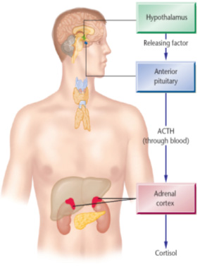
Stress and the HPA Axis
Stress response: release of norepinephrine and epinephrine supports “fight or flight”
Pupils dilate, ↑ HR, vasoconstriction, ↑ BP, ↑ lung capacity
The body is ready to meet the threat or escape
Threat is removed: homeostasis is re-established

Slide 5
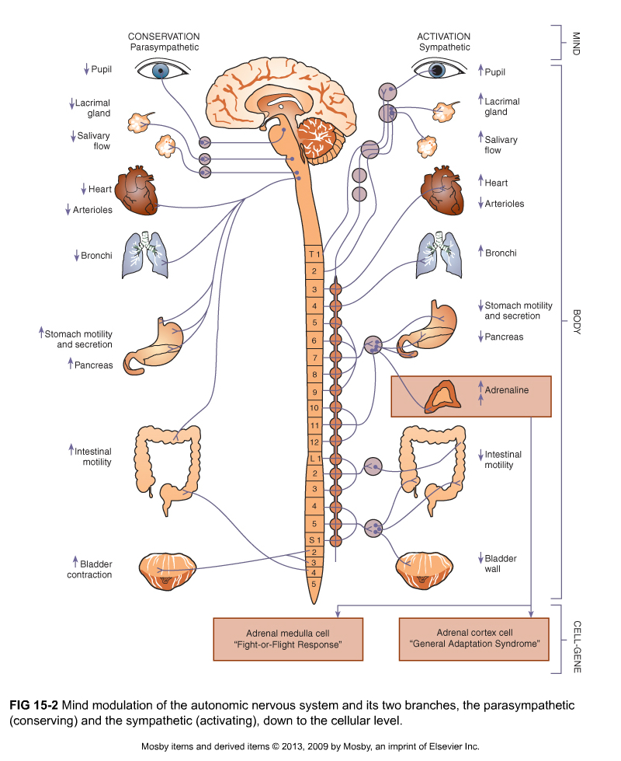

Slide 6
Relationship with neurological function
Locus ceruleus (NE production excess)
Amygdala and hippocampus (limbic system)
Center for emotion and memory
Central to fear response
Serotonin regulation/dysregulation

Slide 7
Psychoneuroimmunology
Connection between the mind and health
Psychosocial stressors suppress immune system
Feedback loop of chemical messengers
Neurotransmitters
Hormones
Cytokines and peptides

Slide 8
Effects of Chronic Stress
Cardiovascular disease, HTN
Insulin resistance, metabolic syndrome, Type II diabetes
Increased appetite, weight gain, abdominal fat
Digestive disorders
Depression
Anxiety disorders
Sleep disorders
Decreased immune response

Slide 9
Coping Mechanisms
Efforts to deal with stress
Starts with an appraisal of the stressor
Response can be constructive when anxiety is treated as a warning sign and the person accepts the challenge OR can be destructive
Problem-focused
Emotion-focused (defense mechanisms)
(Stuart, 2013, p. 51)
Notes:
Problem- or task-focused coping – consciously directed and action oriented (attack, withdrawal, & compromise)
Emotion- or ego-focused

Slide 10
Ego Defense Mechanisms (unconscious)
Denial/minimization- avoidance of difficult realities by ignoring or refusing to recognize them, or minimizing the impact or effect something will have on their life
Projection- attributing one’s own thoughts or impulses to another person
Acting Out- feelings, emotions and conflicts are expressed behaviorally, rather than through language
Intellectualization- excessive reasoning or logic used to avoid painful emotions

Slide 11
More Ego Defense Mechanisms
Rationalization- offering a socially acceptable or apparently logical explanation to justify or make acceptable otherwise unacceptable impulses, feelings, behaviors and motives
Splitting – viewing people and situations as all good or all bad
Identification – process by which people become like someone they admire
Regression – retreating to earlier behaviors
Table 15-1, Stuart, 2013, p. 226

Slide 12
Coping
Protective factors
Spiritual beliefs
Problem-solving skills
Social skills
Material assets
Knowledge and intelligence
Strong ego identity, commitment to social network, cultural stability, a stable system of values and beliefs, and a preventive health orientation
(Stuart, 2013, p. 51)

Slide 13
Anxiety
Vague sense of apprehension accompanied by feelings of uncertainty, helplessness, isolation, and insecurity
Subjective sense of a threat
Necessary for survival
Can be a warning sign of not dealing with stress effectively
Notes:
The DSM states “Fear is the emotional response to real or perceived imminent threat, whereas anxiety is anticipation of future threat” (APA, 2013, p. 189). And they overlap.

Slide 14
Four Levels of Anxiety
Mild - Alert and perceptual field is increased. Increased motivation and learning.
Moderate – Sees, hears, & grasps less. Directable. Focuses only on immediate concern perceptual field narrows.
Severe – Trouble thinking and reasoning. Focuses on specific detail only and unaware of surroundings. Difficult to direct. Tunnel vision.
Panic – Fight, flight, or freeze response. Loss of control, dissociation, shock, dread, terror. Not directable.

Slide 15
Panic Attack
An abrupt surge of intense fear or intense discomfort that reaches a peak within minutes, and during which time 4 + of the following sx’s occur:
Palpitations, pounding heart or increased heart rate
Sweating
Trembling or shaking
Shortness of breath
Choking feelings
Chest pain or discomfort
Nausea or abdominal distress
Feeling dizzy, unsteady, lightheaded or faint
De-realization or depersonalization
Fear of losing control or going crazy
Paresthesias
Chills or hot flashes
Fear of dying
(APA, 2013)
Notes:
A panic attack is not a disorder. Can occur in the context of anxiety, depressive, and other mental and medical disorders. Panic attacks can be expected or unexpected.
Rare in prepubescent children.

Slide 16
Anxiety Disorders
15 – 25% of US population has an anxiety disorder (Stuart, 2013, p. 217)
More prevalent in women and people under 45 years old
Most common psychiatric disorders in the U.S. & most common psych d/o in children and adolescents
Heritability about 40%

Slide 17
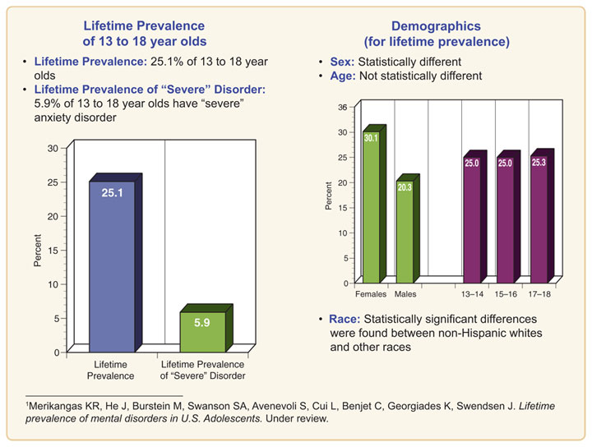
Anxiety D/O’s Epidemiology: Children
http://www.nimh.nih.gov/statistics/1ANYANX_child.shtml

Slide 18
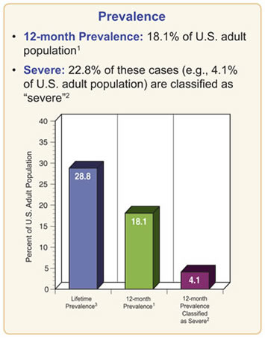
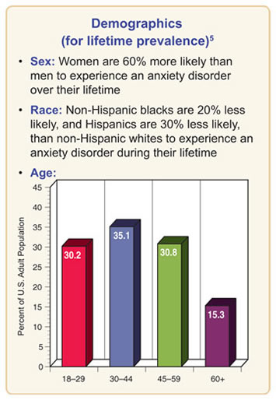
Anxiety D/O’s Epidemiology: Adults
http://www.nimh.nih.gov/health/statistics/prevalence/any-anxiety-disorder-among-adults.shtml

Slide 19

Panic Disorder

Slide 20
Panic Disorder
Recurrent unexpected panic attacks and at least one of the attacks has been followed by at least 1 month of one or more of the following:
Persistent concern or worry about additional panic attacks or their consequences (i.e., losing control, having a heart attack, “going crazy”)
A significant maladaptive change in behavior related to the attacks (i.e., avoiding situations).
(APA, 2013)
Notes:
Generally, with psychiatric diagnoses, medical problems must be ruled along with other psychiatric disorders and substance/medication induced symptoms

Slide 21
Phobia
Irrational dread of and compelling desire to avoid a specific object, situation or activity.
Characterized by extreme anxiety and/or panic when exposed to the specific object or situation.

Slide 22
Specific Phobias
Public speaking is the most common
Animal (i.e., spiders, insects, dogs)
Claustrophobia- fear of small, closed in space and unable to escape
Blood-Injection-Injury Type (e.g., needles, invasive medical procedures)
Situational (e.g., airplanes, enclosed spaces)
Many others

Slide 23

Agoraphobia (“fear of the marketplace”)
Abnormal fear of being helpless in a situation from which escape may be difficult or embarrassing.
Often accompanied by panic or anticipatory anxiety and eventually by avoidance of open or public spaces

Slide 24

Generalized Anxiety Disorder

Slide 25
GAD
Excessive anxiety and worry on more days than not for at least 6 months about a number of events or activities (i.e. school, work). The worry is difficult to control. There are also at least 3 of the following symptoms present (note – only one item is required in children):
Restless, keyed up or on edge
Easily fatigued
Difficulty concentrating, mind going blank
Irritability
Muscle tension
Sleep disturbance
(APA, 2013)

Slide 26

Social Anxiety D/O
Fear of scrutiny and judgment
Worry about looking foolish and being embarrassed
Performance anxiety
Fear of acting in a way or showing anxiety sx’s that will be negatively evaluated
Social situations almost always provoke anxiety/fear
Associated features often include hypersensitivity to criticism, negative evaluation or rejection. Difficulty being assertive, low self esteem, underachievement, less friendships and social supports.
(APA, 2013)

Slide 27
Treatment of Anxiety Disorders
Relaxation techniques
Exercise
Sleep & nutrition
Psychotherapy
Pharmacological
Desensitization (for phobias)

Slide 28

Obsessive Compulsive Disorder

Slide 29
Obsessive Compulsive Disorder
Obsessions
Persistent thoughts, ideas, images that are intrusive, inappropriate, and cause marked distress.
Compulsions
Repetitive behaviors or mental acts designed to prevent or reduce anxiety.

Slide 30
OCD
Recurrent, persistent, inappropriate thoughts that result in anxiety or distress
Person attempts to neutralize with some other thought or action or suppress/ignore symptoms
Person recognizes that the thoughts are their own, unreasonable, excessive
Patient is likely to conceal symptoms
Rigid adherence to rules, behavior patterns that decrease anxiety
Obsessions or compulsions consumer greater than 1 hour per day
(APA, 2013)

Slide 31
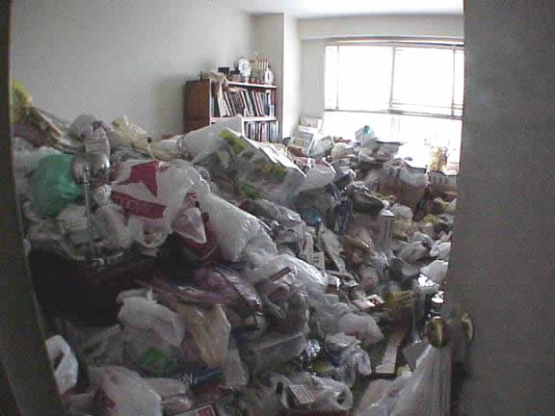
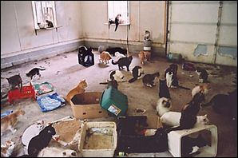
OCD-Related Disorder
Hoarding Disorder including manifestation of Animal Hoarding
Notes:
10:23 min, but first few minutes are informative

Slide 32
Treatment of OCD
Behavior modification
Medications, particularly SSRI’s
Psychotherapy (e.g., CBT)

Slide 33
Trauma- and Stressor- Related Disorders
Posttraumatic Stress Disorder (PTSD)
Acute Stress Disorder
(Several others)

Slide 34
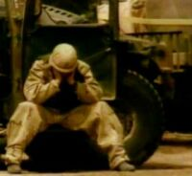
Post Traumatic Stress Disorder
Psychological and physiological response to an extreme stressor

Slide 35
PTSD
An acute acquired mental disorder that can occur soon after trauma or can have a delayed onset of more than 6 months after the trauma
The associated trauma must be an event that is outside the range of normal human experience and would be seriously disturbing to anyone.
(APA, 2013)
Notes:
Examples of types of trauma
War related Activities
Assault or Rape
Natural Disaster
Witnessing Serious Violence
Accident
Destruction of home or community
Child or domestic abuse

Slide 36
PTSD
Exposure to actual or threatened death, serious injury, or sexual violence in 1+ of the following ways:
Direct experience
Witnessing the event occur to someone else in person
Learning of the traumatic event(s) occurring to a close family member or friend
Experiencing repeated or extreme exposure to aversive details of traumatic events

Slide 37
PTSD cont’d
Presence of 1+ of the following intrusive sx’s associated with the event:
Recurrent, involuntary, and intrusive distressing memories of the traumatic event
Recurrent distressing dreams about the event
Dissociative reactions (e.g., flashbacks) as if reexperiencing event
Psychological distress at exposure to cues
Physiological reactions at exposure to cues

Slide 38
PTSD con’t
Avoidance associated with the event either internally or externally
Negative alterations in cognitions and mood
Alterations in arousal and reactivity
Lasts > 1 month

Slide 39
Treatment for PTSD
Cognitive Behavioral Therapy: Trauma Focused
SSRI’s, Anti-Anxiety medication
Family support and education
Watch closely for heavy drinking and/or drug abuse
Watch closely for suicide risk
Major Depression very common

Slide 40
Acute Stress Disorder
Similar to PTSD symptoms, but different in terms of duration
Occurs no longer than 1 month of the traumatic event

Slide 41




We all have anxiety sometimes- here’s what helps
Rest,
take
breaks
Sit
Quietly,
Meditate, do Yoga
Or Tai-Chi
Play, laugh

Slide 42
Nursing Assessment and DX
Assessment of anxiety level and other problem identification
NANDA
Anxiety
Ineffective coping
Readiness for enhanced coping
Fear
Other ND may also apply

Slide 43
Goals for Moderate Anxiety
Patient will identify and describe feelings of anxiety
Patient will identify antecedents of anxiety
Patient will describe adaptive and maladaptive coping responses
patient will implement 2 adaptive responses for coping with anxiety

Slide 44
Goals for Severe and Panic Anxiety
Patient will be protected from harm
Patient will experience fewer anxiety-provoking situations
Patient will engage in a daily schedule of activities
Patient will experience relief from symptoms of severe anxiety

Slide 45
Nursing interventions for stress and anxiety
Safety, comfort
Decrease stimuli
Self-awareness of anxiety level
Clear and simple approach
Use of short, simple sentences
Low, calm voice
Encourage/teach stress management strategies
Relaxation techniques/exercises
Sleep & nutrition
Medication administration

Slide 46
CAM
Diaphragmatic breathing
PMR
Energy therapies (e.g., Reiki)
Yoga
Meditation
Acupuncture
Herbals (kava, valerian)
Patients do use these…ask

Slide 47


Slide 48

PHARMACOTHERAPY

Slide 49
Overview
Medications act largely at the amygdala increasing serotonin and enhancing g-aminobutyric acid (GABA)
Antidepressants
Benzodiazepines
Non-benzodiazepine anxiolytics

Slide 50
Antidepressant treatment
SSRIs are first-line treatments for chronic anxiety symptoms associated with Panic Disorder, Phobias, Social Anxiety Disorder, and OCD.
Serotonin dysregulation
therapeutic effects may take 3-6 weeks for depression and 12-16 weeks for anxiety.

Slide 51
Selective Serotonin Reuptake Inhibitors (SSRIs)
Fluoxetine (Prozac, Sarafem): 20-80mg/day for depression and anxiety disorders; 60-80mg/ day for bulemia. Prozac weekly: 90mg.
Fluvoxamine (Luvox): 100-300mg/day for OCD; 100-200 mg/day for depression
Paroxetine (Paxil): 20-60 mg/day
Sertraline (Zoloft): 50-200 mg/day
Citalopram (Celexa): 20-60mg/day
Escitalopram (Lexapro): 10-20mg/day

Slide 52
Benzodiazepines
Benzodiazepines are used for acute anxiety and agitation
Mechanism of action: potentate the effect of g-aminobutyric acid (GABA), inhibiting neurotransmission in limbic system and cortex
Anti-anxiety effects in 30-60 minutes
Use lowest possible effective dose for shortest possible period of time

Slide 53
Benzodiazepine: Duration of Action
Shorter Half-lives
Advantages
No drug accumulation
Less daytime sedation
Disadvantages
More frequent dosing
Earlier and more severe withdrawal syndromes
Rebound insomnia
Longer Half-lives
Advantages
Less frequent dosing
Less variation in plasma concentration
Less severe withdrawal
Disadvantages
Drug accumulation
Daytime sedation
Daytime psychomotor impairment

Slide 54
Benzodiazepines: Half-lives
Long acting benzodiazepines treat anxiety disorders, seizures, ETOH withdrawal
Clonazepam (Klonopin): 18-50 hrs
Diazepam (Valium): 20-80 hrs
Intermediate acting benzodiazepines commonly treat anxiety symptoms
Alprazolam (Xanax): 6-27 hrs
Lorazepam (Ativan): 10-20 hrs
Short acting benzodiazepines treat sleep onset insomnia, and may be used for preoperative anesthesia
Triazolam (Halcion): 1.5-3 hrs.

Slide 55
Management of Benzodiazepine Side Effects
Common Side Effects:
Drowsiness, fatigue, depression, dizziness, ataxia, slurred speech, weakness, forgetfulness
Risk for injury (falls, accidents) especially in elderly
Avoid alcohol or other CNS depressants
OTC drugs may potentiate the actions
Driving should be avoided until tolerance develops
Deficient Knowledge: Patient Teaching
Do not use to treat minor stresses of everyday life
Do not discontinue abruptly
Take with food if GI upset occurs
Report symptoms of urinary incontinence
Discontinue during pregnancy and breast feeding

Slide 56
Discontinuation of Benzodiazepines
Because of the risk of physical dependence, long-term use should be carefully monitored. The drugs should be tapered at discontinuation.
Discontinuation syndromes depend on the length of time on drug, the dosage taken, the rate of taper, and the half-life. The higher the dose and, the shorter the half-life, the more severe the withdrawal symptoms.
Withdrawal symptoms include: anxiety, nervousness, diaphoresis, restlessness, irritability, fatigue, light-headedness, tremor, insomnia, weakness,
risk for seizures and death.

Slide 57
Non-benzodiazepine anxiolytics
Serotonin Partial-agonist: Buspirone (BuSpar)
Usual dose: 20-30 mg/day
Therapeutic effects may take 4 weeks
No physiological dependence
Beta-blockers: Propranolol (Inderal)
Useful for performance anxiety where tremor might be a problem
Usual dose: 10-20 mg bid or tid
Alpha-2 agonist: Clonidine
Medication to decrease NE production at locus cereleus

Slide 58
Summary of Interventions: Pathological Stress and Anxiety
Combined therapy and meds gives best results
Psychotherapy
Positive reframing
Decatastrophizing
Assertiveness training
Utilizing coping strategies

Slide 59
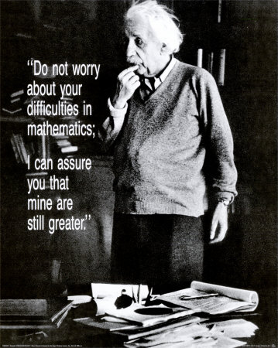
Maintain
perspective

