Slide 1
T-test
Tests the differences in the means between two groups
Answers the question: Is there a difference?
Compares the differences in the means of two groups.
Test scores by … (attended class vs not)
Height by …(gender)
Miles per hour by …. (moped vs bicycle)
Number of cigarettes smoked by …. (COPD vs not)
Generates a t-value using group means,variabilility and sample size.

Slide 2
T-test
One nominal variable – grouping variable
Independent variable
What varies is the group membership
Married and not married
Male and Female
Intervention and Control
One “continuous” variable –calculating the mean
Outcome or dependent variable
Ordinal, interval and ratio level → treated as continuous

Slide 3
Credit for graphics on several slides in this section
http://www.socialresearchmethods.net/kb/stat_t.php

Slide 4
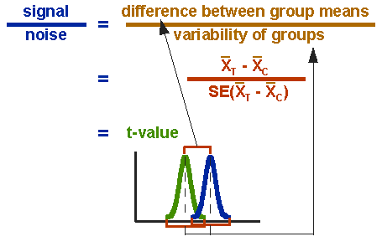

Slide 5
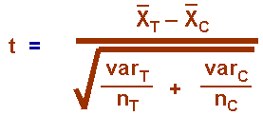
Difference between means
Variance
Sample size

Slide 6
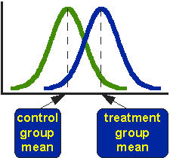

Slide 7
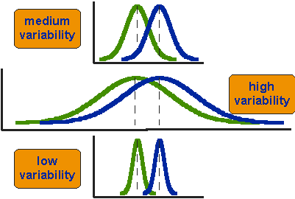
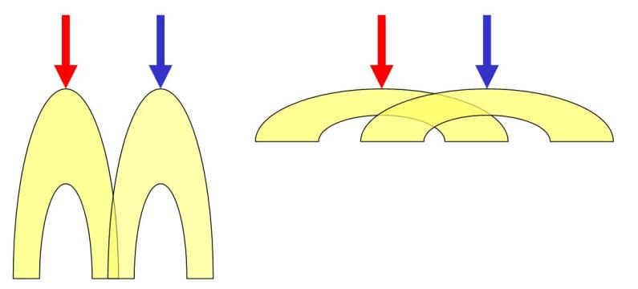
The higher the t value is, the more likely that the two means are different.

Slide 8
Degrees of freedom
Number of observations free to vary about a parameter
say you have three scores (e.g., test scores from a class), you know the first two scores 76 and 72 and you know the average (mean), say 78, then you can figure out the third test score by solving (76+72+x)/3 =78. Even though there are three test scores, one of them is determined by the other two (given the mean). So there are only "two degrees of freedom."
For paired t-test
Degrees of freedom= n-1, where n is the number of pairs
For an independent t-test :
the number of degrees of freedom is (n₁ + n₂)-2

