Slide 1
What is the Shapiro-Wilk Test?
The Shapiro-Wilk test is a way to tell if a random sample comes from a normal distribution.
The Shapiro-Wilk test is based on the correlation between the data and the corresponding normal scores
The test gives you a W value; small values indicate your sample is not normally distributed (you can reject the null hypothesis that your population is normally distributed if your values are under a certain threshold). The formula for the W value is:
WHERE: X_{I} ARE THE ORDERED RANDOM SAMPLE VALUES A_{I} ARE CONSTANTS GENERATED FROM THE COVARIANCES, VARIANCES AND MEANS OF THE SAMPLE (SIZE N) FROM A NORMALLY DISTRIBUTED SAMPLE.
THE TEST HAS LIMITATIONS, MOST IMPORTANTLY THAT THE TEST HAS A BIAS BY SAMPLE SIZE. THE LARGER THE SAMPLE, THE MORE LIKELY YOU’LL GET A STATISTICALLY SIGNIFICANT RESULT.

Slide 2
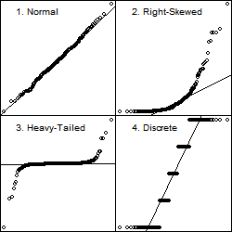
Q-Q plot
Q-Q plot is a graphical tool used to assess if a set of data plausibly came from a normal distribution
created by plotting two sets of quantiles against one another
If both sets of quantiles came from the same distribution, we should see the points forming a line that’s roughly straight

