Slide 1
Social Justice as Fairness:
The Ethical Theory of Johns Rawls
Jeffrey V. Johnson, Ph.D.
Professor and Director, Office of Global Health, UMSON
NRSG 780

Slide 2
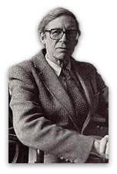
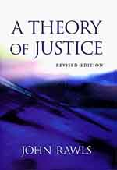
What is ‘Social Justice?’
John Rawls’ Theory of Justice

Slide 3
John Rawls’: Justice as Fairness
Focus on social starting positions
“What the theory of justice must regulate is the inequalities in life prospects between citizens that arise from social starting positions”;
“Basic structure (of society) is the primary subject of justice because its effects are so profound and present from the start.”
“The institutions of society favor certain starting places over others. These are especially deep inequalities that are pervasive and cannot be justified by an appeal to the notions of merit or desert.”

Slide 4
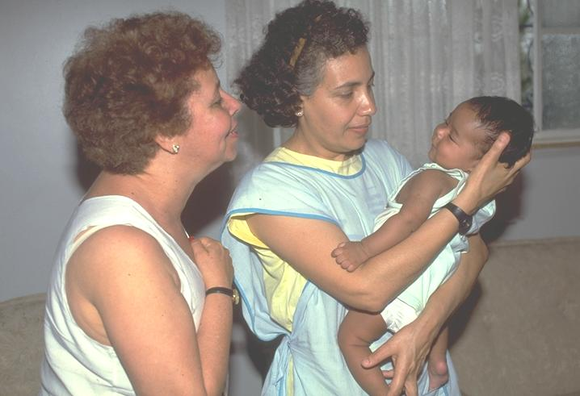
No One Has Control Over to Whom or Where They are Born

Slide 5
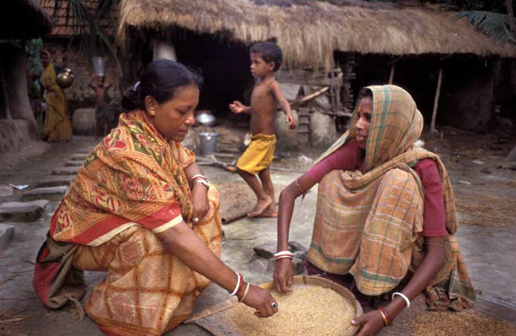
The Course of One’s Life is Influenced by the Circumstances of One’s Birth

Slide 6


Being Born Rich …

Slide 7
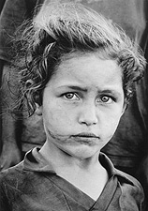
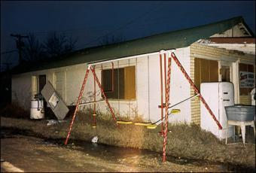

..or poor creates an environment that influences the entire life course.

Slide 8
Why is Jason in the Hospital?

Slide 9
Rawls: Social Justice Works for a ‘Fair System of Cooperation’
Goal of social justice is to make sure that social, economic and political institutions work in a fair, non-exclusive way
Social patterns are unjust if they hinge on victimizing or exploiting one group for the benefit of another

Slide 10
Rawl’s Theory has led to Social Policy Interventions
Social Protections and Redistribution efforts reduce the structural basis of poverty
  Example: Poverty among elderly was dramatically reduced after the passage of Medicare in the 1960s
Policy interventions directed at reducing the impact of poverty differ dramatically between economically developed countries.

