Slide 1
Health Inequities and the Social Class Gradient
Jeffrey V. Johnson, Ph.D.
Professor and Director, Office of Global Health, UMSON
NRSG 780

Slide 2
Why Do Top People Live Longer?
“I’ve been poor, and I’ve been rich. Rich is better.” -- Sophie Tucker
We know poverty is ‘bad for you.’
Yet, there are large differences in health status not just on the basis of poverty, but across the entire class gradient

Slide 3
Example: The Whitehall Study
Marmot and co-workers have followed ten thousand British civil servants for over 2 decades.
Person specific and longitudinal data.
Unambiguous group characteristics: status
risk gradient from top to bottom of the occupational status hierarchy.

Slide 4
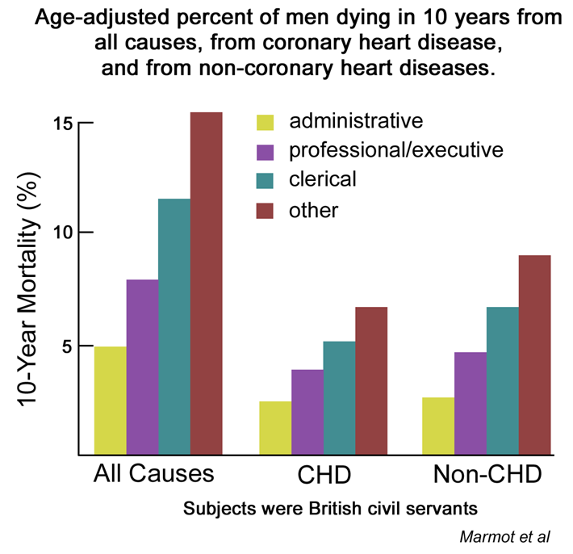
The British Whitehall Study

Slide 5
Class Gradient also exists in developing countries

