Slide 1

Primary, Secondary and Tertiary Prevention: Model Population-based Prevention Program
Susan Wozenski, JD, MPH
Vice Chair, Family and Community Health
MS/MPH Program Director
wozenski@son.umaryland.edu

Slide 2
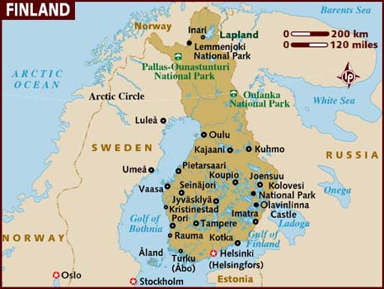

Slide 3
At the end of the 1960s, Finnish men, especially men in North Karelia, had the highest international rates of coronary heart disease mortality.
Vartiainen, E., et.al. Thirty-five-year trends in cardiovascular risk factors in Finland. International Journal of Epidemiology 2010; 39:504-518 citing Thom, T, et. Al., Total mortality and mortality from heart disease, cancer and stroke from 1950 to 1987 in 27 countries: National Institutes of Health; 1992. Report No.: 92-3088

Slide 4
North Karelian Petition to the Finnish Government
The petition stated that national authorities and organizations “should urgently undertake efficient action to plan and implement a program which would organize and finance general health information to the public, necessary basic research, and individual health education to reduce this greatest public health problem of the country.”

Slide 5
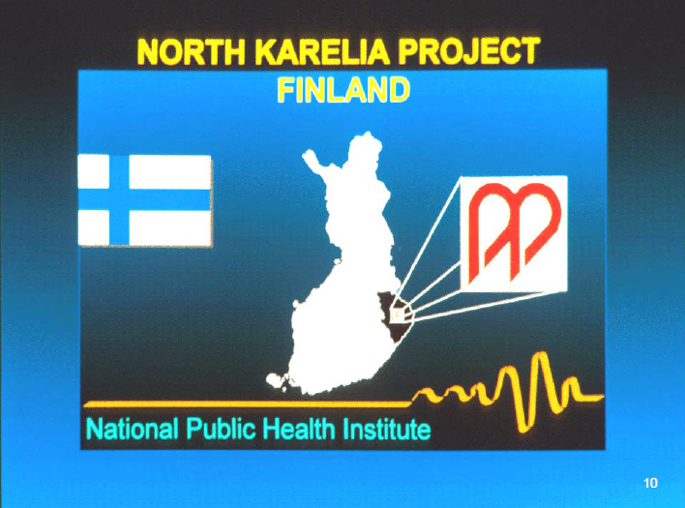

Slide 6
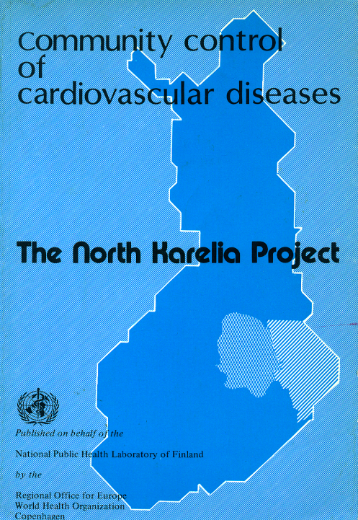

Slide 7
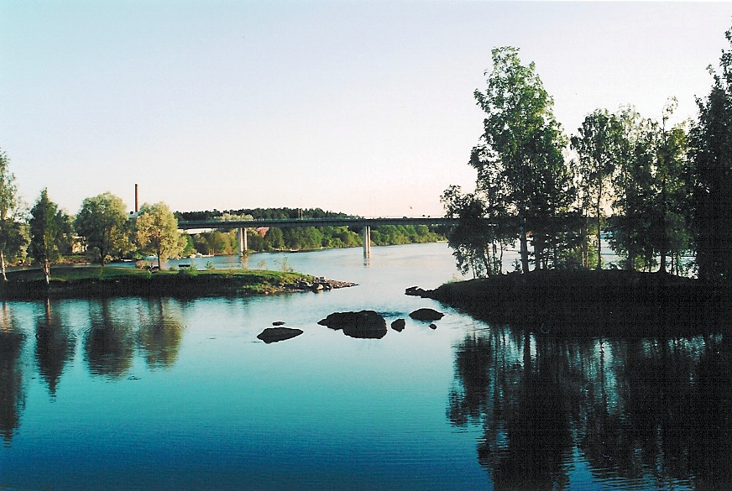

Slide 8


Slide 9
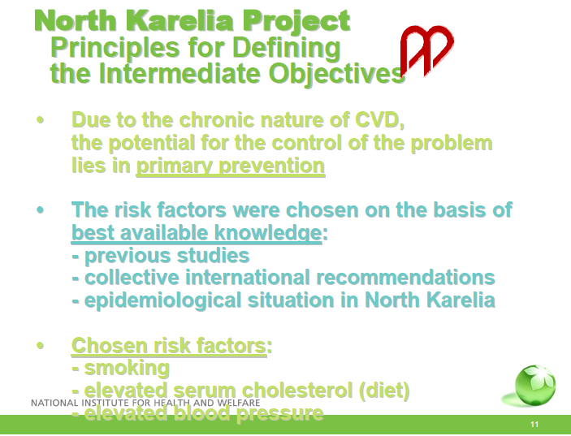


Slide 10
Key Components of the North Karelia Project
Informing the public
Reorganizing services
Training personnel
Environmental changes
Evaluation services

Slide 11
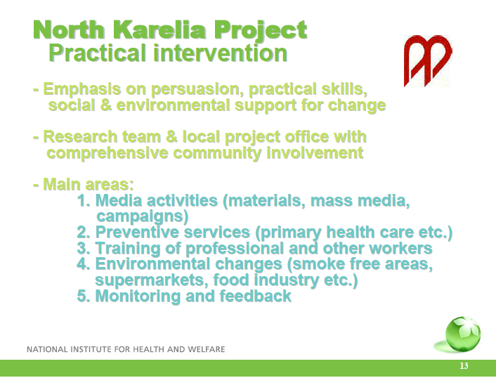

Slide 12
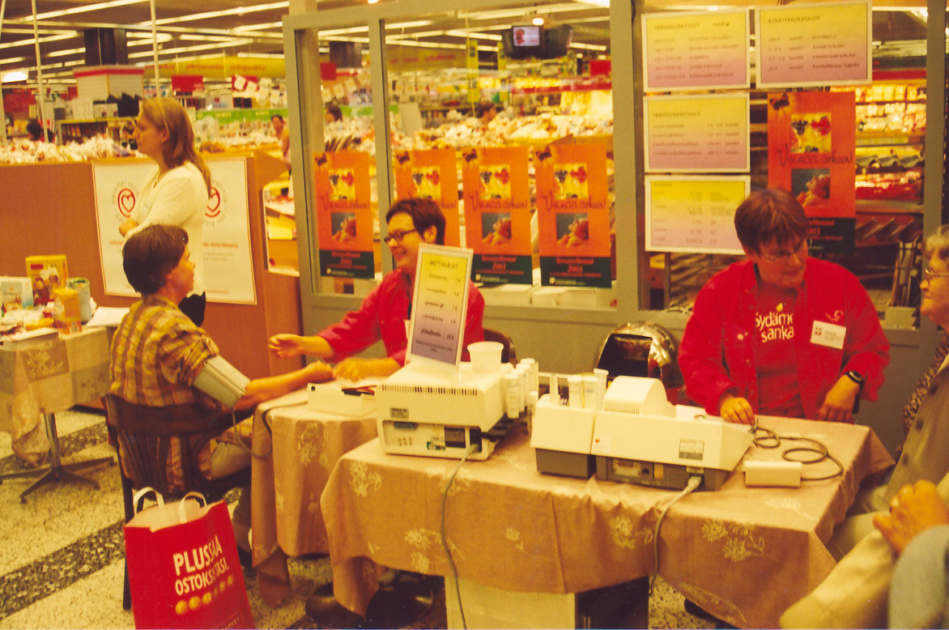

Slide 13
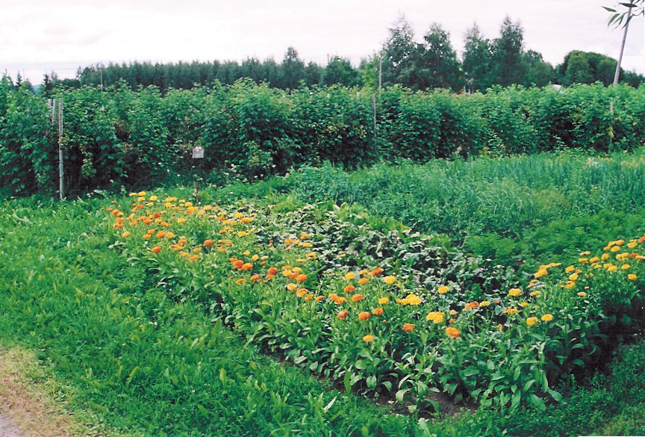

Slide 14
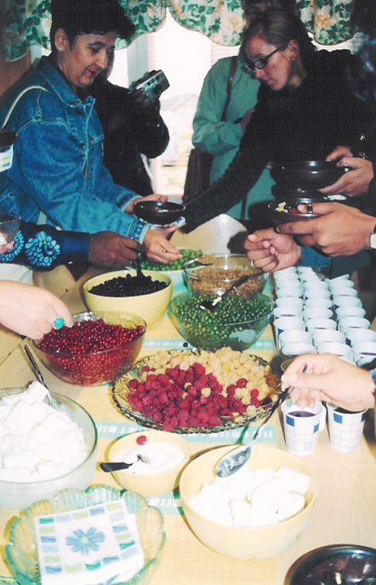

Slide 15
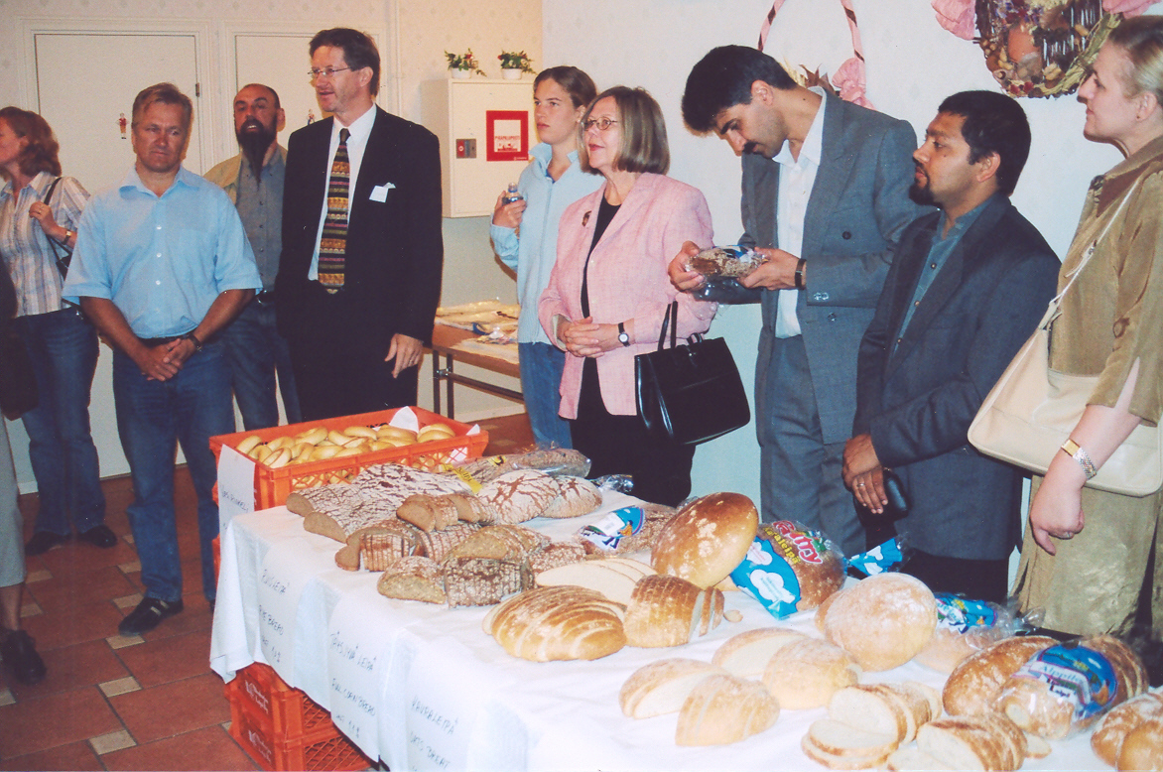

Slide 16
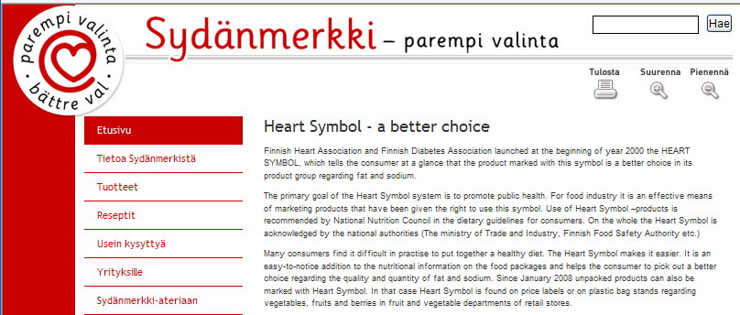



Slide 17
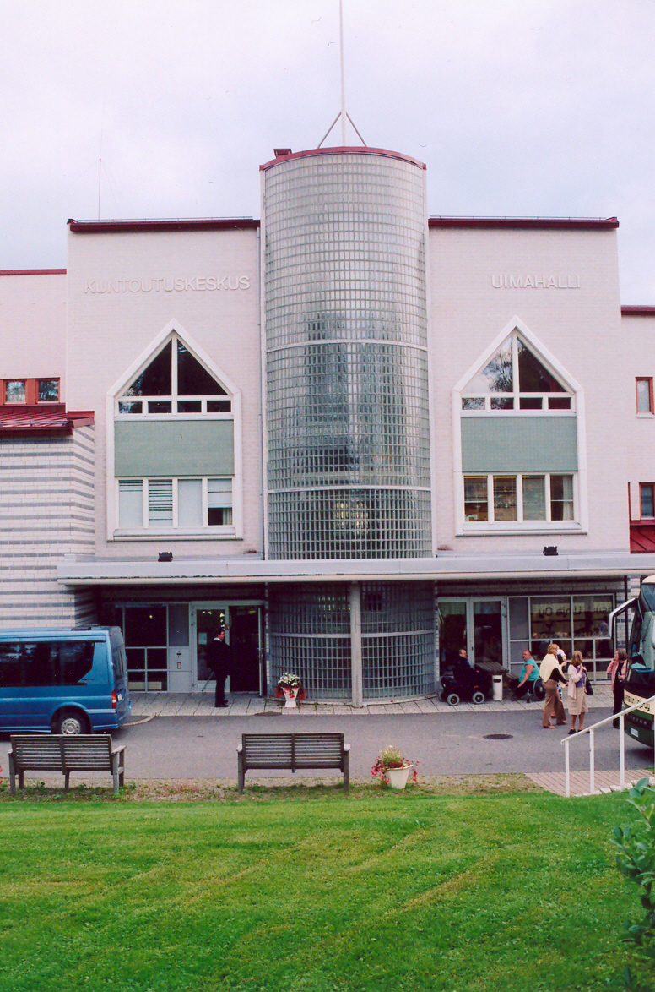

Slide 18


Slide 19
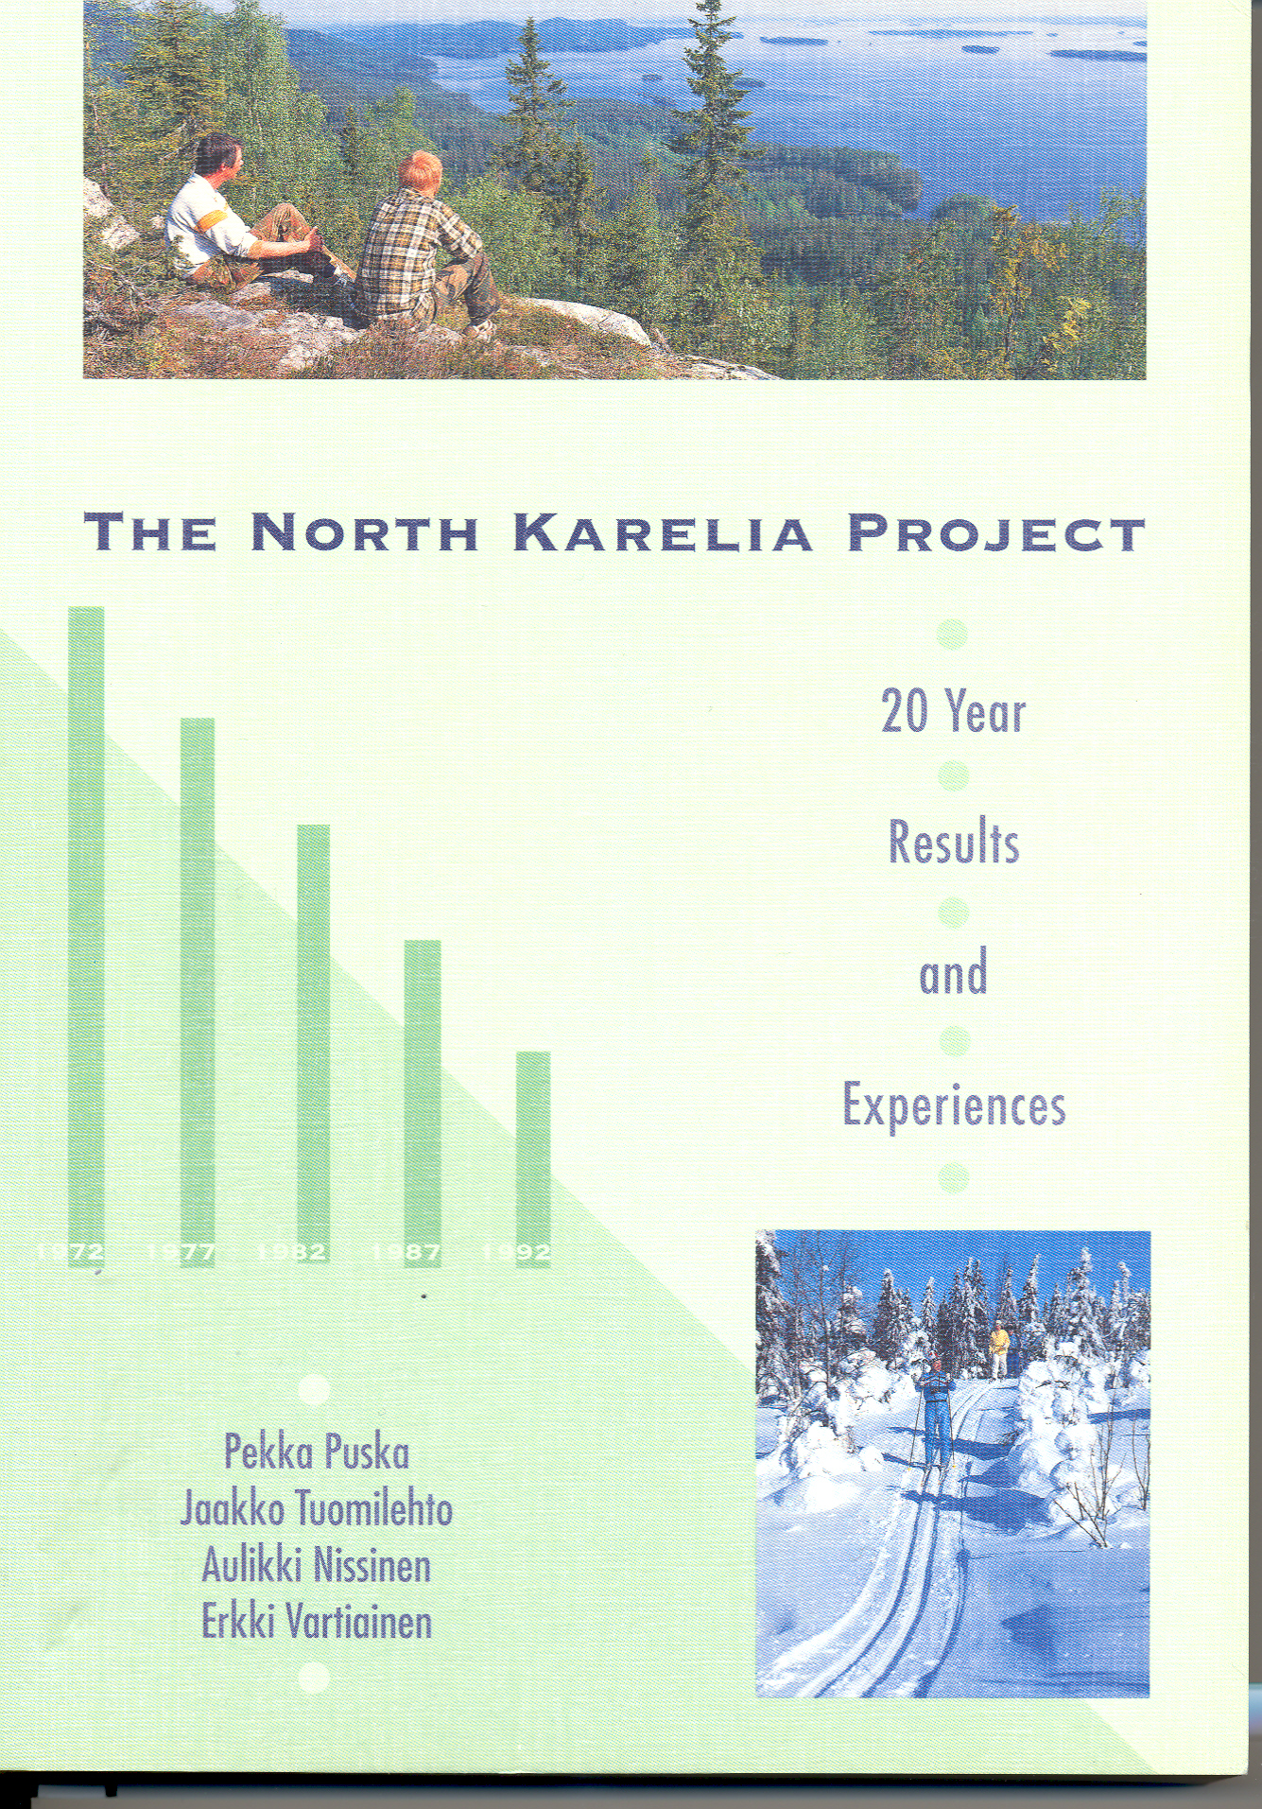

Slide 20
Prevalence of CHD Risk Factors in NK, 1972 vs. 1992
1972 1992
High cholesterol
Men 60% 27%
Women 56% 17%
High blood pressure
Men 65% 49%
Women 65% 39%
Smoking
Men 52% 32%
Women 10% 17%
Vartiainen E et al. Int J Epid 2000; 29:49-56.

Slide 21
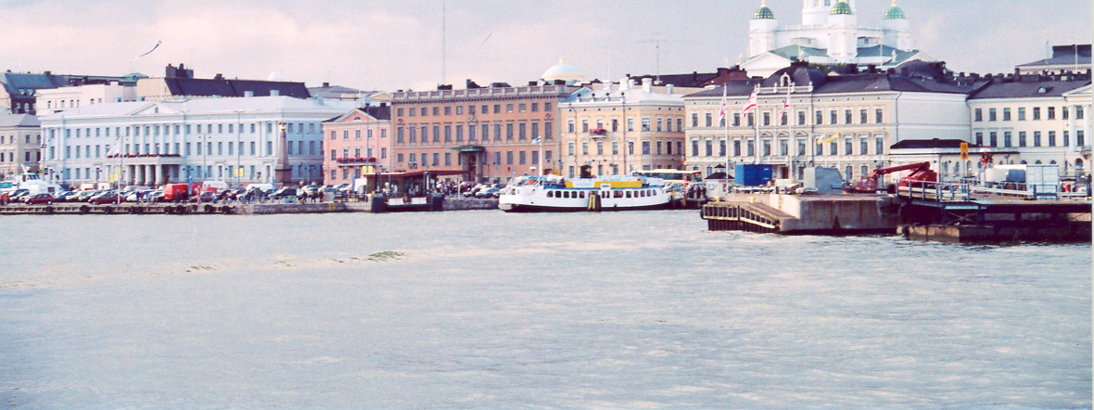

Slide 22
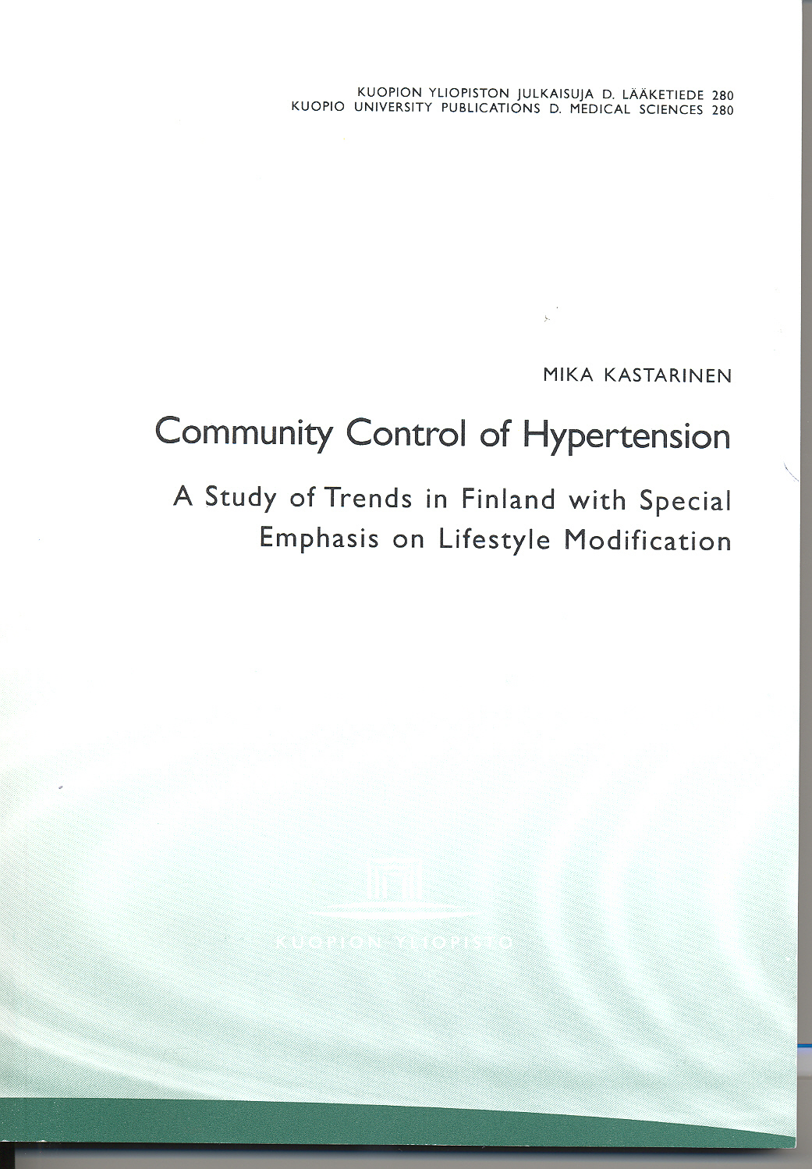

Slide 23
Declines in Mean Level of CHD Risk Factors of Finnish Men Aged 35-64
blood pressure
D
e
c
l
i
n
e
cholesterol
smoking
Vartiainen E et al, BMJ 1994; 309: 23-27.

Slide 24
Changes in Mean Level of CHD Risk Factors in Finnish Women Aged 35-64
Chang
e
smoking
blood pressure
cholesterol
Vartiainen E et al, BMJ 1994; 309: 23-27.

Slide 25
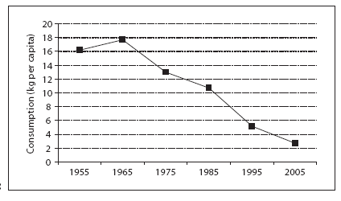
Butter consumption per capita in Finland
Puska, P. (2009) Fat and heart disease: yes we can make a change—the case of North Karelia (Finland) . Annals of Nutrition and Metabolism 2009;54 (suppl 1) 33-38.

Slide 26
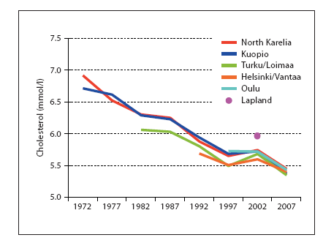
Serum Cholesterol in Men 30-59 1972-2007
Puska, P. (2009) Fat and heart disease: yes we can make a change—the case of North Karelia (Finland) . Annals of Nutrition and Metabolism 2009;54 (suppl 1) 33-38.

Slide 27
Changes in Salt Intake in Finland, 1972-2002
Karpannen H and Mervaala E. Prog Cardiov Dis 2006; 49:59-75.

Slide 28
Changes in Diastolic Blood Pressure in Finland, 1972-2002
Karpannen H and Mervaala E. Prog Cardiov Dis 2006; 49:59-75.

Slide 29
Changes in Mortality from Stroke in Finland, 1968-2002
Karpannen H and Mervaala E. Prog Cardiov Dis 2006; 49:59-75.

Slide 30
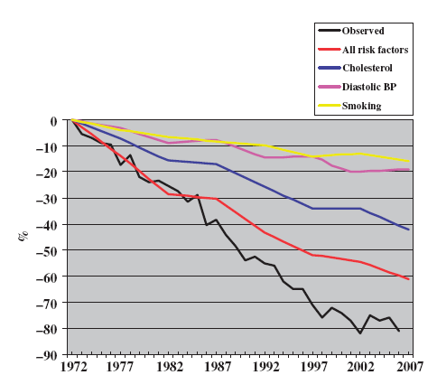

Observed and Predicted Decline in CHD Mortality in Men 1972-2007
Vartiainen, E., et.al. (2010) Thirty-five-year trends in cardiovascular risk factors in Finland

Slide 31
Decline in CHD Risks and Mortality, Finnish Men Aged 35-64
smoking
D
e
c
l
i
n
e
blood pressure
cholesterol
predicted
observed
Vartiainen E et al, BMJ 1994; 309: 23-27.

Slide 32
Changes in CHD Risks & Mortality, Finnish Women Aged 35-64
smoking
D
e
c
l
i
n
e
blood pressure
cholesterol
predicted
observed
Vartiainen E et al, BMJ 1994; 309: 23-27.

Slide 33
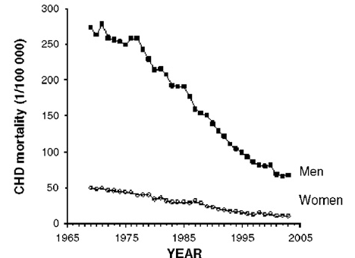
Changes in Mortality from CHD in Finland,
1968-2002
Karpannen H and Mervaala E. Prog Cardiov Dis 2006; 49:59-75.

Slide 34
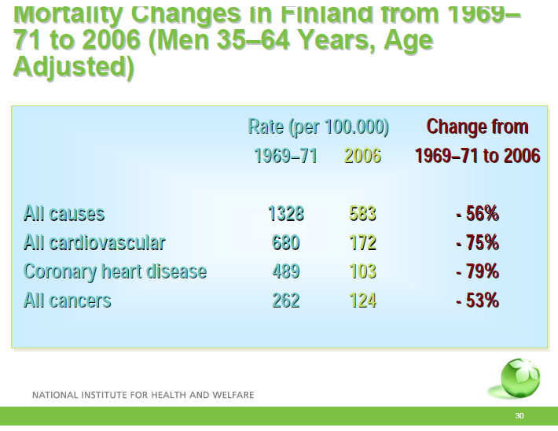

Slide 35
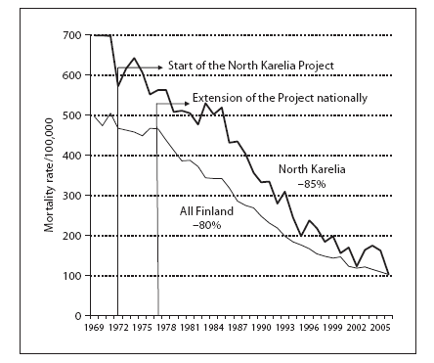
Finnish Mortality Rate per 100,000 1969-2005
Puska, P. (2009) Fat and heart disease: yes we can make a change—the case of North Karelia (Finland) . Annals of Nutrition and Metabolism 2009;54 (suppl 1) 33-38.

Slide 36
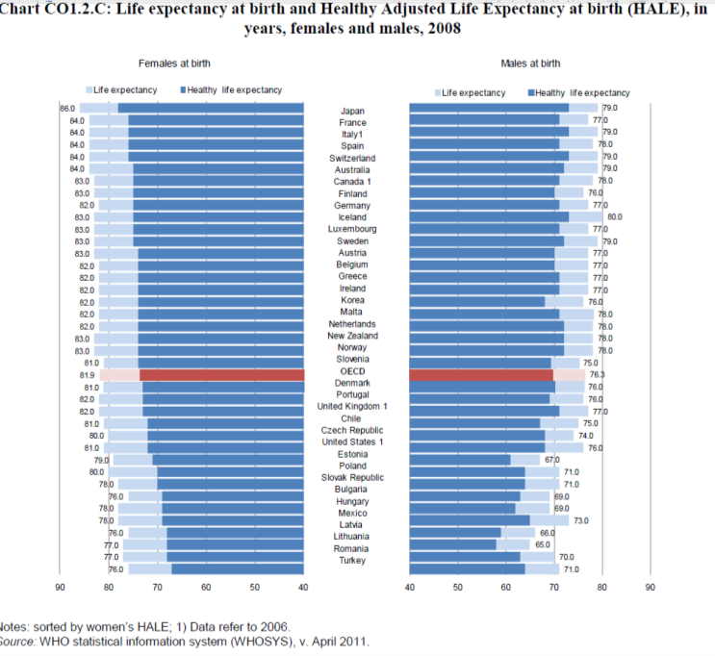

Slide 37
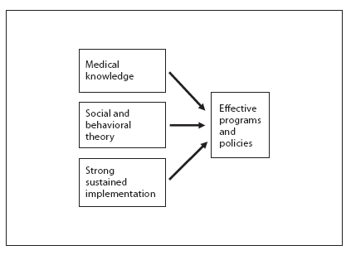
Theory and Action for Effective Programs and Policies
Puska, P. (2009) Fat and heart disease: yes we can make a change—the case of North Karelia (Finland) . Annals of Nutrition and Metabolism 2009;54 (suppl 1) 33-38.

Slide 38
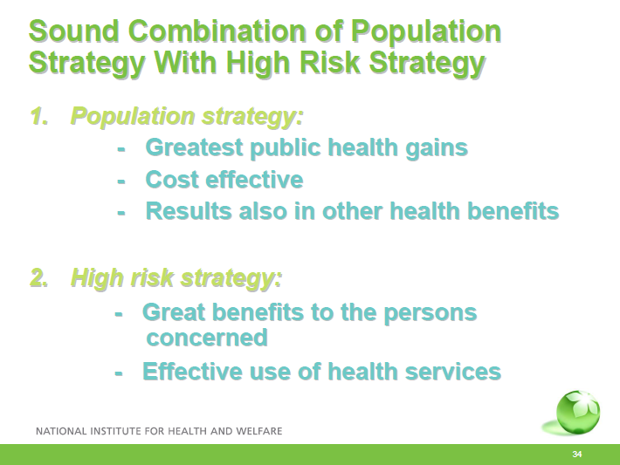

Slide 39


Slide 40
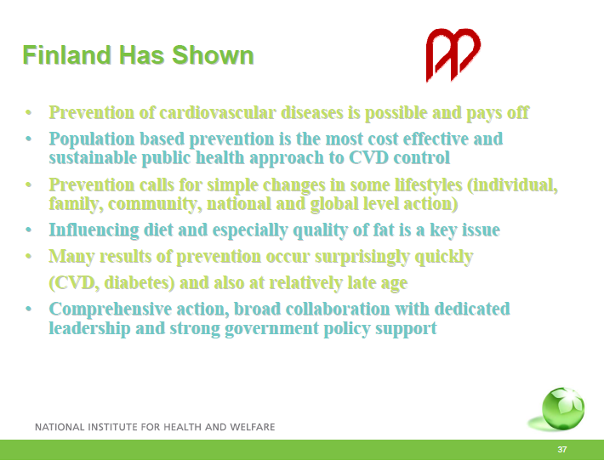

Slide 41
Summary
Think upstream
Recognize the importance of primary, secondary and tertiary prevention
Become familiar with clinical guidelines for clinical and population-based practice
Apply this in your practice and in developing population-based programs

