Slide 1
General survey, HEENT, Neck, Cranial Nerves

Slide 2
Objectives HEENT, Neck and CNs:
Demonstrate normal exam components for adult
State normal exam components for pediatric patient
Identify abnormal findings and tests
Explain rationales for focused exam
Document accurate findings

Slide 3
Common or Concerning Symptoms
Head | Headache, history of head injury
Eyes | Visual disturbances, spots (scotomas), flashing lights, use of corrective lenses, pain, redness, excessive tearing, double vision (diplopia)
Ears | Hearing loss, ringing (tinnitus), vertigo, pain, discharge
Nose | Drainage (rhinorrhea), congestion, sneezing, nose bleeds (epistaxis)
Oropharynx | Sore throat, gum bleeding, hoarseness,
Neck | Swollen glands, goiter

Slide 4
Focused Exam-Adults
HEENT & Neck

Slide 5
Adults—Exam Techniques
How to examine….Head
Ophthalmoscope exam
Position to examine inner ear
How to examine nares
Mouth/tongue
Oral Exam
Cranial Nerves

Slide 6
Focused Exam—Adult Case
Chief complaint:
Susan J. is a 33-year-old married factory worker who presents with a 6-day history of nasal congestion and rhinorrhea.
How would you document Chief Complaint?
Answer: In quotes, the patient’s own words

Slide 7
History Questions
What are the HPI components?
OLDCART
Based on chief complaint, what HEENT history needs to be asked?
PMH, FH, SH
What information must be asked for every episodic?
1.Medication Allergies
2. Medications
What information must be asked for every childbearing woman?
LMP
Notes:
Onset, location, duration, associated/aggravating, relieving, treatments, characteristics/course
Ask about history of allergies/asthma, family history of asthma, allergies, occupation triggers, smoking, etc habits
Medications, allergies, LMP

Slide 8
History Answers
HPI: Onset, location, duration, associated/aggravating, relieving, treatments, characteristics/course
PMH, FH, SH: Ask about history of allergies/asthma, family history of asthma, allergies, occupation triggers, smoking, habits
All episodic visits: Medications, allergies
All childbearing women: LMP

Slide 9
Adult Episodic Case: Susan
History of Present Illness
She was well until 6 days ago when she developed nasal congestion, a nonproductive cough, and clear rhinorrhea (onset, location, timing)
Her nasal discharge became greenish yellow on the day of her visit, and she now asks for antibiotics for what she believes is a sinus infection (quality/perception).
She complains of a constant generalized headache and pain in her nose and cheeks when she bends forward (severity/quality/aggravating/setting) .

Slide 10
Adult Episodic Case--Susan
She admits to occasional chills and sweats but has not taken her temperature (associated symptoms)
She denies pain in her teeth and has obtained minimal relief from over-the-counter decongestants (relieving/treatment).
She denies using decongestant nose sprays.
She says she has at least one or two “sinus infections” every year, and she cannot seem to get over them unless she takes an antibiotic.

Slide 11
Susan--History
Past Medical History
Susan has had two vaginal deliveries but no other hospitalizations. LMP: 2 weeks ago. She denies any history of serious illnesses or surgery.
She has no history of asthma or hay fever
Allergies: no history of drug, food, or seasonal allergies.
Medications: oral contraceptive

Slide 12
Susan--history
Family History
There is no history of hay fever or asthma in the family.
Father: HTN and elevated cholesterol. Mother: osteoarthritis. Her only sibling, an older brother, is alive and well. No grandparent history available.
Social History
Nonsmoker
Alcohol 1-2 drinks/week (wine).
Sexually active & monogamous
Denies illicit drug use.
Works on an electronics assembly line and helps her husband on the farm during the “busy season.”

Slide 13
Questions
What ROS questions need to be asked?
Cover HEENT, Neck, CV, Resp, GI
What systems need to be examined for this episodic/focused exam?
HEENT, Neck, CV, Resp, GI
What system must be examined on every episodic case?
Skin

Slide 14
Review of Symptoms-Susan
General: As in HPI. No weight loss
Head: Pain in frontal/maxillary sinus area, no dizziness, some lightheadedness
Skin: no rashes, lumps or sores
Eyes: no pain, redness, or excessive tearing, no vision changes
Ears: no pain, no discharge, no change in hearing
Nose: clear to green discharge noted, no nosebleeds, sinus infections 1-2 per year
Throat: no bleeding gums, no sore throat, or hoarseness
Oral: No painful teeth, no recent dental work
Neck: no swollen glands, pain or stiffness of neck
Respiratory: nonproductive cough, no shortness of breath or wheezing
Cardiovascular: no chest pain, palpitations, or paroxysmal nocturnal dyspnea
GI: no nausea, vomiting, constipation or diarrhea

Slide 15
Focused Exam--Susan
General Survey
Vital Signs
Skin
HEENT, Neck
Lungs
Cardiovascular
Abdomen

Slide 16
Exam Findings: Documentation
Normal: regular text
Abnormal: bold text

Slide 17
Exam Findings: Documentation
General Survey: Alert, WD, WN white woman with NAD, A & O x 3
VS: BP 110/70 mm Hg. HR 80, RR 20, T 98.8F
Skin: no rash
HEENT: Normocephalic, atraumatic; PERRLAC, disc margins sharp; fundi without hemorrhages or exudates; External ear canals patent; TMs with serous fluid bilaterally. Tenderness with palpation over maxillary sinuses. Nasal mucosa pink with clear discharge noted. Nasal patency decreased bilaterally. Oral mucosa; pharynx slight erythema, post-nasal drip, tonsils 2 +,without exudates.
Neck: supple, without lymphadenopathy
Respiratory: Thorax symmetric with good expansion; lungs resonant; breath sounds vesicular
CV: rate regular, S1, S2 without S3 or S4; no murmurs, rubs or clicks
GI: Bowel sounds present., abd soft, non tender to light & deep palpation. No masses noted.

Slide 18
Pediatric Considerations & Focused Exam for HEENT, Neck

Slide 19
How to Approach a Child for Exam
What’s different from examining an adult?
Infant
Toddler/preschool
School age
Adolescent
Sequencing for HEENT and Neck—depends on age of child

Slide 20
Head Exam: Key Points
Head Circumference: Frontal to Occipital
Fontanels/sutures:
Anterior closes at 10-18 months, posterior by 2 months
Symmetry & shape: Face & skull
Facial expression: Sadness, signs of abuse, allergy, fatigue
Abnormal facies: “Diagnostic facies” of common syndromes or illnesses
Temporal bruits—can be normal up to age 5
Hair: Patterns, loss, hygiene, pediculosis in school aged child

Slide 21
Eyes Exam: Key Points
Always check red reflex
Strabismus and Amblyopia (preschool child (cover/uncover test, corneal light)
Tumbling “E”, Allen, Snellen charts for older children (visual acuity)
PERRLA
EOMs: tracking 6 fields of vision
Fundoscopic exam of internal eye & retina

Slide 22
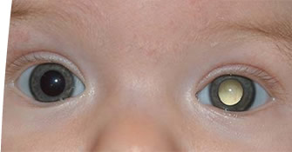
www.stjude.org/retinoblastoma
For more information: http://s.stjude.org/multimedia/disease_summaries/retinoblastoma/spotlight_retinoblastoma_0602.swf
Notes:
Leukocoria means white pupil

Slide 23
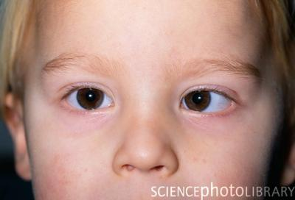
http://lasereyesurgeons.net/strabismus

Slide 24
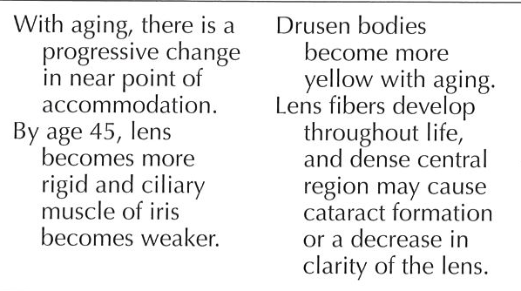
Geriatric --Eyes
Normal Typical Variations

Slide 25
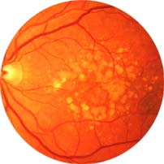
Drusen bodies

Slide 26
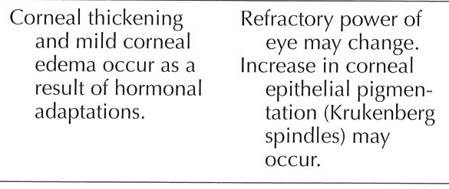
Pregnancy--Eyes
spindle-shaped, vertical deposit of chocolate-brown coloured pigment in the cornea of the eye, created by flakes of pigment rubbed off the back of the iris.

Slide 27
Ears Exam: Key Points
Examine last in younger children, hold young children in lap, head braced against parent’s chest
Hearing: language delay or frequent otitis media
Otoscope exam:
Pull auricle down & back for infants, toddlers, preschoolers
Pull auricle up & back for school aged & adolescents
Cerumen removal may be necessary
Use pneumatic otoscopy
Tuning fork:
Weber & Rinne tests to differentiate conductive vs sensorineural

Slide 28
Conductive vs. Sensorineural
Conductive hearing loss = external/middle ear dysfunction
(noisy environment helps)
Sensorineural hearing loss = inner ear
(sounds like people are mumbling, noisy environment worse)

Slide 29
Special Ear Tests
(See posted videos within module)
Weber and Rinne are quick office screenings. If you or your patient has any concern with their hearing , you refer to audiologist for diagnostic testing.
Pneumatic otoscopy is quite tricky. Don’t get discouraged!
Typanonometry- sensitive and specific for inner ear fluid, many office have these devices
Have a low threshold for referring young children to audiologist- speech and language development is heavily impacted by even short periods of hearing impairment

Slide 30
Ears: Abnormal Tests
Weber:
Unilateral conductive hearing loss= sound heard in impaired ear
Unilateral sensorineural hearing loss=sound is heard in good ear
Rinne:
Conductive: heard through bone as long or longer than air
Sensorineural: sound is heard longer through air (normal pattern prevails)

Slide 31
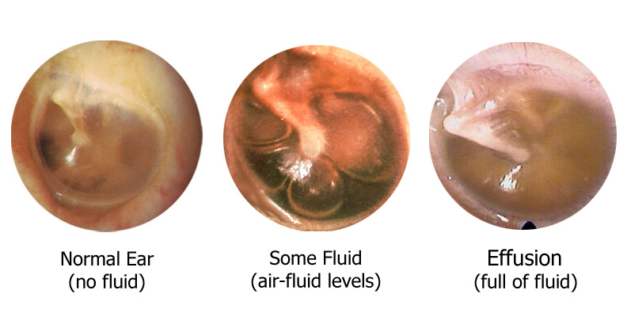
http://www.kids-ent.com/website/pediatric_ent/ear_infections/index.html

Slide 32
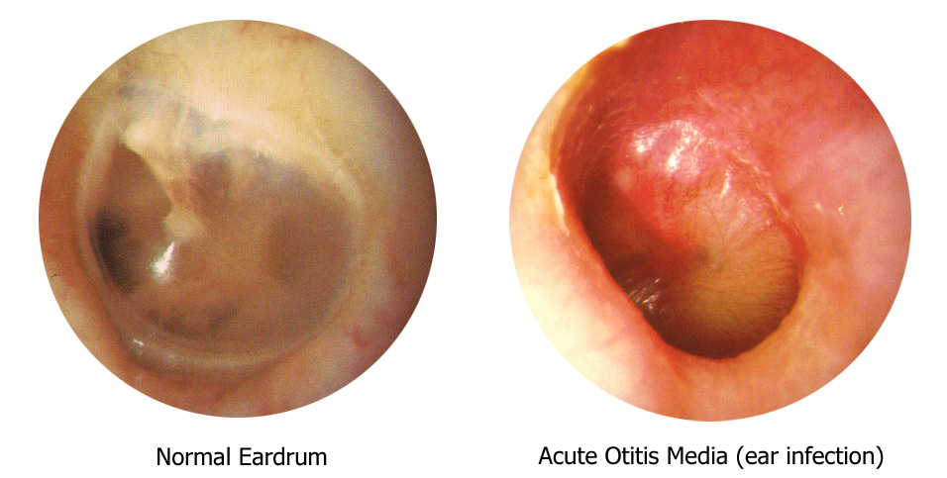
http://www.kids-ent.com/website/pediatric_ent/ear_infections/index.html

Slide 33
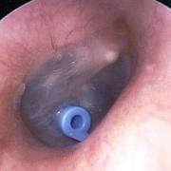
Tympanic Tube

Slide 34
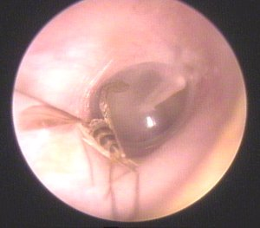
Visitors found in the ear

Slide 35
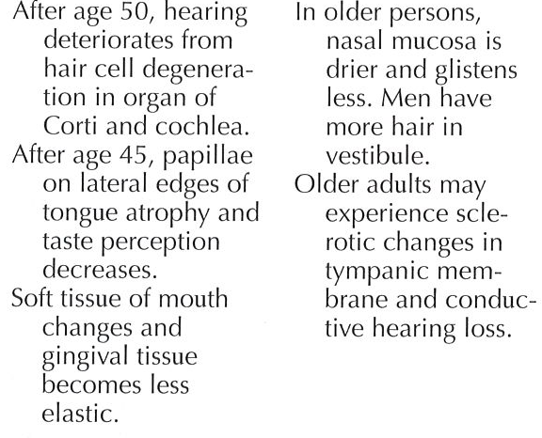
Geriatric--Ears

Slide 36
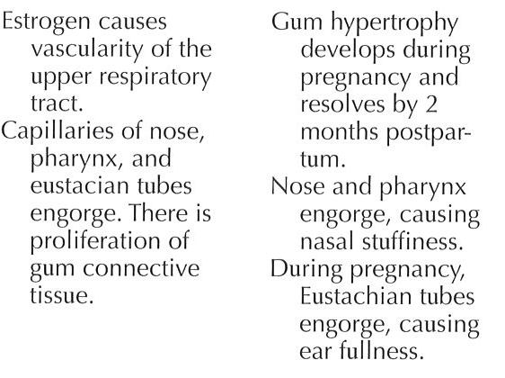
Pregnancy--ENT

Slide 37
Nose/ Mouth Exam: Pediatric Key Points
Exam nose & mouth after ears (after crying from ear exam)
Observe shape & structural deviations
Nares: (check patency, mucous membranes, discharge, inferior turbinates, bleeding, foreign bodies)
Septum: (check for deviation)
Infants are obligate nose breathers
Nasal flaring is associated with respiratory distress

Slide 38
Sinuses Exam: Key Points
Palpate maxillary & frontal sinus areas for tenderness of sinusitis in older children
Age of Development
Maxillary cheek & upper teeth present @ birth
Ethmoid medial & deep to eye present @ birth
Frontal forehead & above eyebrow approximately 7 years
Sphenoid deep behind eye in occiput adolescence

Slide 39
Mouth & Pharynx Exam: Key Points
Inspect uvula for symmetrical movement
Observe for quality of voice
Observe infants for rooting and sucking reflexes
Observe breath for halitosis
Grade Tonsils
Malampati Score (Aacute care and Anesthesia)

Slide 40
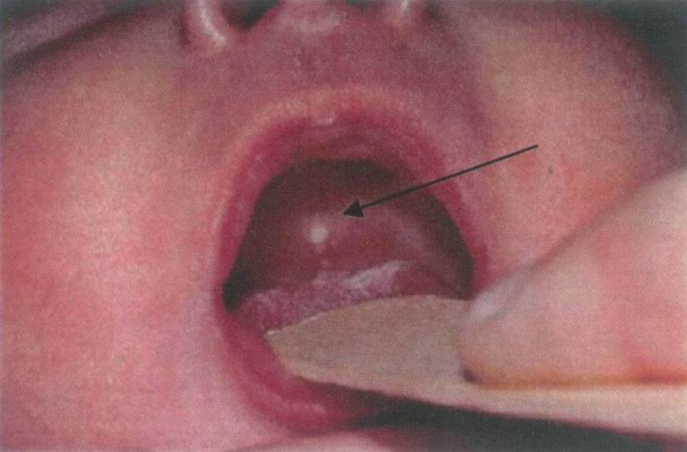
Epstein Pearl: normal in newborn
Notes:
Epstein pearl 80% of newborns—whitish/yellow
Disappears in 1-2 weeks. Can be on gums.

Slide 41
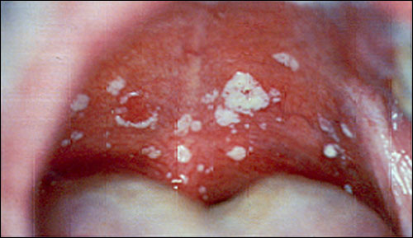
Thrush--abnormal

Slide 42
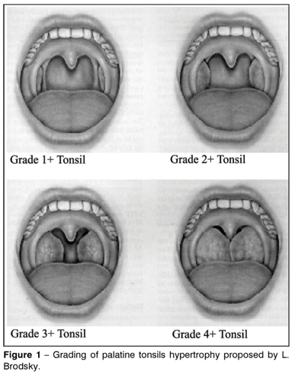
Grading of Tonsils

Slide 43
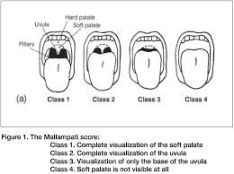
Mallempoti Score

Slide 44
Oral Exam: Teeth, Gums, Buccal Mucosa
Must use tongue blade or gloved finger to properly inspect mouth
Inspect Teeth for caries, fractures, missing restorative elements
Inspect Gums for sores, pustules, erosion around teeth
Inspect Buccal mucosa for lesions
Count teeth & inspect for caries, malocclusion and loose teeth.
20 deciduous teeth, begin eruption at 6 months & continue adding approximately 1/month
32 permanent teeth, erupt from 6 to 25 years

Slide 45
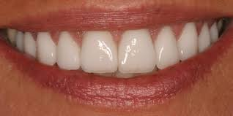
Oral Health

Slide 46
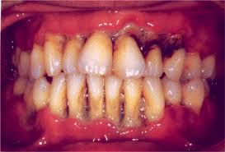
Dental Decay

Slide 47
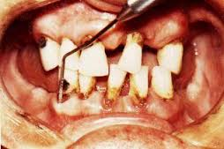
Periodontal disease

Slide 48
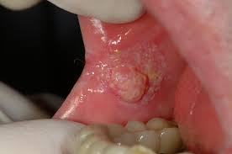
Oral Cancer Screening

Slide 49
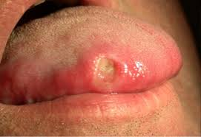
Tongue Lesion

Slide 50
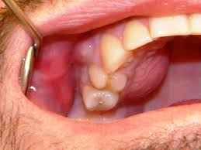
Dental Abscess : Adult

Slide 51
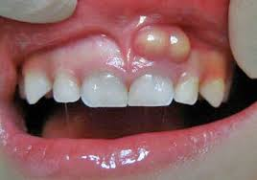
Dental Abscess Pediatric

Slide 52
Neck Exam: Key Points
Check for position, lymph nodes, masses, cysts or fistulas/clefts
Check clavicle in newborn
Head control in infant
Trachea & thyroid in midline ( more on Thyroid in endocrine)
Carotid arteries (bruits)
Nuchal ridigity—test for meningitis
Patient cannot flex neck to place chin on chest
Unreliable in age under 18 months due to underdeveloped neck musculature
Suppleness & Range of Motion (ROM)
Child may be hyper extending neck

Slide 53
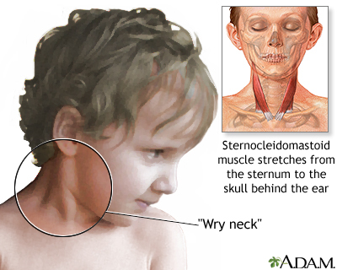
Torticollis

Slide 54
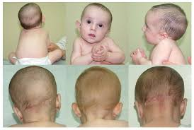
Torticollis in Newborn

Slide 55
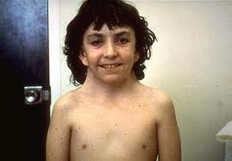
Webbed neck Turner’s syndrome

Slide 56
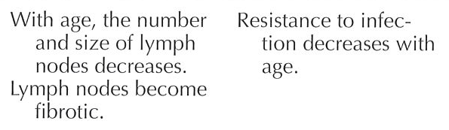
Geriatric--Neck
Thyroid more fibrotic and nodular

Slide 57
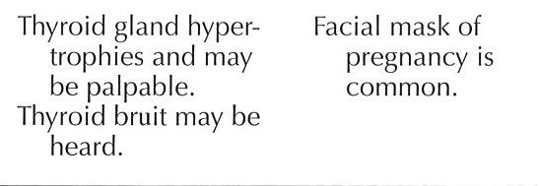
Pregnancy—Head and Neck

Slide 58
Examination — Cranial Nerves (CN)
CN I – Olfactory | Occlude each nostril and test different smells
CN II – Optic | Test visual acuity with Snellen eye chart or hand-held card; inspect fundi; screen visual fields by confrontation
CN II-III – Optic, Oculomotor | Inspect size and shape of pupils; test reactions to light and near response
CN III, IV, VI – Oculomotor Trochlear, Abducens | Test extraocular movements in 6 cardinal directions of gaze; lid elevation; check convergence
CN V – Trigeminal | Palpate temporal and masseter muscles while patient clenches teeth; test forehead, each cheek, and jaw on each side for sharp or dull sensation; test corneal reflex

Slide 59
Examination: Cranial Nerves (CN)
CN VII – Facial | Assess face for asymmetry, tics, abnormal movements. Ask patient to raise eyebrows, frown, close eyes tightly, show teeth (grimace), smile, puff both cheeks.
CN VIII – Acoustic | Test hearing, lateralization, and air and bone conduction.
CN IX and X – Glossopharyngeal, Vagus | Assess if voice is hoarse; assess swallowing. Inspect movement of palate as patient says “ah.” Test gag reflex, warning patient first.
CN XI – Spinal Accessory | Assess strength as patient shrugs shoulders up against your hands. Note contraction of opposite sternocleidomastoid, and force as patient turns head against your hands.
CN XII – Hypoglossal | Ask patient to protrude tongue and move it side to side. Assess for symmetry, atrophy.

Slide 60
Practice CAses

Slide 61
Pediatric HEENT Case--Henry
8 year old Henry presents to the clinic with moderately severe left eye pain 6 hours after riding his bicycle through some low hanging leaves from a tree. He didn't notice the tree branches until a few leaves hit him in the face. He has no bleeding wounds.
What are the HPI components addressed in this case? Is anything missing?
How do you approach this patient for the exam?

Slide 62
Answers
What are the HPI components addressed in this case?
Onset, location, severity(quality), timing,
Is anything missing?
Aggravating/relieving
How do you approach this patient for the exam?
He will be upset and in pain. Explain process in appropriate language. Examine good eye first.

Slide 63
Henry-con’t
VS are normal. He does not want to open his left eye because of discomfort.
How do you conduct your exam?
See next slide

Slide 64
What Happened…
Some anesthetic eye drops are instilled into his left eye. He complains that this burns a lot and he begins to cry.
After 10 minutes, he is able to open his eye.
His visual acuity was 20/20 in the right eye and 20/30 in the left eye.
His pupils are equal and reactive. His conjunctiva is slightly injected. A drop of saline is placed on a fluorescien paper strip. This drop is then touched to his lower eyelid so fluorescein dye flows over the surface of his eye

Slide 65
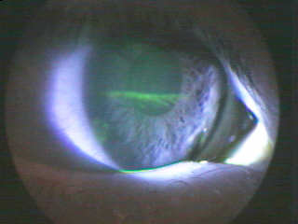
What is this?—Corneal abrasion

Slide 66
Geriatric Case HEENT
A 69-year-old woman
Chief Complaint: “My vision is blurry”
HPI—What questions do you ask?
Gradual onset, cloudy blurry vision like a “film”, denies pain, complains of decrease in vision in both eyes for 2 years. Unable to carry out daily activities. Not recognize people unless close. Watching TV and reading increased difficulty.

Slide 67
Geriatric Case HEENT
PMH: Hypertension
Medications: HCTZ 12.5 mg daily
Allergies: Sulfa---rash
FH: no history of glaucoma, macular degeneration
SH: She quit smoking approximately 4 years ago, but prior to that, she smoked 1 pack of cigarettes per day for 32 years. , 1 gin and tonic/night, denies illicit drug use
What other information needs to be obtained?
Caffeine intake, menstrual status
ROS?---
Focus on HEENT, Neck, CV, Resp.
Notes:
Caffeine intake
She is post-menopausal.

Slide 68
Geriatric Case HEENT
Exam:
General: A + O x 3 in NAD
VS: T 97 F, P 85, R 22 BP 142/87
Skin: No rashes or lesions noted.
Visual acuity: Right 20/60, left 20/40
PERRLA
EOM intact
When conducting fundoscopic exam…

Slide 69
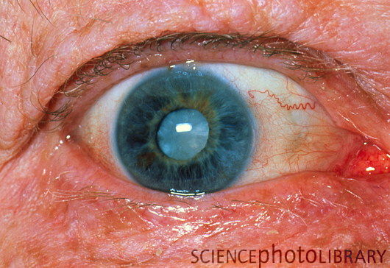
cataract

Slide 70
Pregnancy Case-HEENT, CNs, Neck
33 y.o. woman who is 30 weeks pregnant G2 P1
Chief complaint
“I have a throbbing and stabbing headache”

Slide 71
Pregnancy Episodic---HPI
Began 2 days ago, unilateral, temporal and retro-orbital pain—described as throbbing and stabbing. Exacerbated by head movement. Pain rated 8 out of 10. Nausea and some vomiting. Intense sensitivity to light. Took acetaminophen once with no relief.
What information do you need to know about her history?
Does she have a history of headaches?

Slide 72
Does she have a history of HAs or is this new?
History of migraines without aura
Unilateral temporal and retro-orbital pain
Quality “throbbing and stabbing”
+ photophobia
+ phonophobia
Mild nausea
Maximum intensity within 2-3 hours, lasts 5-6 hours
Pain 8 out of 10

Slide 73
Migraine History
Childhood: no childhood headaches
Teens/20s: 1-2 migraines/ month clustering around her menses
In her 30s, increase migraine to one/week
First pregnancy: very few migraines, returned after stopped breastfeeding
This pregnancy, only one migraine to date

Slide 74
History
PMH: mild persistent asthma, migraines
FH: + migraines in sister and mother
SH: married with one daughter, no tobacco, ETOH, illicit drugs, increased stress due to work schedule
Medications: Prenatal vitamins
Fluticasone/salmetrol inhaler, albuterol
NKDA

Slide 75
Review of Symptoms
General: no fever or chills, no URI sx
Head: per HPI
Eyes: no vision changes, intense sensitivity to light
Ears: no ear pain or drainage, no vertigo
Nose: No discharge, some nasal congestion
Mouth: no hoarseness, no sore throat
Neck: no swelling or lumps
Respiratory: no cough, slight SOB with exertion, no wheeze
CV: no chest pain
Neuro: no altered mental status changes, no weakness, no numbness, no gait disturbances

Slide 76
Physical Exam
General: WN pregnant female
VS: afebrile, P 94 and regular, 128/82 (baseline 110/70)
Head: Normocephalic, no TMJ tenderness or click
Eyes: EOM intact without nystagmus, visual fields full bilaterally, PERRLA, optic discs sharp bilaterally
Ears: TMs pearly grey, good cone of light
Nose: nares slight swelling, bilaterally pale, no sinus tenderness bilaterally
Mouth: pharynx pink. No exudates noted
What’s abnormal?
BP
otherwise normal changes noted in pregnancy

Slide 77
Physical Exam
Neck: No adenopathy, Thyroid palpable, no nodules palpated
Neuro: CN II to XII intact
Reflexes 2+ throughout, normal gait, finger to nose coordination intact
Respiratory: lungs clear bilaterally to auscultation. No wheezes noted.
CV: S1, S2. No extra sounds. No murmurs, rubs, or thrills noted.
What’s abnormal?
Nothing, normal changes in pregnancy

