Slide 1
Measurement in Quality Improvement Projects
Run Charts
Presented by:
Carla Storr, ScD
Professor, Family and Community Health
Co-Director, Center for Health Outcomes Research
QI Brief
QI Brief 2.10 : Released Fall 2018
Notes:
Welcome to the University of Maryland School of Nursing’s Quality Improvement Briefs series. The Quality Improvement Briefs are made up of short presentations that provide an introduction to key quality improvement concepts, methods, and tools.
My name is Carla Storr and I will be introducing you to run charts.

Slide 2
Learning Objectives
QI Brief
Understand when to use run charts
Learn the basic elements of a run chart
Notes:
The learning objectives of this QI brief are to 1) introduce you to when to use run charts in quality improvement projects and 2) describe the basic elements of the run chart and what to look for.

Slide 3
What is a run chart?
A line graph that shows data points over time, that allows one to detect signals of improvement or degradation in a process overtime
Run charts are precursors to control charts used in statistical process control, however run charts do not show the control limits of the process.
Notes:
First what is a run chart? It is a visual aid for tracking information and predicting trends or patterns over time.
Run charts can reveal whether a process is stable or changing. We look at the central tendency, variation and randomness of patterns in the data for clues that improvements may be needed.
Run charts are precursors to control charts used in statistical process control, however run charts do not show the control limits of the process, akin to what you know as confidence intervals. Control charts include an upper and lower control limit line that is calculated at three sigmas or standard deviations above or below the center line.

Slide 4
Where are run charts used in the MAP-IT QI process ...
Mobilize
Assess
Plan
Implement
Track
Implement data collection in the “Assess” stage.
Understand how your metrics behaved historically, before improvements are planned
Run charts are often the best choice for tracking data over time
Notes:
As part of the MAP-IT process the run chart is used to follow the trends or patterns in data over a specified time period. It allows you to focus attention on vital changes in the process. Baseline data would be collected in the assess stage, providing you an opportunity to understand what is happening before any changes are initiated. One can continue to collect data through out the implementation phase, but the regular evaluation of your measure in the tracking phase will enable you to assess changes from baseline.
A run chart can be used to determine if a process has common cause (chance variation) or special cause variation. Special cause variation results from planned interventions or unplanned change that impacts the outcome.

Slide 5
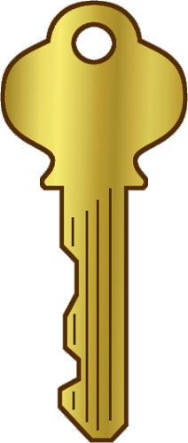
Run charts are an excellent tool to put SMART into practice:
Specific – Clear operating definition is essential
Measurable - Can use any unit of measure or percentage
Achievable - The charted history will indicate the potential for realistic improvement
Relevant – Good visual for Sponsor validation that the measure and project is relevant
Time-bound – All run charts are time-bound!
DNP
Notes:
Run charts are an excellent tool to put SMART into practice. By starting out with SMART objectives, a program or plan can systematically and meaningfully measure progress, show achievements and identify opportunities for improvement.
Objectives should be well-defined, and clear to other team members and to stakeholders who also understand the program or plan. The selected measure needs to be meaningful and valid as it will need to show the improvement, impact or success. Objectives should be achievable within a specific time frame and what you measure should be relevant or important to the team and other stakeholders.

Slide 6
The basic run chart:
Y axis : outcome metric of interest
X axis : relevant time frame
Baseline and future data
Draw center line: the median (from baseline data).
Indicate your goals on the timeline
Best practices:
Assure that the data represented is accurate and repeatable.
Chart new data as close to real-time as possible.
Notes:
Lets go over some of the basic components of a run chart. The next slide will also illustrate these elements.
To create a run chart you begin by identifying your measure and visualizing the scale for both axes. The vertical y-axis is labeled with the outcome units that are appropriate for what is being measured (mg, %, etc) and the horizontal x axis is labeled with the time units (minutes, days, weeks, months). Plot your data and join the data points over time. A basic run chart needs a minimum of 10-15 data points, and usually needs 20-25 data points to detect meaningful patterns, especially if evaluating any interventions. Draw the center line based on the median (aka 50th percentile) calculated from baseline data. The median is used because it is the point where half of the data points are expected to be above and below. It is not influenced by extreme points in the data. You’ll also want to draw a line indicating your goal (e.g., national standard).
And of course the run chart is meaningless if you don’t pay attention to the quality of the data. Ensure the measure is properly collected and chart new data in a timely fashion.

Slide 7
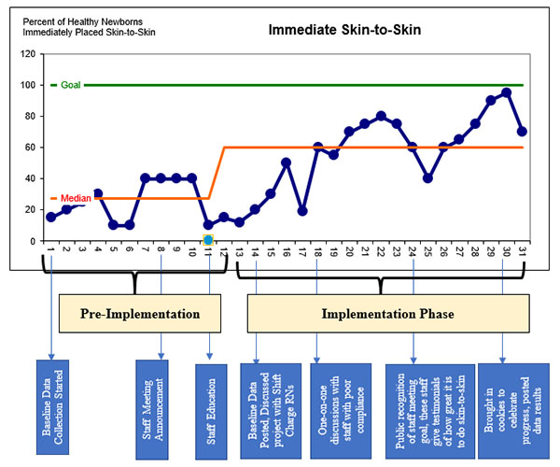
Anatomy of an example run chart
Title names the measure
Target line
Appropriate scale
Center line= baseline median
Time ordered data
Annotations tell the story
Notes:
Lets review what we just learned with a visual. This is an example of a run chart for implementing mother baby skin to skin contact.
Lets first focus on the plot area and the axes. Notice the y axis is labeled as being a percentage and the x axis represents the time (days) and labels indicate the pre and post implementation phases. Labels on the axis are very important. The center line or median is illustrated in orange with the target goal indicated in green. In addition to plotting the data it is important to include a title that names the measure. This example also includes annotations that describe what is happening at various time points through out the process. For example day 8 there is a staff meeting announcement, day 11 staff education. These notes let you know what is happening at different stages that may provide some insight into the variation observed. Annotations are not a required component of a run chart.

Slide 8
Analyzing the run chart for indications of non random variation (special cause)
Runs - sequence of consecutive points which all lie on the same side of the median line.
Standard rules (need minimum of 25 points):
Shift - greater than 5 data points in a row above or below the median line
Trend – greater than 5 data points in a row either go upward or downward
Astronomical data points – Visibly huge negative or positive spikes in a single data point.
Notes:
So now lets turn our attention to what to look for once the run chart is created. Remember we are looking for variation. First look for runs. A run is a sequence of consecutive points which all lie on the same side of the median line.
There are also some standard rules to follow when looking at the patterns. A shift occurs when 5 or more consecutive points are all above or all below the median line. Also look for trends which involve more than 5 consecutive points all going up or all going downward. A visibly huge negative or positive spike of a single time point is also another indication of non random variation.

Slide 9
“Trend”
“Shift”
Notes:
Using our mother baby skin to skin contact run chart as an example, you can see points positioned above and below the median during baseline indicating a steady process. A shift is illustrated as we see greater than 5 data points in a row below the median line. When there are more than 5 data points in a row, in this case going upward, this is referred to as a trend.

Slide 10
Steps in the process
Define measure
Collect data over a long enough period of time so that a “usual” range of variation is experienced (minimum of 20-25 data points)
If the only thing going on is random variation, you would expect to see the points scattered randomly above and below the median.
If there are sufficient data points you can draw a best fit trend line from the begin to end of the run chart. If the line is approximately horizontal then the mean of the process can be considered stable.
Review with team, project sponsors and champions
Notes:
Lets quickly review steps of a run chart. It all begins with defining your measure. Collect your data over a long enough time period (minimum of 20-25 data points). Look to see if data is within the usual range of variation. If the only thing going on is random variation, you would expect to see the points scattered randomly above and below the median. In addition to looking for shifts and trends, be cognizant of any cyclic patterns (something reoccurring weekly, monthly, etc). If you have enough data points you could draw the best fit trend line from the beginning to the end. If this line is horizontal then the process is considered stable. Then of course share your findings with the rest of the team, project stakeholders and champions.

Slide 11
More information about run charts can be found on these short videos from the Institute for Health Care Improvement
IHI Run Chart Video Part 1 (5:32)
http://www.ihi.org/education/IHIOpenSchool/resources/Pages/AudioandVideo/Whiteboard13.aspx
IHI Run Charts Video Part 2 (8:26)
http://www.ihi.org/education/IHIOpenSchool/resources/Pages/AudioandVideo/Whiteboard14.aspx
Notes:
More information about run charts can be found on these short videos from the Institute for Health Care Improvement

Slide 12
  Questions?
  Shared Lessons?
  Want to contribute to or develop any of these Briefs?
QI Brief
Email:
NRSDoctoral@umaryland.edu
Notes:
The QI Briefs are being developed as a resource for faculty and students. Please let us know if you have any suggestions or questions.
Let us know if there are any topics that you think should be added.
Your collaboration and support is greatly appreciated. Together we will achieve our goal To expand the expertise of the University of Maryland’s Faculty and Students in the education of and use of quality improvement and safety concepts, methods, and tools.
Thank you for completing this presentation!

