Slide 1
Defining the Problem and Opportunities for Improvement Presented by: Jeff Martin, MBA, LSSBB Sr Business Improvement Analyst Department of Partnerships, Professional Education, and Practice JeffreyMartin@umaryland.edu
QI Brief
QI Brief 1.8 : Released Fall 2018
Notes:
Welcome to the University of Maryland School of Nursing’s Quality Improvement Briefs series.
My name is ________, and I work with University of MD Baltimore, School of Nursing.
These Quality Improvement Briefs are short presentations providing an introduction to key quality improvement concepts, methods, and tools;
developed especially for Nursing students, but also applicable to faculty and staff endeavoring to implement process improvements.
This presentation is a lesson in properly defining the process problem or opportunity for improvement facing the organization

Slide 2
Objectives
QI Brief
Discuss why it is critical to thoroughly define the opportunity or problem.
Describe how to develop a problem statement.
Outline the basic elements of a problem statement.
QI Brief 1.8 : Released Fall 2018
Notes:
The objectives of this Quality Brief are:
Read thru the three objectives.
“Problem vs Opportunity”. Does it matter? Whatever you are most comfortable with and best fits the situation.

Slide 3
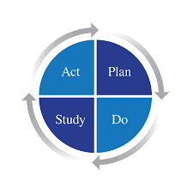
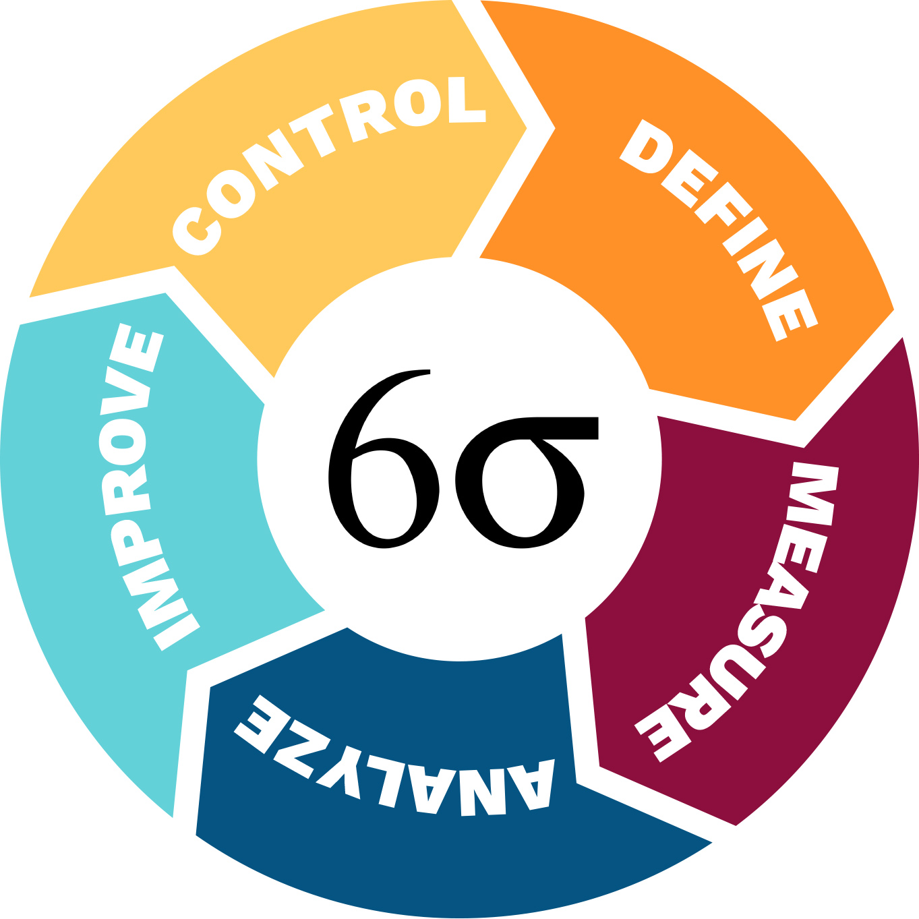
Many QI Process Models..
Mobilize
Assess
Plan
Implement
Track
Refer to The QI Brief: “QI Process Models” for more detail
QI Brief 1.8 : Released Fall 2018
Notes:
Before we jump into WHY defining the problem statement is so important, lets recall the various Quality Improvement process models – Lean Six Sigma, PDSA, and MAP-IT.
These models all have special applications and advantages for different industries. But the large majority of their elements and characteristics are common, including the importance of clearly defining the problem before launching an improvement project.
The School of Nursing has adopted MAP-IT as our standard Quality Improvement model.
The UMB School of Nursing Black Board includes a QI Brief titled Introduction to QI Process Models. Please view this Brief for more background information.

Slide 4
A critical first step is common to all QI process models: Clearly DEFINE the problem to be solved
DNP
Prioritizes this problem against all the others
Justifies time and resource investments
Assures everyone is working on the SAME PROBLEM!
QI Brief 1.8 : Released Fall 2018
Notes:
Here is this brief’s Key Slide. WHY is defining the problem important?
Read the bullets

Slide 5
Defining the Problem in MAP-IT
Begin defining the problem in the Mobilize stage
Refine the problem definition in Assess
Revisit the problem statement as the project progresses
Mobilize
Assess
Plan
Implement
Track
QI Brief 1.8 : Released Fall 2018
Notes:
Read the slide

Slide 6
Steps in Defining the Problem or Opportunity for Improvement
Review the current evidence related to the practice problem – make the case for why the change is needed.
Interview those who are affected by the process you propose changing - process owners, stakeholders, and subject matter experts (SME)
Develop a draft problem statement
Facilitate stakeholder consensus
QI Brief 1.8 : Released Fall 2018
Notes:
Now that we know WHY defining the problem is so important, lets look at the steps involved in putting this together.
Read the bullets
Make sure a reasonable amount of time is allotted to get these tasks done.
What’s a “draft” problem Statement look like? It’s the first try capture of the most salient issues, best captured as a series of bullet points.

Slide 7
Essential Elements of a Problem Statement:
WHAT are we trying to solve and WHY
Articulate what is wrong with the current state
WHO is impacted by the problem
Which types of Patients? Staff?
WHEN the problem arose
Related to another change?
Periodic?
HOW MUCH – quantify the impact
Address “so what?”
Consider the cost or impact of doing nothing
QI Brief 1.8 : Released Fall 2018
Notes:
These bullet points should address all these essential elements.
Read the slide

Slide 8
EXAMPLE Scenario
Developing a problem statement
QI Brief 1.8 : Released Fall 2018
Notes:
We’ll now quickly walk you through one example of developing a robust and helpful problem statement

Slide 9
Scenario:
Unit leadership says: “Our hospital receives a “D”, in the Leapfrog rating for patient safety”
QI Brief 1.8 : Released Fall 2018
Notes:
Here’s what I call a “scenario”. This is often the problem as it’s seen at higher levels in the organization, and is rarely defined in a properly actionable way.
Oftentimes the individuals stating thir version of the problem will slip in potential solution elements, or add bias in some way. It’s important to hear these statements, but do not take them as a problem statement for your project.

Slide 10
Scenario : “Our hospital receives a “D”, in the Leapfrog rating for patient safety”
WHAT are we trying to solve and WHY:
“Our safety metrics need improvement, and evidence-based solutions have been implemented successfully at other hospitals, but not at ours.”
WHO is impacted by the problem:
“Patients, Nursing, Hospital Administration, Community”
WHEN did the problem arise:
“Patient safety has always been a challenge, but our relatively low performance became evident with the CMS measures initiated 24 mos ago.”
HOW MUCH – quantify the impact:
“Our hospital receives a “D”, the lower 6th percentile, in the Leapfrog rating. Incidents directly cost the hospital in reputation, State and Federal fines, and uncompensated care.”
QI Brief 1.8 : Released Fall 2018
Notes:
We heard the scenario “Our hospital receives a “D”, in the Leapfrog rating for patient safety”
Now let’s dig into this further starting with the first two steps from the previous slide: “1. Review the current evidence related to the practice,
2. Interview individuals who are most impacted by the process
Read the bullets as they present on the screen
This gives you the “Draft problem statement”, in bullet form, which can then be crafted and word-smithed.

Slide 11
Scenario: “Our hospital receives a “D”, in the Leapfrog rating for patient safety”
Problem Statement:
“Our hospital is in the lower 6th percentile in patient safety. Incidents directly cost the hospital in community reputation, regulator fines, and uncompensated care. Patients, Nursing, and Hospital Administrators all would benefit from improved safety. Patient safety bundles have been implemented successfully at similar hospitals.”
QI Brief 1.8 : Released Fall 2018
Notes:
Here’s an example of how it may look:
Read the statement
Note that what, why, who, when, and ho much are all addressed.
Also importantly, note that no solutions are dictated. No individuals or dept. targeted.
This is a problem that you AND the various stake holders can be excited about.
Additional information may be added to make this a stronger problem statement, for example..
- Determine the actual costs of the safety issues, or,
- Add counts of specific safety incidents and the date range for these incidences.

Slide 12
Next Steps once the Problem is Defined:
Logic Modeling
Objectives and Benefits
Key Milestones
Scope Definition
Constraints and Dependencies
Project Team Members
QI Brief 1.8 : Released Fall 2018
Notes:
Now that you have developed the problem statement, and have a thorough understanding of the problem to be addressed, you can more efficiently move onto the next steps of your project.
Read the steps
That concludes this Quality Improvement Brief.

Slide 13
Questions? Shared Lessons? Want to provide feedback or contribute to any of these Briefs?
QI Brief
Email:
DBingham@umaryland.edu
JeffreyMartin@umaryland.edu
QI Brief 1.8 : Released Fall 2018
Notes:
Thank you for completing this Quality Improvement Brief presentation.
This series of Briefs are developed as a resource for students, faculty, and staff, and your feedback is welcome.
Let us know if there are any topics that you think should be added.
Your collaboration and support is greatly appreciated.
Together we will achieve our goal:
“Expand the expertise of the University of Maryland’s Faculty and Students in the education of, and utilization of quality improvement and safety concepts, methods, and tools.”
Thank you for viewing this brief.

